Slide 1
Neutron Electric Dipole Moment
Stephanie Betancourt University of Kentucky Summer REU

Slide 2
Matter Anti-Matter Imbalance
Taken from Kurzgesagt : Strange Stars
Notes:
During the first couple of seconds after the Big Bang, the universe was extremely hot and dense with matter and antimatter buzzing around. Considering matter and antimatter are created and destroyed together, it seems the universe should contain nothing but leftover energy. a tiny portion of matter –about one particle per billion to be exact- managed to remain, and that 1/billionth of a particle is what composes the observable universe. So, where did antimatter go? Finding the nEDM could explain why matter did not become annihilated along with antimatter in the early stages of the big bang by studying particle physics.

Slide 3
Matter Anti-Matter Imbalance Analogy
Notes:
Consider a coin spinning on a table. It can land on its heads or tails, but it cannot be defined as "heads" or "tails" until it stops spinning and falls to one side. A coin has a 50-50 chance of landing on its head or its tail, so if enough coins are spun in exactly the same way, half should land on heads and the other half on tails. In the same way, half of the oscillating particles in the early universe should have decayed as matter and the other half as antimatter. However, if a special kind of marble rolled across a table of spinning coins and caused every coin it hit to land on its head, it would disrupt the whole system. There would be more heads than tails. In the same way, some unknown mechanism could have interfered with the oscillating particles to cause a slight majority of them to decay as matter. This UNKNOW MECHANISM is thought to be CP VIOLATION

Slide 4
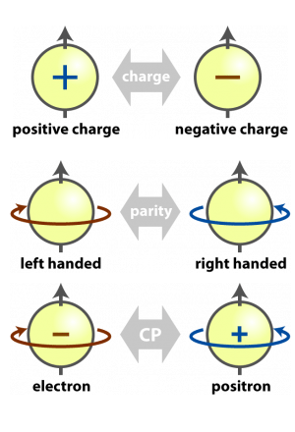
CP& T Violation
This Photo by Unknown Author is licensed under CC BY
Notes:
Charge Conjugation- M.O. turns a particle into an antiparticle with reversed momentum but identical spin.
-Parity- like a mirror, reverses the direction of particle motion but preserves spins.
-CP: the combination of CP on a left-handed, negatively-charged particle would transform it into a right-handed, positively-charged particle.
-Time reversal symmetry (T) When there is an invariance under time, it implies that whenever a motion is allowed by the laws of physics, the reversed motion is also an allowed one. doesn’t change the direction, but it will change spin or velocity.
-Electric dipole moment changes sign under both parity transformation and time reversal.
If there is a CP or parity violation, then there is also a T violation.

Slide 5
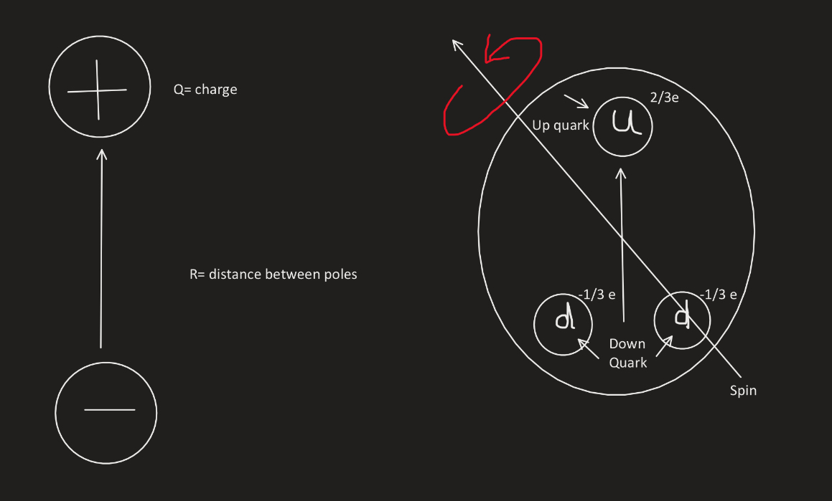
What is Neutron Electric Dipole Moment (nEDM)?
Notes:
-The neutron electric dipole moment (nEDM) is a miniscule separation within a neutron that is used to measure the distribution of positive and negative charge inside the neutron.
-if we can measure a 0 nEDM that could explain why the world exists. So far, no nEDM has been found.
Neutrons can spin in different ways, we can only measure if the separation is in the same or opposite direction as the spin axis.
****( don’t really know how to tie this in ☹ ****Thus ; Under parity the neutron edm changes
Under time the neutron violates time reversal symmetry and therefore also cp

Slide 6
Why do we need to measure nEDM?
CPT theorem implies that T violation is equivalent to CP violation
Since both C and CP relate particles to antiparticles, if either were a symmetry of the laws of nature, particle production would always be countered by equal antiparticle production, and no baryon asymmetry could result. This is one of the Sakharov conditions needed to explain the Baryon Asymmetry of the Universe.
One possible place to discover CP violation is by measuring a nonzero neutron electric dipole moment (nEDM)

Slide 7
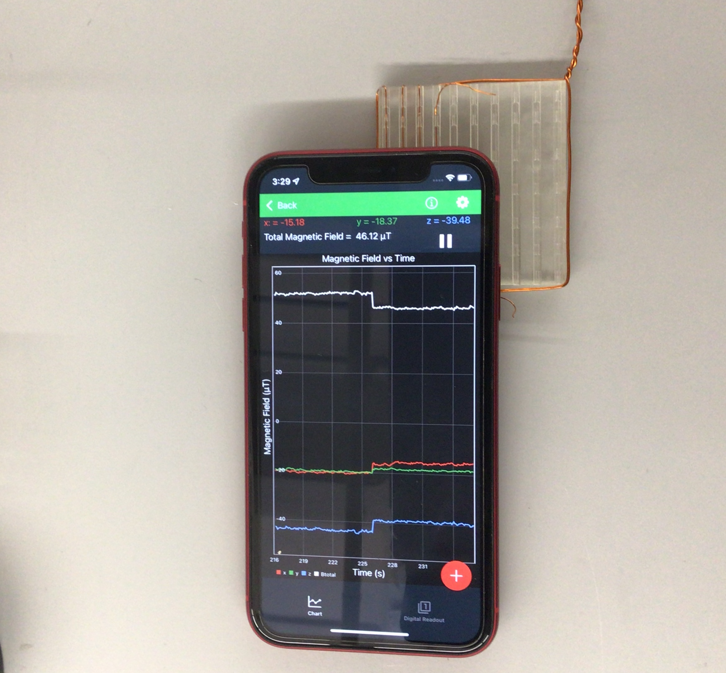
Simple Square Dipole
Notes:
A square that was 31 mm was wound once
We ran 2 amps of power
we found the sensor on the phone using a steel wire
We placed the phone in the center then measured the magnetic field (left) and then turned off the power and measured the earths magnetic field* or background noise* (right)
We then used matlab to calculate our magnetic field and it came up to be the same

Slide 8
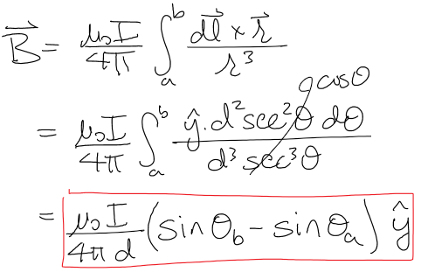
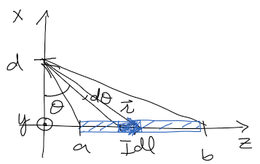
Notes:
mu0/4pi = 1 G mm/A
I= 2A
a = 31 mm
sqrt(8)/2 = 5.6
=> B = 0.36 G

Slide 9
Experiment In Action
Day 1: I learned the specifics and created my first set-up that was flawed in precision.
Day 2: I found a way to gather more precise measurements using the magnetometer and tweaking the design to have specific placement points for my tools. Data was gathered and averaged using excel.
Day 3: The data gathered was input into MATLAB and then a plot was created.
Notes:
Day 1: we were using books that had different heights to take measurements and eyeballing the measurements
Day 2: we also found it was easier to use the recording feature in the magnetometer to average one single point in relationship to time.
Day 3: hiccups in matlab and learning to use it.

Slide 10
Experiment Set-up
Flat boxes are cut and measured to 1” for stacking
Measures are ½” and phone aligns with the line for precise measures
Magnet and hollow casing are secured for more stability
Hollow casing allows for more stability
Notes:
Mention its called a cos theta coil- gives yopu a nice uniform field
Bring in the magnet to show

Slide 11
Measured Magnetic Field VS Calculated Magnetic Field
Notes:
Each arrow vector Is a direction and magnitude of the b field
Talk about how similar they are and how we expected that
In summary based on the findings, matlab and measurements proves that the fields are precise and uniform. The ultimate takeaway,

