Slide 1
SrVO3 Strontium Vanadate

Slide 2
Perovskite
Refers to any material with a crystal structure following the formula ABX3.
Can be deposited as epitaxial thin films on top of other perovskites using techniques like PLD, doing so results in new types of properties raising.
Ex) LaAlO3 grown on SrTiO3, where the interface can display conductivity, despite both LaAlO3 and SrTiO3 are non-conductive.
These materials can exhibit interesting properties:
Colossal magnetoresistance, ferroelectricity, superconductivity, charge ordering, spin dependent transport, high thermopower, etc.

Slide 3
Transparent conducting oxides
Transparent conducting oxides (TCOs) are electrically conductive materials, close to that of metals, and have high optical transmission at visible wavelengths.
What makes them effective is the high transmittance and low resistivity.
In most traditional materials, these two properties are mutually exclusive.
The industry standard is indium tin oxide
Resistivity: ~10^-4 ohm * cm
Used with in solar cells, displays, onto-electrical interfaces, and circuitries.
They are fragile and tend to break down with use.

Slide 4
Strontium Vanadate
Some experiments have shown that strontium vanadate is a highly conducting perovskite-type product with Pauli paramagnetic behavior.
Strontium vanadate is being researched to see if it can replace the industry standard Indium tin oxide.
ITO is extremely expensive due to its limited amount and its high demand.
It is used in solar panels, displays for smart phones, etc.
Is a transparent conductor and has a low work function.
This makes it a promising new electron emission material

Slide 5
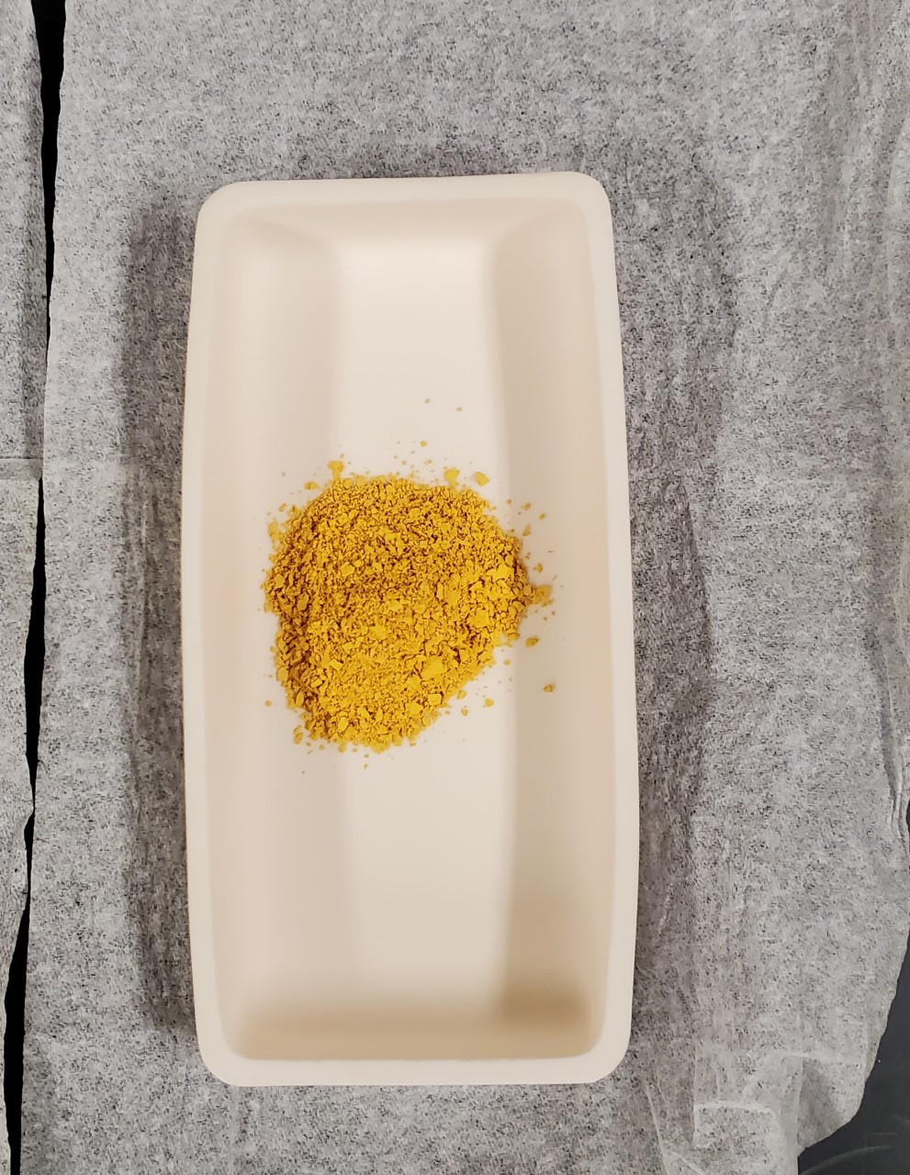
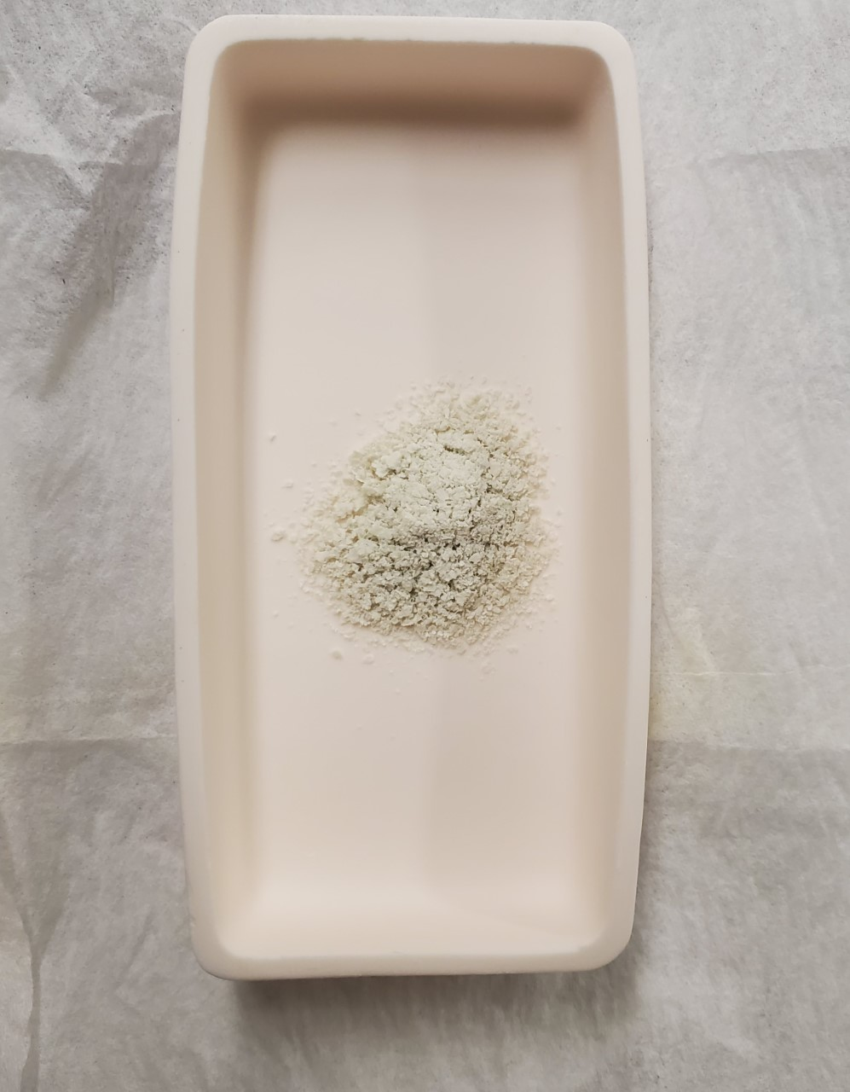
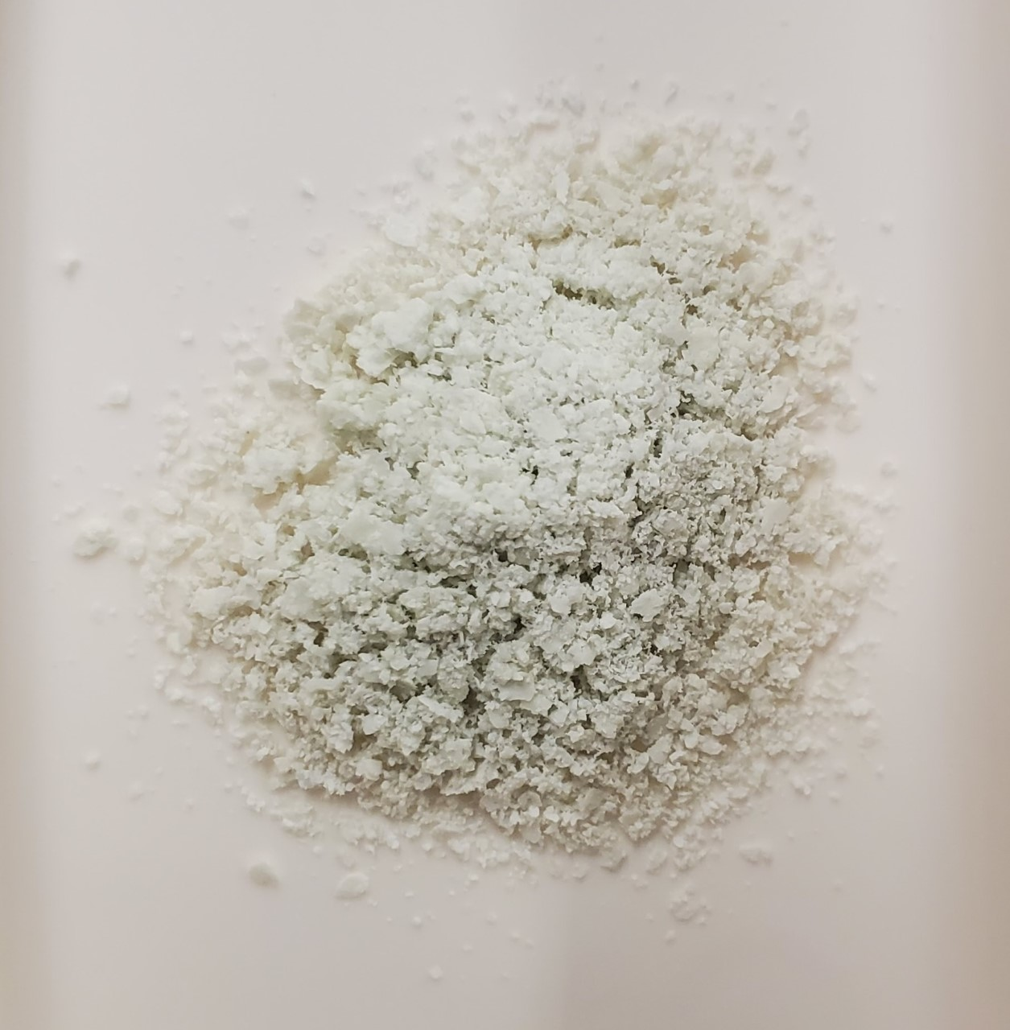
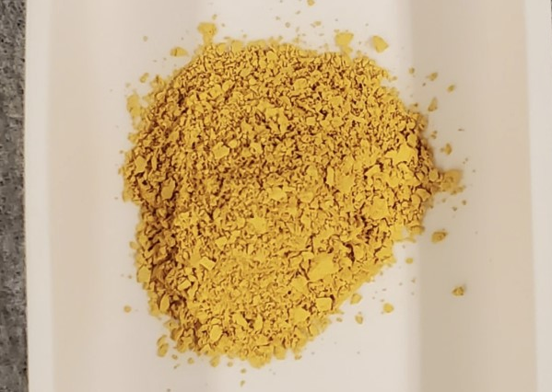
Homogenous mixture of SrCO3 and V2O5 (pre-calcination)
Mixture after first calcination

Slide 6
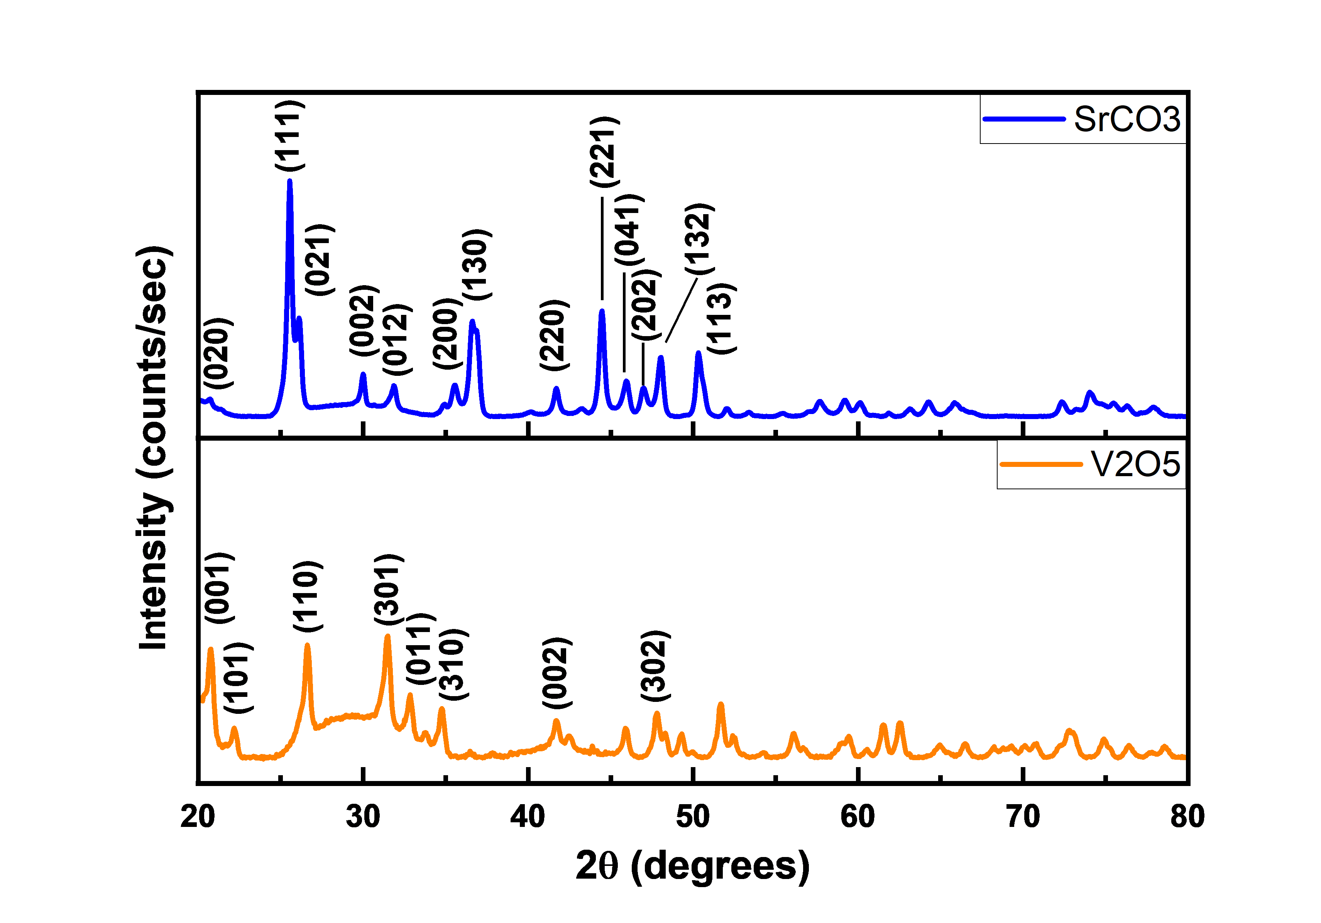
XRD graph of SrCO3 and V2O5

Slide 7
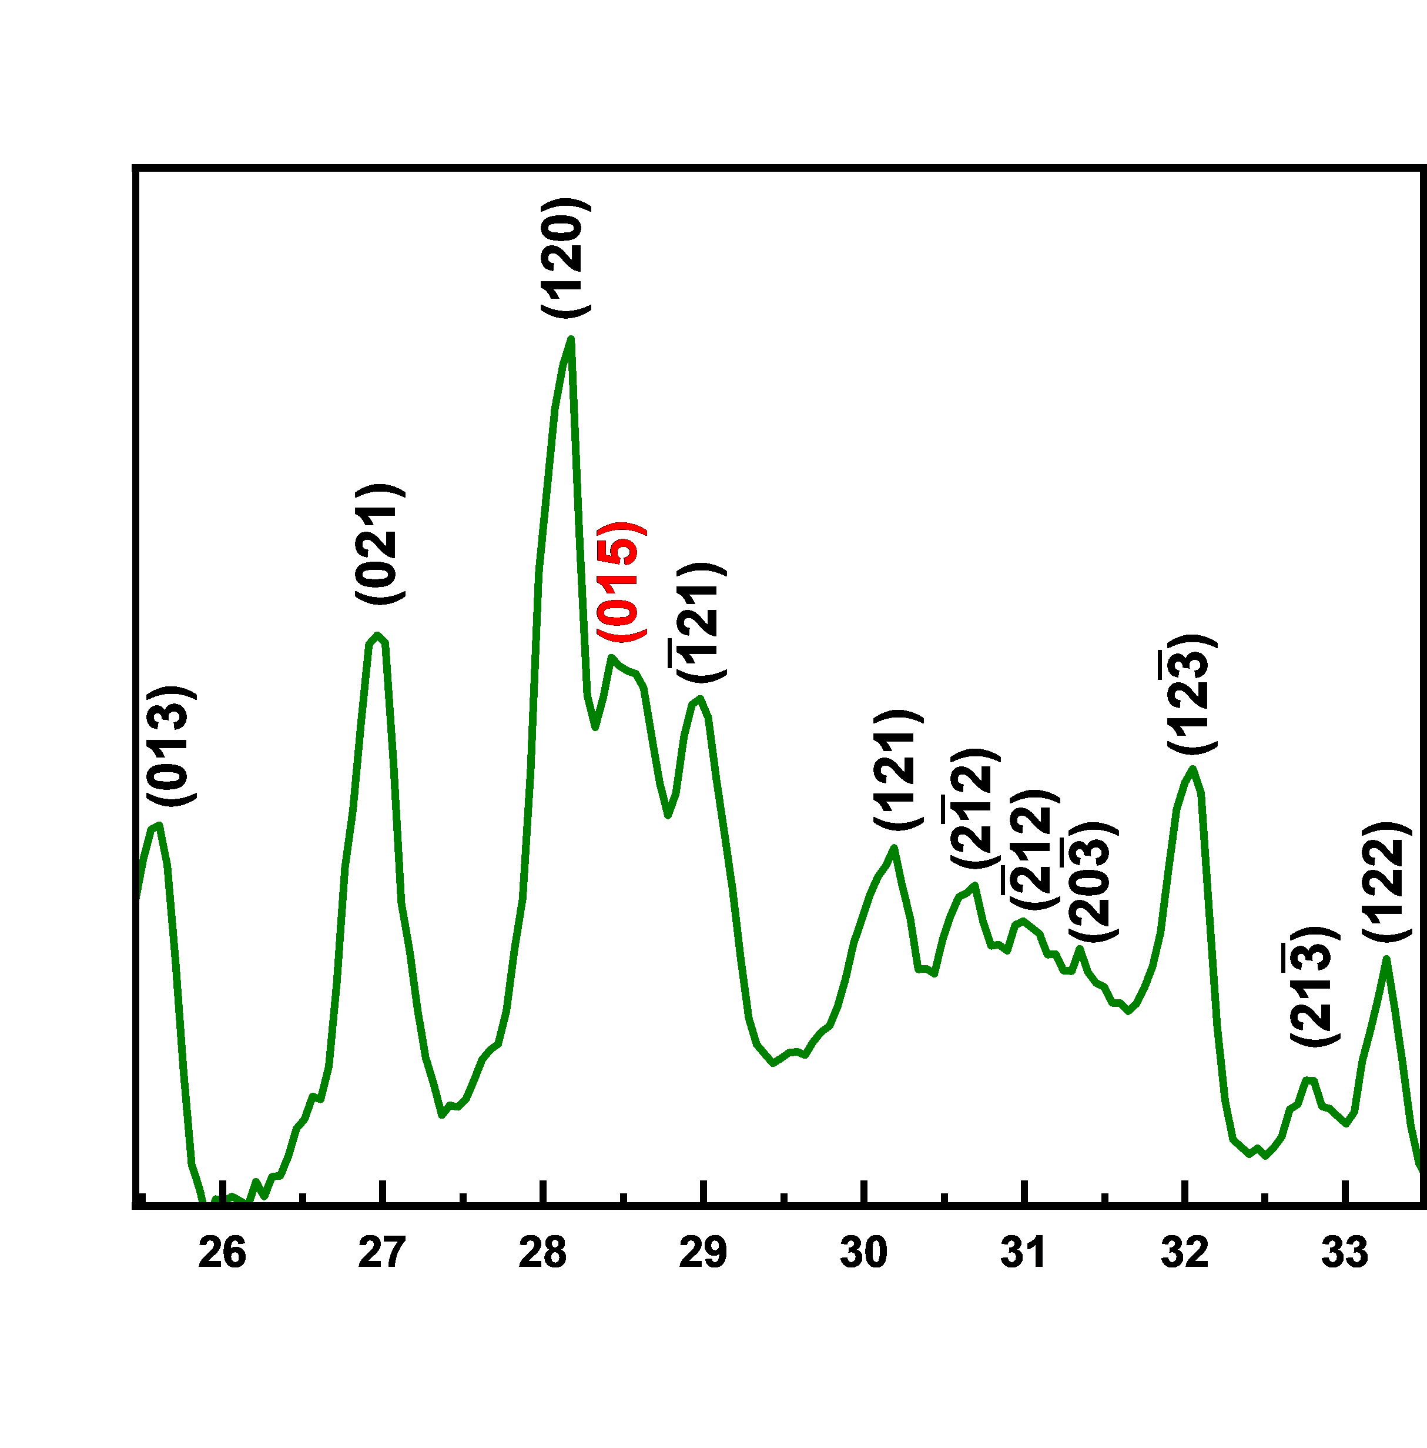
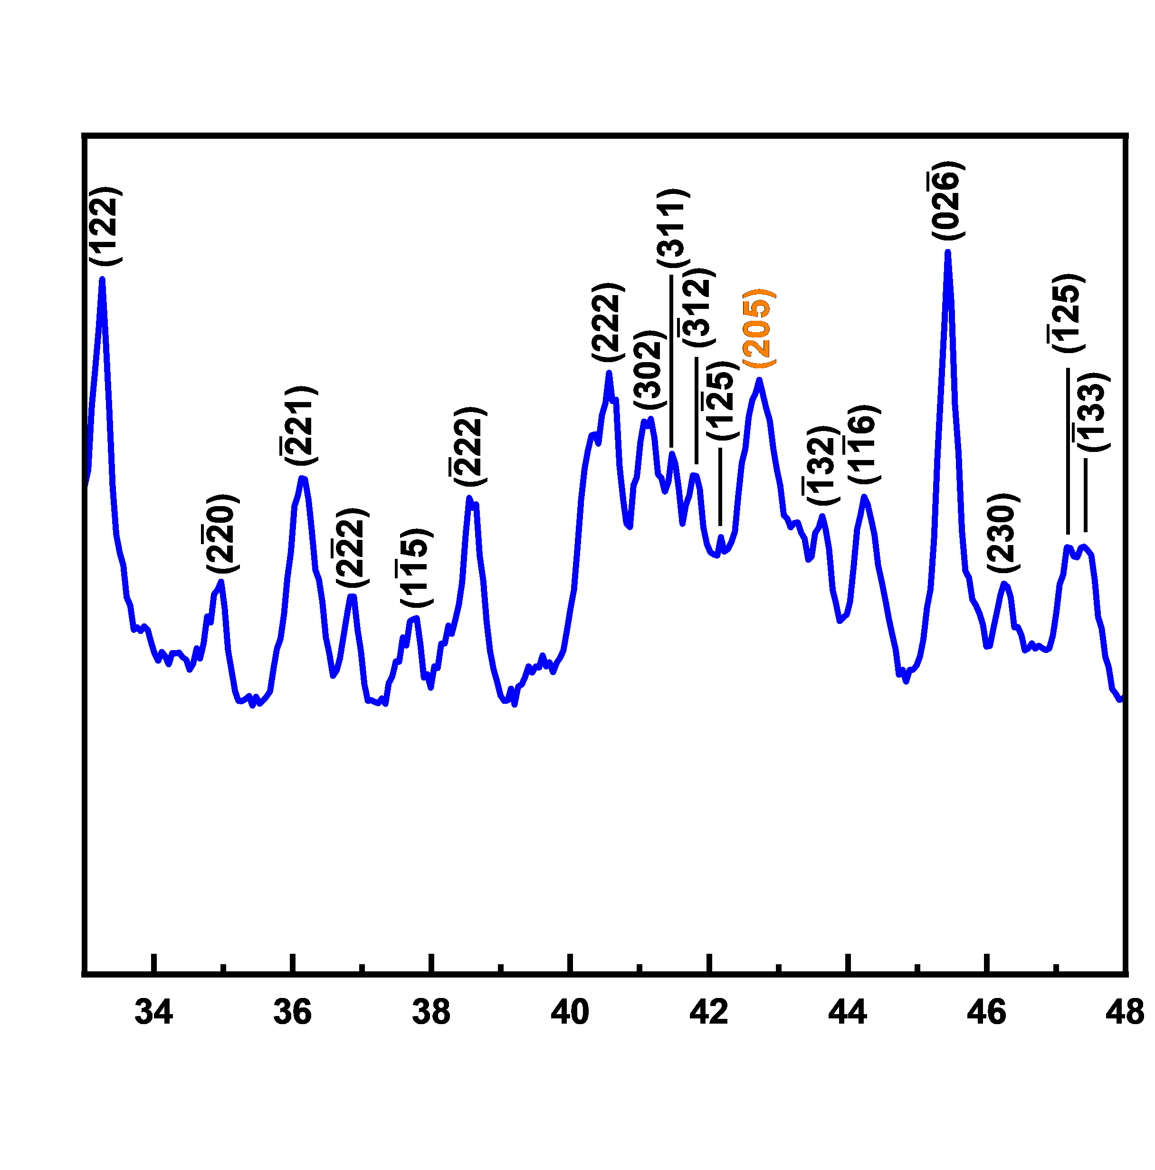
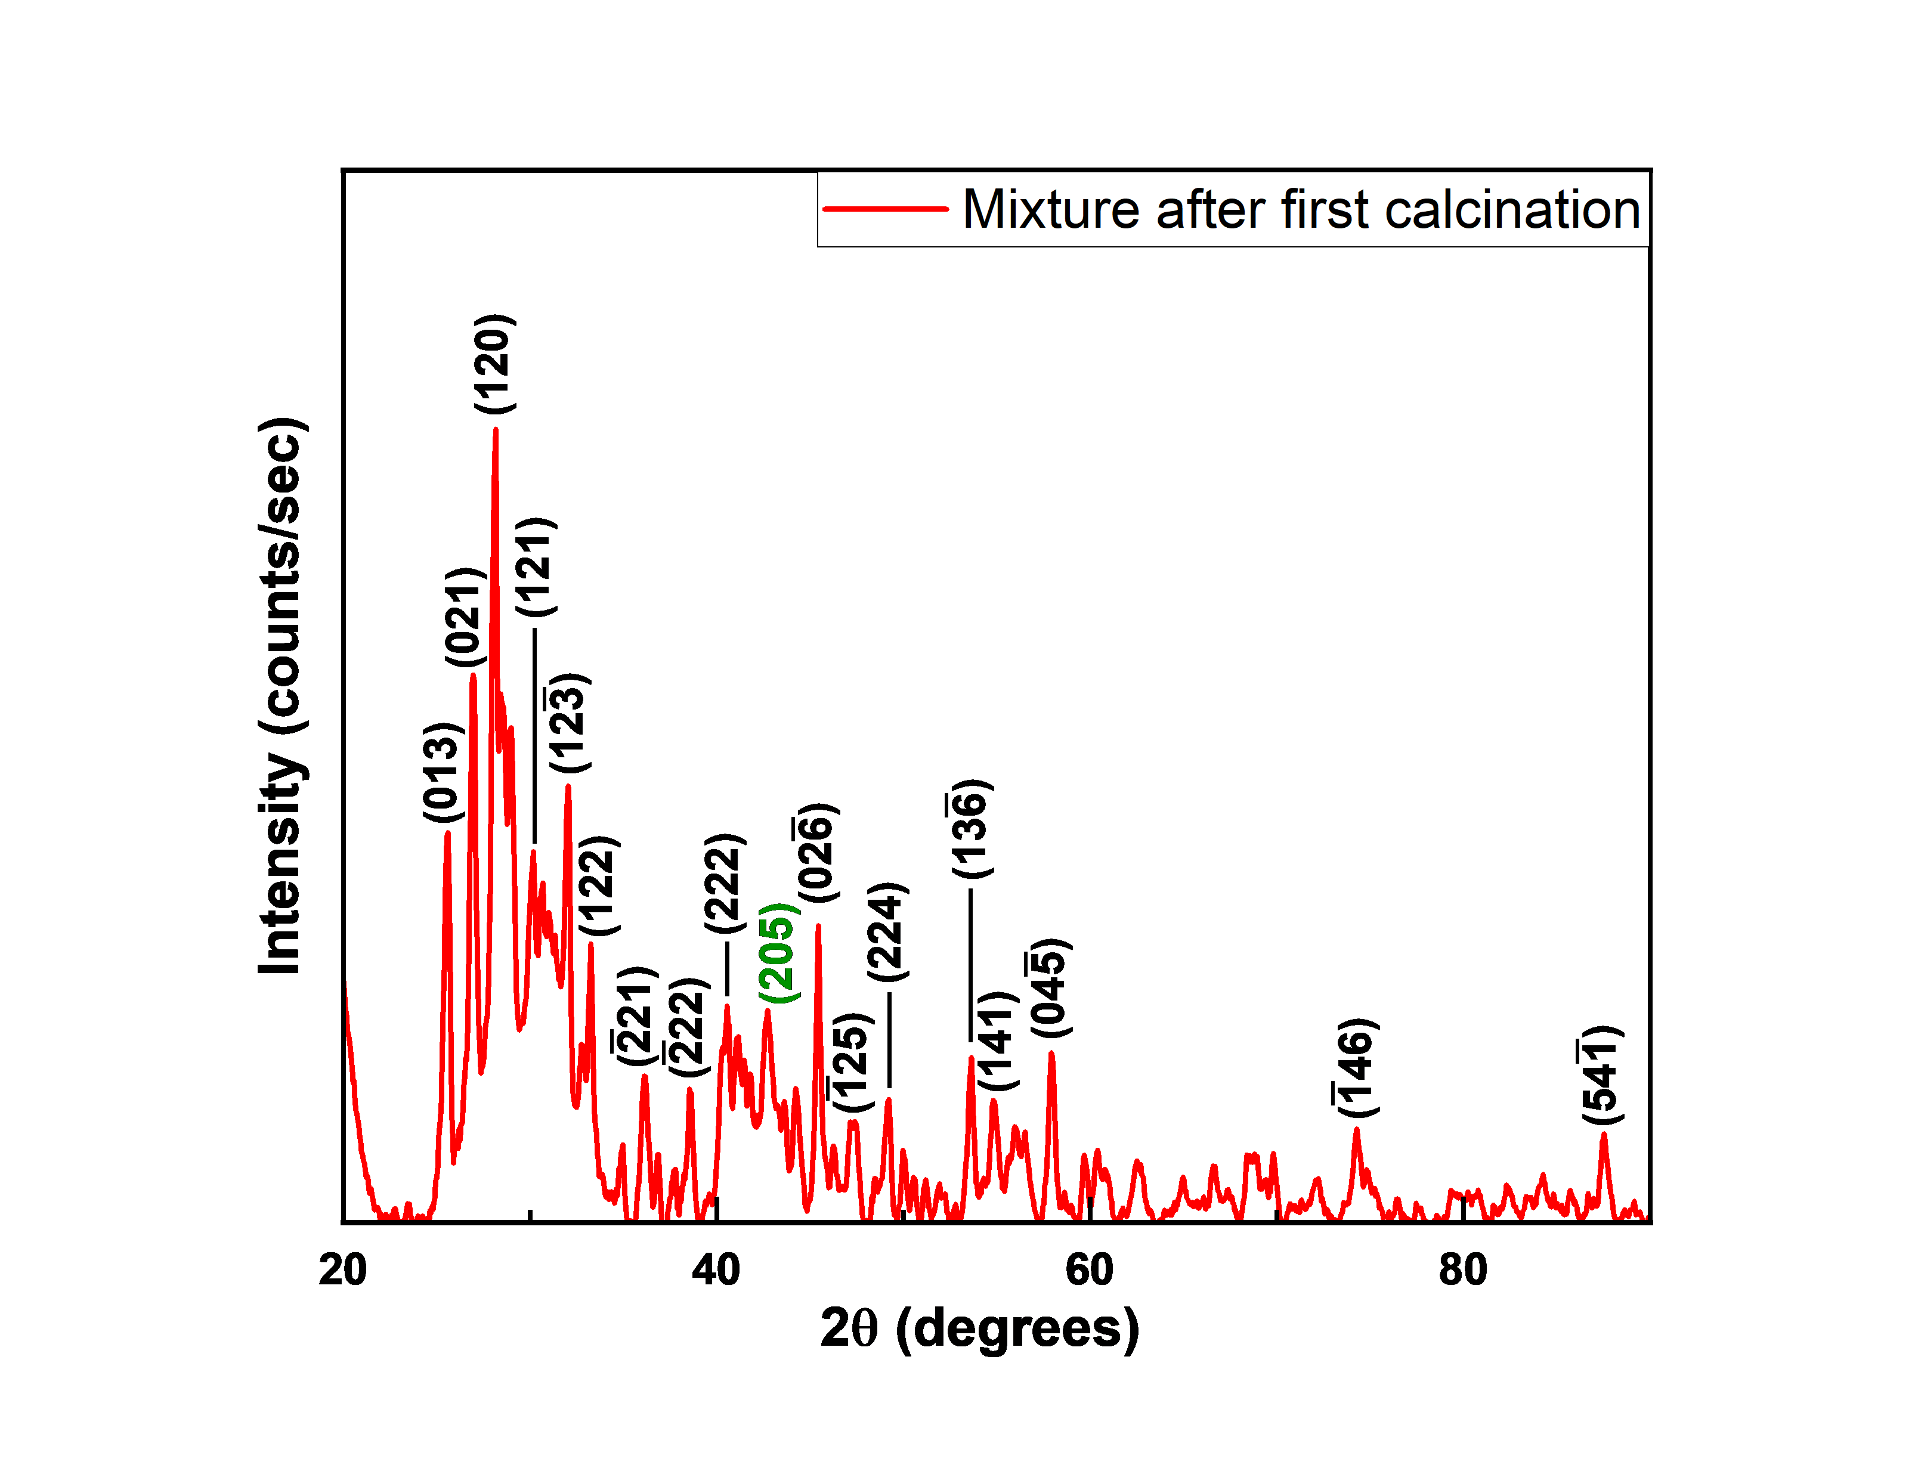
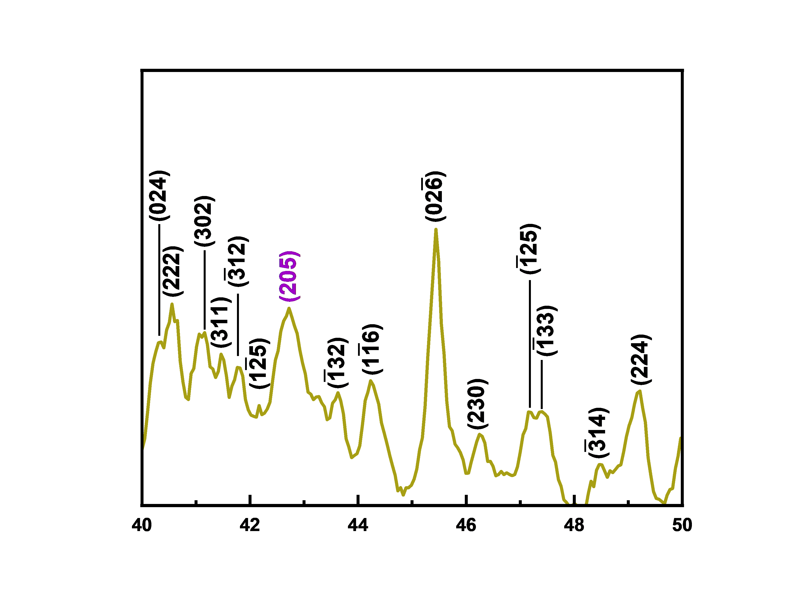
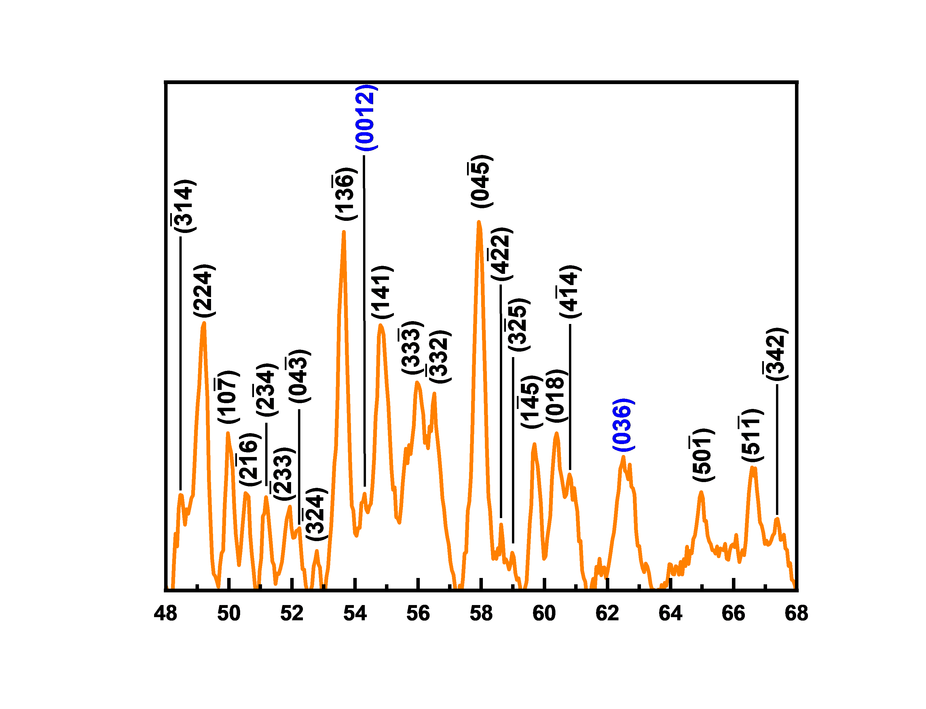
*Colored index is to indicate Sr3V2O8 peak

Slide 8
VESTA generated Sr2V2O7 (*triclinic) powder diffraction
*Triclinic meaning that is it not very symmetrical; therefore, there will be lots of peaks.

Slide 9
VESTA generated Sr3V2O8 (trigonal) powder diffraction

Slide 10
