Slide 1
3D Apertures
Tyler Mason

Slide 2
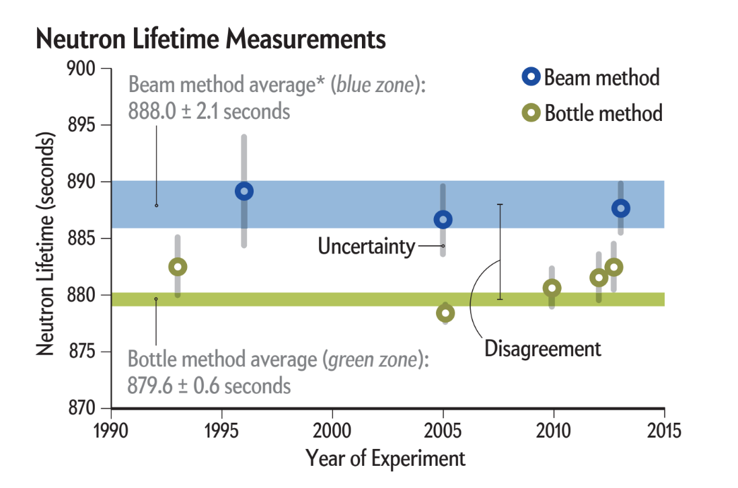
Neutron Lifetime Disagreement
Notes:
Foolproofing of both experiments, retesting, agreement with other fundamental particles

Slide 3
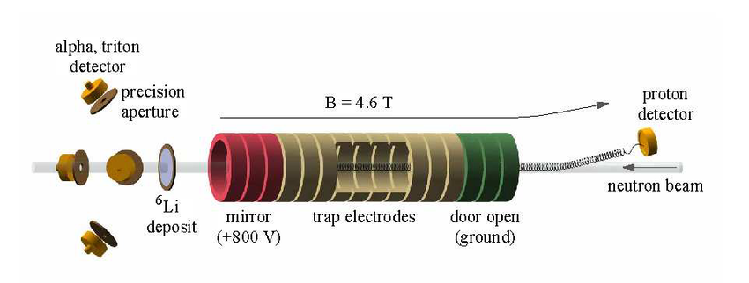
BL3 Proposal

Slide 4
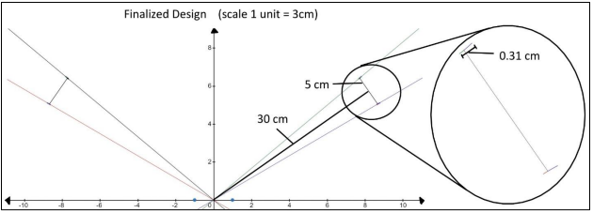
Starting Points
A Novel Caustic Aperture for Detector Optimization, Joshua Young

Slide 5
Python Applications and Shortcomings
Automating root finding algorithms
Generating data quickly
Difficult to store and modify numerical functions
Debugging functions takes forever
Notes:
Chasing rabbit holes

Slide 6
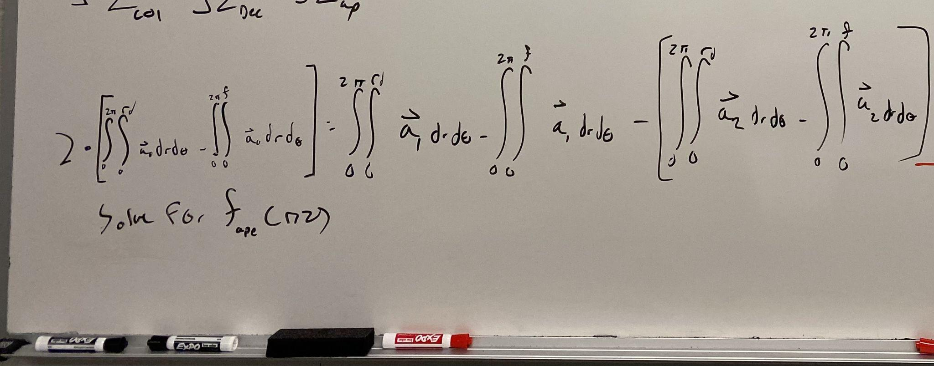
Governing Differential Equation

Slide 7
Current Work
“Build Up” process
Blender as visualization tool
Switching to Matlab for Splines

Slide 8
Build Up Process
Assign 3 of the surfaces to a constant
Calculate tangent to those 3 surfaces
Determine point needed on 4th to have uniformity
Repeat for all points on source

Slide 9
Whats Next
Automating the test process for a given/random point
Shaping possible apertures
Interpolate functions to possible solutions
Analytically test findings
Model solutions in CAD

Slide 10
Summary
Understanding previous work in entirety
Deciding on numerical route
Working out governing equations and methodology
Whats next

