Slide 1
Advocating Nuclear Power
Joseph P. Straley
Physicists should take an active role in explaining science to the general public. As an example, I will explain why I think nuclear power is (still) a good idea.

Slide 2
Contemporary Science Issues
There are many public issues that have a science component
Natural gas liquids pipeline
solar power, wind power
Nuclear power
Evolution
Hazards of microwave pollution
fracking
vaccination
Next generation science standards
Global warming
Iran nuclear agreement
The War on Coal
EPA mercury standards
Genetically modified organisms in food

Slide 3
Contemporary Science Issues
There are many public issues that have a science component
Natural gas liquids pipeline
solar power, wind power
Nuclear power
Evolution
Hazards of microwave pollution
fracking
vaccination
Next generation science standards
Global warming
Iran nuclear agreement
The War on Coal
EPA mercury standards
Genetically modified organisms in food

Slide 4
Contemporary Science Issues
There are many public issues that have a science component
Natural gas liquids pipeline
solar power, wind power
Nuclear power
Evolution
Hazards of microwave pollution
fracking
vaccination
Next generation science standards
Global warming
Iran nuclear agreement
The War on Coal
EPA mercury standards
Genetically modified organisms in food

Slide 5
Science Advocacy

Slide 6
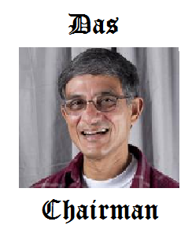

Slide 8
Contemporary Science Issues
There are many public issues that have a science component
Hazards of microwave pollution
Evolution
fracking
Nuclear power
Global warming
Iran nuclear agreement
The War on Coal
Genetically modified organisms in food

Slide 9
Contemporary Science Issues
There are many public issues that have a science component
Natural gas liquids pipeline
solar power, wind power
Nuclear power
Evolution
Hazards of microwave pollution
fracking
vaccination
Next generation science standards
Global warming
Iran nuclear agreement
The War on Coal
EPA mercury standards
Genetically modified organisms in food

Slide 10
Anatomy of a Societal Problem

Slide 11
Science advocacy: nuclear power
We have an important role to play:
In our field of expertise
Playing a significant role now
Zero carbon, no pollution under normal operation
A lot of unease in the general public

Slide 12
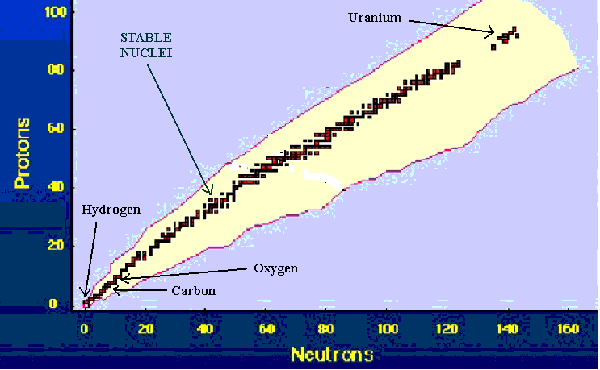
Nuclear physics
a

Slide 13
Nuclear physics
Natural uranium is 0.7% U-235.
The rest is U-238
U-235 + n ➔ smaller nuclei + neutrons + energy
U-238 absorbs neutrons but doesn’t fission
U-235 is much more likely to absorb neutrons that are moving slowly: we need a “moderator” (water, heavy water, graphite, helium)

Slide 14
Nuclear physics
Sustained reaction:
dn/dt = (k-1) n/τ
Need to make k = 1.
Need a “moderator”: water, graphite, heavy water, helium.

Slide 15
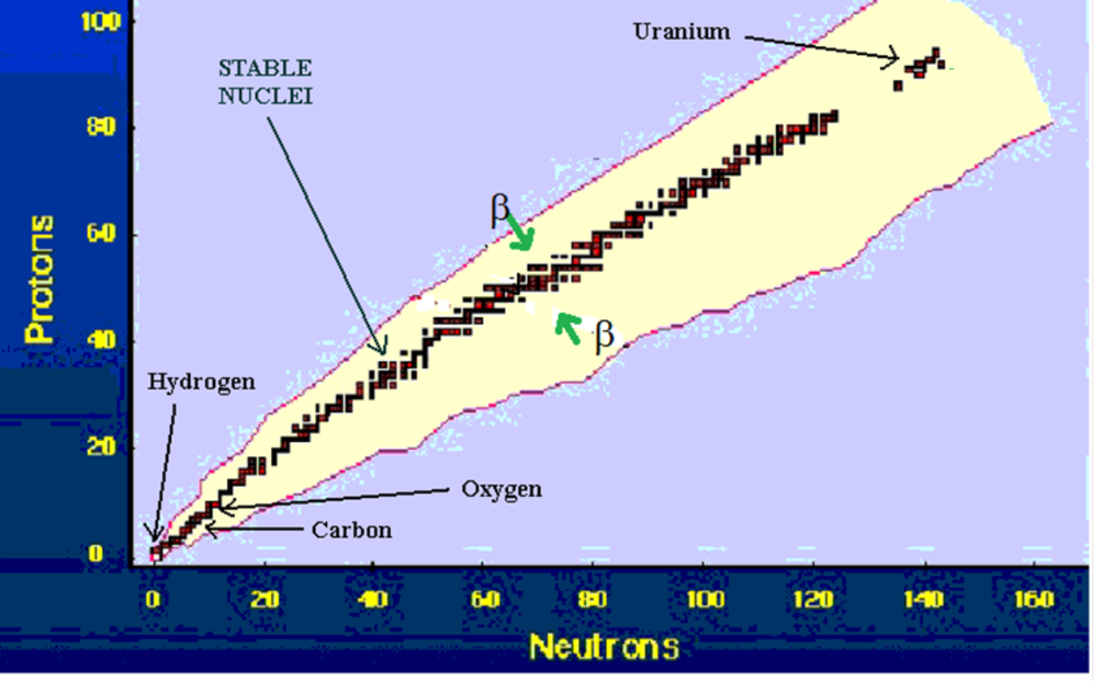

Nuclear physics

Slide 16
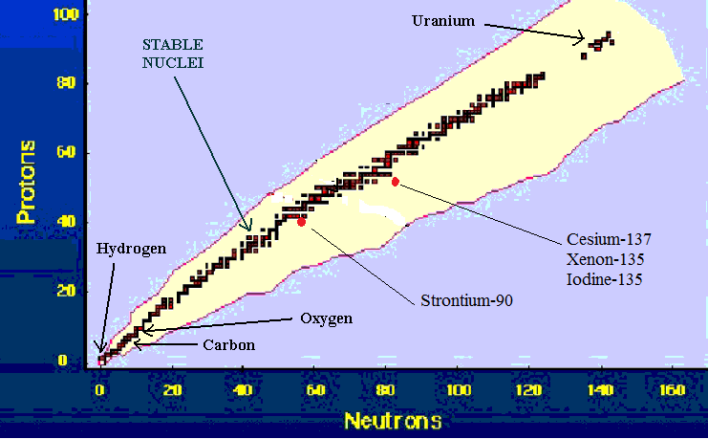
Nuclear physics

Slide 17
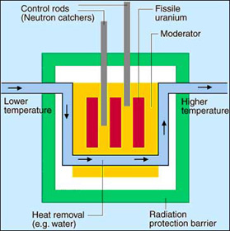
Nuclear reactor

Slide 18
Nuclear physics
“Afterheat”
Right after a reactor turns off, it is still producing 7% of the power; this decreases to
1.5% in an hour,
0.4% in a day,
0.2% in a week.

Slide 19
Nuclear physics
Longer lived fission daughters
Strontium 90 half-life 29 years
Cesium 137 half-life 30 years

Slide 20
Nuclear physics
Iodine pit
Fission produces Iodine 135
It decays (half life 7 hours) into Xe 135
which decays (half life 9.2 hours) into Cs 135.
Xe-135 is a very strong neutron absorber. While the reactor is operating, the Xe-135 is destroyed as fast as it is formed. But when the reactor is turned off, the concentration builds up, making it hard to restart the reactor (for about 3 days).

Slide 21
Zirconium cladding
The uranium fuel is inside zirconium metal tubes. This helps keep radioactive material isolated.
At high temperatures zirconium will react with water
Zr + H₂O ➔ ZrO + H₂
The hydrogen gas will burn or explode when mixed with air.

Slide 22
Advantages of nuclear power
Abundant energy, economically competitive (?) with other power resources
We know how to do it
Near-zero pollution (under normal circumstances). No carbon (or anything else) released to the environment.

Slide 24
The problems with nuclear power
Waste disposal: a small volume of very dangerous stuff
Connection to weapons production
Accidents

Slide 25
Breeding
n + U-238 → Pu-239
n + Pu -239 → fission
“Spent” fuel can have a higher fuel value that the original fuel did!

Slide 26
Reprocessing
“Spent” fuel contains lots of uranium and plutonium. But fission daughters absorb neutrons, so that the fuel is no longer usable.
Separating pure plutonium from the mix is (relatively) easy. It’s a route to making bombs. So the US has decided not to do it.
Waiting 50 years before reprocessing is a good idea, anyway.

Slide 27
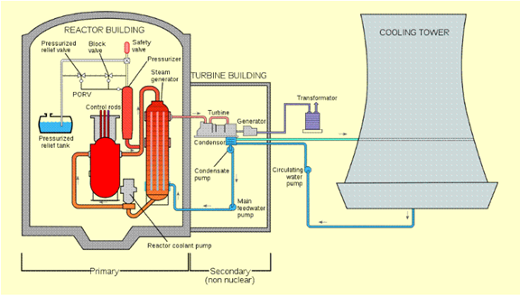
U.S. Nuclear Power Plant

Slide 28
Consequences of Three Mile Island (1979)
The power company went bankrupt.
Some radioactivity was released to the environment

Slide 29
Radioactivity and radiation units
1 Becquerel = 1 decay/second
Due to K-40 and C-14, a body contains 7000 Bq
1 Sievert = measure of the health effects of an absorbed radiation dose
0.002 Sievert/year = normal background
1 Sievert = about 5% increase in cancer risk
5 Sievert in a short time = lethal dose

Slide 30
Radiation hazard
0.0001 Sievert = dose to people near TMI
0.002 Sievert/year = normal background
0.06 Sievert = chest Xray
0.07 Sievert = largest dose to Fukushima evacuees
1 Sievert = exposure to a long-term astronaut
= increased cancer risk about 5%
5 Sievert in a short time = lethal dose

Slide 31
Radiation vs chemical hazard
Ionizing radiation is easy to measure.
The measurements can be directly translated into a health hazard.
We can measure radiation and radioactivity at levels that don’t pose any hazard.
The situation is very different for chemical hazards: we don’t know what to measure, how to measure it, nor what the measurements mean.

Slide 32
Fukushima
A powerful earthquake and tsunami killed 20,000 people and displaced over 200,000. Over 100,000 buildings were destroyed.
The tsunami took out electrical power for the nuclear complex.
The reactors self-destructed over several days.
The hydrogen gas exploded, destroying the containment buildings.
A significant amount of radioactive material was released

Slide 33
Fukushima

Slide 34
Fukushima
A powerful earthquake and tsunami killed 20,000 people.
No civilians were killed or injured by the failure of the nuclear power plants.
300,000 people were evacuated from the region.
It is not expected that there will be a detectable increase in cancer rates; statistically we can expect that eventually there will be an excess of 100 deaths attributable to the radiation release.

Slide 35
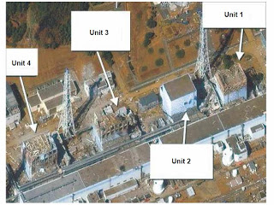
Fukushima

Slide 36
Fukushima

Slide 37
Russian nuclear reactor

Slide 38
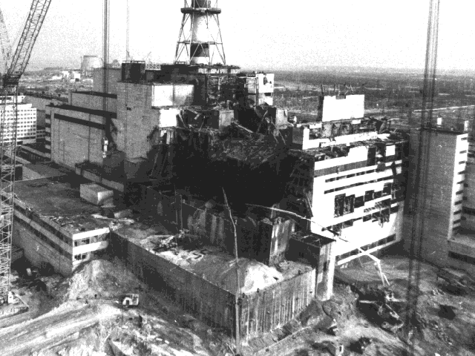
Chernobyl

Slide 39
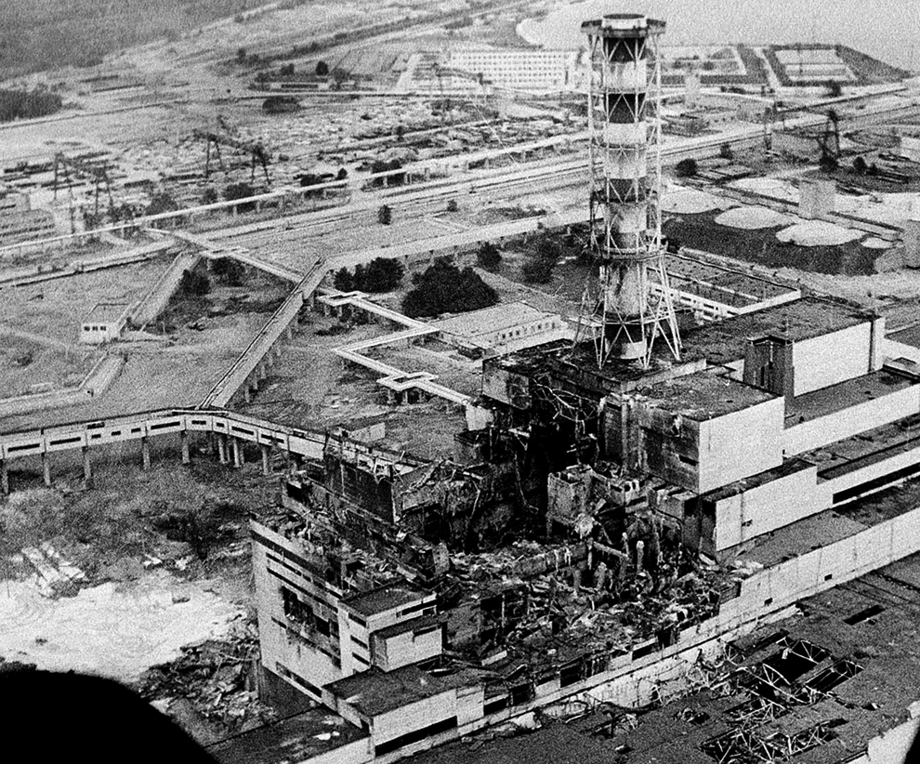
Chernobyl 1986)

Slide 40
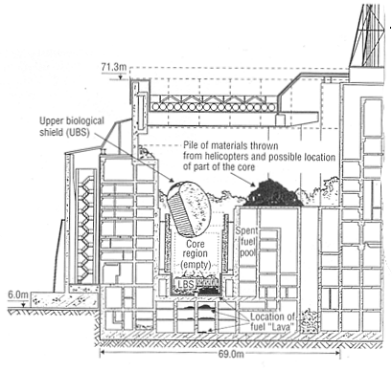

Slide 41
Chernobyl
10¹⁸ Bequerel released to the environment
30 plant workers and first responders died
300,000 people evacuated
4000 excess thyroid cancers
Other health effects “small”

Slide 42
What went wrong
There was no containment building.
There was a design flaw in the control rods.
There was no plan for what to do in case of an accident
The experiment was poorly designed and not executed according to the plan
The authorities refused to believe anything bad had happened, and delayed telling anyone or taking necessary action.

Slide 43
Is nuclear power safe?
Nuclear power is much safer than coal

Slide 44
The cost of coal-fired power
According to the EPA, toxic emissions from power plants are a serious public health concern, causing
• 6,800-17,000 premature deaths
• 11,000 heart attacks
• 120,000 asthma attacks
• 850,000 missed work or “sick” days

Slide 45
Uranium supply
Fuel cost is not a major component of the cost of nuclear power.
Rich uranium ores are not plentiful.
One-trip fuel use will run us “out of uranium” within a century.
Reprocessing increases supply by 100 x.
Thorium is very common. Thorium + neutron = fissionable material.

Slide 46
Economics
Nuclear power benefits from various subsidies and government guarantees.
Also true of coal, oil, gas, wind, and solar power.
Nuclear plants are very expensive to build. But they are cheap to run.
Eventually they pay for themselves and become cash cows.
Right now, fracking is overproducing natural gas, and gas power is the cheapest. The future is unclear.

Slide 47
Advantages of nuclear power
We know how to do it
Abundant energy, economically competitive (?) with other power resources
Near-zero pollution (under normal circumstances). No carbon (or anything else) released to the environment.

Slide 48
Science advocacy: nuclear power
We have an important role to play:
Lots of technical content
In our field of expertise
Playing a significant role now
Zero carbon, no pollution under normal operation
Future potential
A lot of unease in the general public

Slide 49
Science Advocacy
There are many public issues that have a science component.
It’s an important part of our job to become informed about these, and to find ways to educate the public about them. We should all become science advocates.
The nuclear power issue is a good example where the public needs advocacy.
But there are lots more to choose from.

Slide 50
Contemporary Science Issues
There are many public issues that have a science component
Hazards of microwave pollution
Evolution
fracking
Nuclear power
Global warming
Iran nuclear agreement
The War on Coal
Genetically modified organisms in food

Slide 51
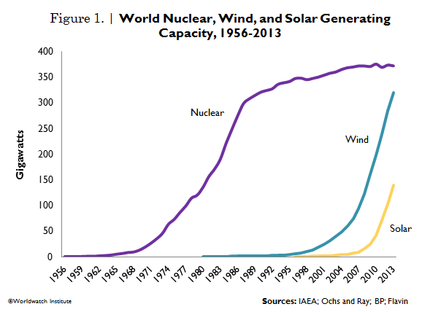
Current status of “renewable” power

