Slide 1
Explaining the global warming theory
Explaining the implications of science to contemporary public issues is an important part of our job. As an example I will give an introduction to the global warming issue.

Slide 2
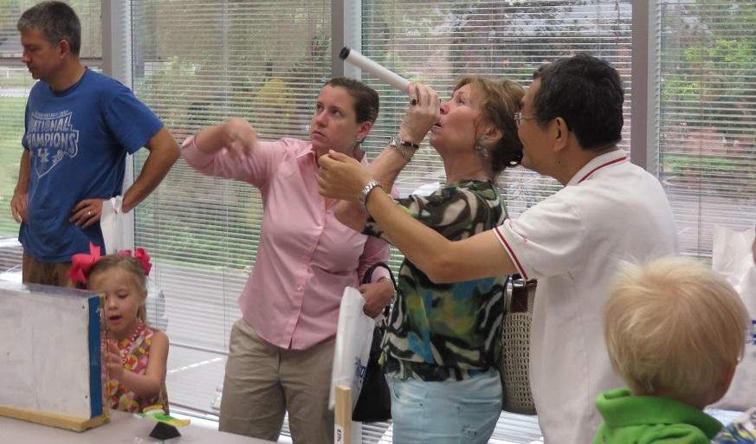
Science outreach

Slide 3
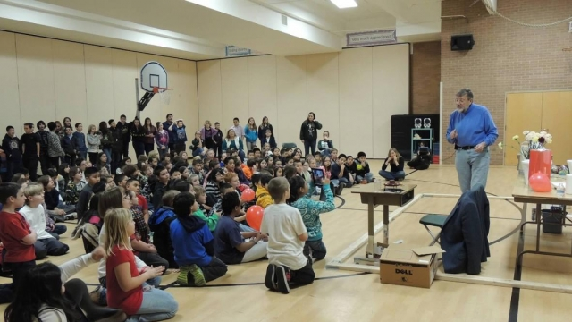
Science outreach

Slide 4
Science Outreach
Explain current science issues to the public
The natural gas liquids pipeline
Nuclear power
Alternate energy schemes
Global warming/climate change

Slide 5
Climate change
It’s confusing!
Climate change is happening, humans are causing it, and I think this is perhaps the most serious environmental issue facing us. -- Bill Nye
"The claim that global warming is caused by man-made emissions is simply untrue and not based on sound science.“ Senator James Inhofe, 2003
Results from a wide range of climate model simulations suggest that our planet’s average temperature could be between 2 and 9.7°F (1.1 to 5.4°C) warmer in 2100 than it is today.
National Oceanic and Atmospheric Administration
“There is no convincing scientific evidence that human release greenhouse gases will cause catastrophic heating of the Earth’s atmosphere and disruption of the Earth’s climate. Increases in atmospheric carbon dioxide produce many beneficial effects upon the natural plant and animal environments of the Earth.”
—Global Warming Petition Project, signed by more than 31,000 US scientists and engineers (2007)

Slide 6
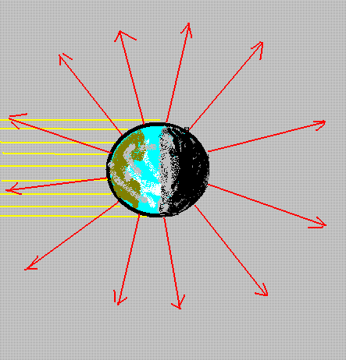
The temperature of the earth
Energy comes from the sun in the form of visible light
All of this energy is reemitted, so that the energy of the earth stays the same from day to day.
Both input and output are nearly constant in time.

Slide 7
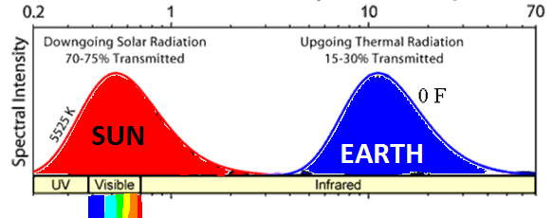
The temperature of the earth
Energy comes from the sun in the form of visible light, and leaves in the form of infrared light..
This determines the average temperature of the earth

Slide 8
The temperature of the earth
There’s a problem with the theory: The power from the sun averages to 235 W/m². To balance this, the temperature of the earth only needs to be 0 F (= -17 C).
The average temperature is 55 F (+15 C), so that the power radiated should be 460 W/m².

Slide 9
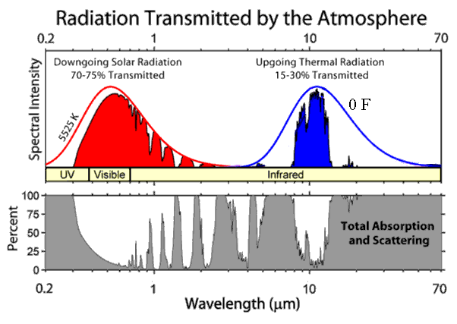
What prevents radiation?
The atmosphere is transparent in the visible, but not in the infrared. This is due to the presence of “greenhouse gases”:

Slide 10
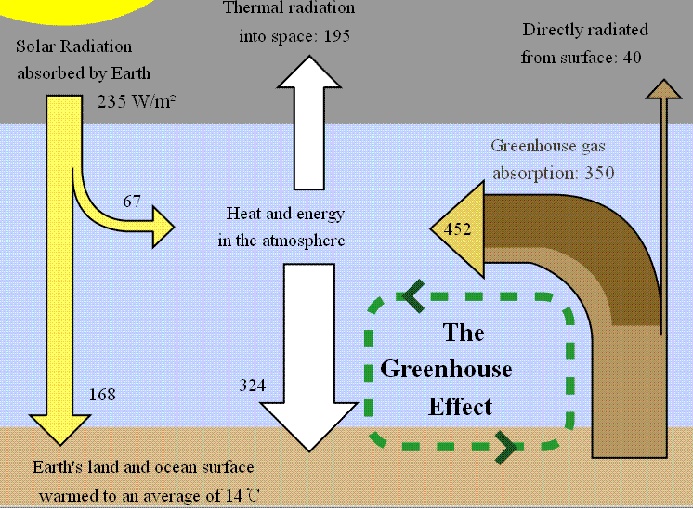
Greenhouse effect

Slide 11
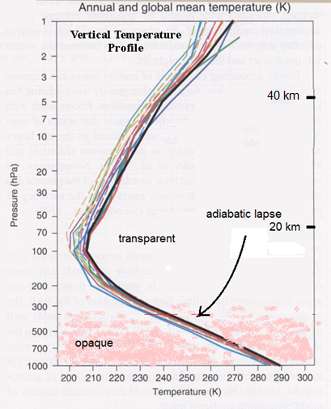
Atmospheric temperature profile
The temperature of the atmosphere decreases with altitude due to adiabatic expansion as air is carried upwards.

Slide 12
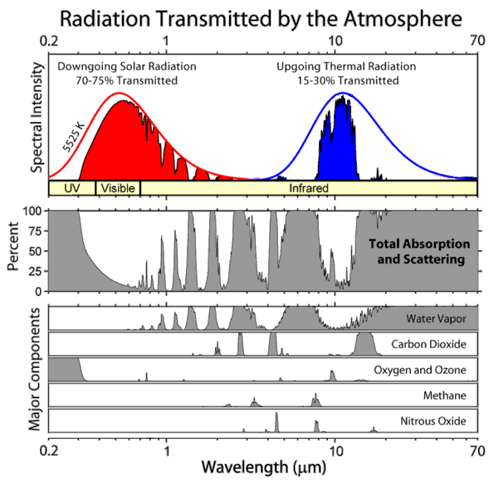

Slide 13
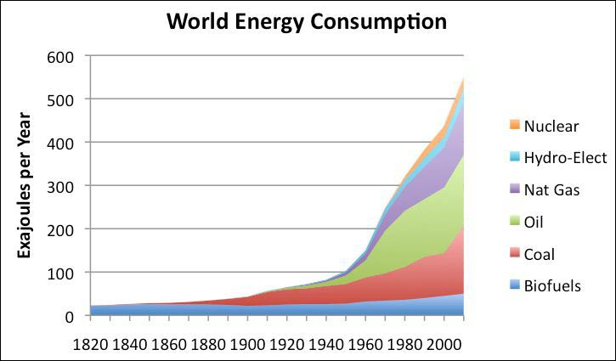
Where does our energy come from?
… from burning fossil fuels.

Slide 14
Where does the CO₂ go?
The atmosphere
Ocean surface water
Plants
The atmosphere and the ocean surface water are closely coupled: CO₂ freely moves among them, and is shared in a fixed proportion.
Plants take up CO₂, but the biomass reservoir is also in equilibrium with the atmosphere: most of the biomass turns back into CO₂ within decades.

Slide 15
Implication of the theory
The CO₂ content of the atmosphere is cumulative of all burning of fossil fuels. It is a permanent change (on a 500-year time scale). The amount of CO₂ in the atmosphere is steadily rising, and this will continue as long as we continue to burn fossil fuels.

Slide 16
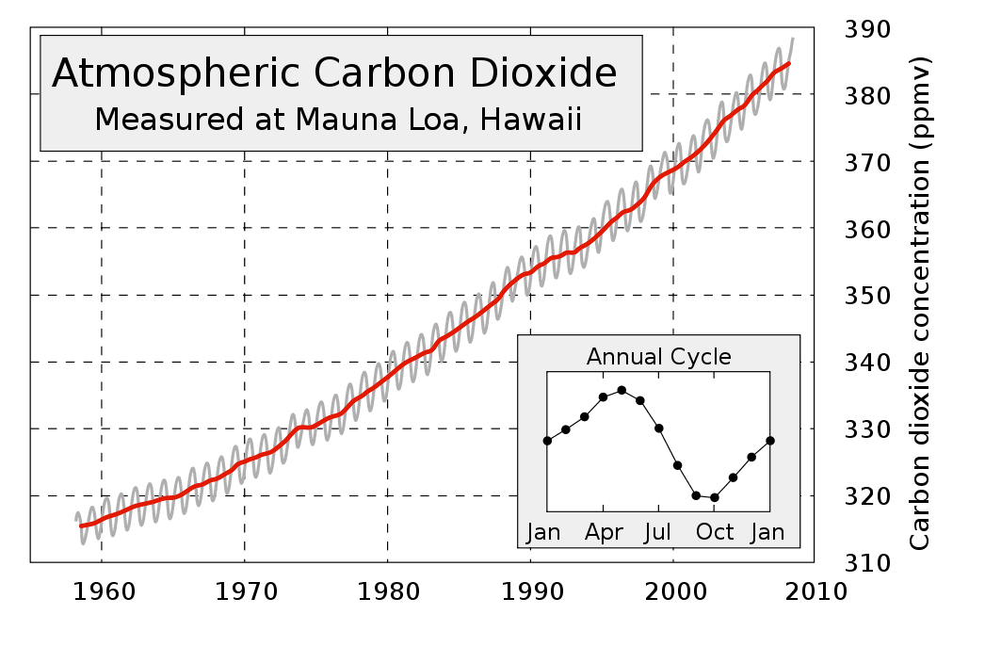
Increasing carbon dioxide

Slide 17
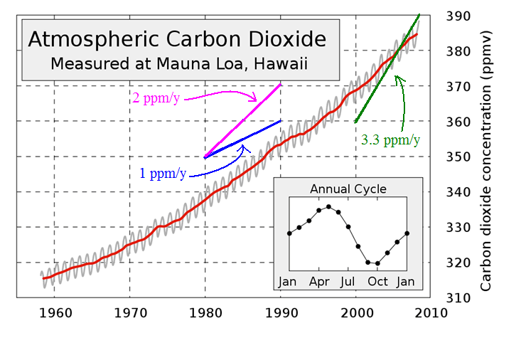
Did humans cause the increase?
It seems likely. We know how much coal and oil we burn in a year.

Slide 18
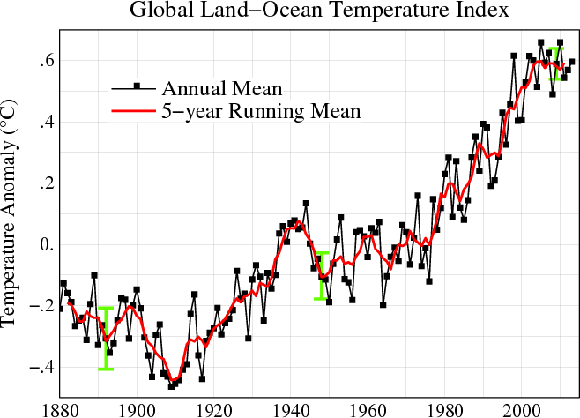
Is the temperature increasing?

Slide 19
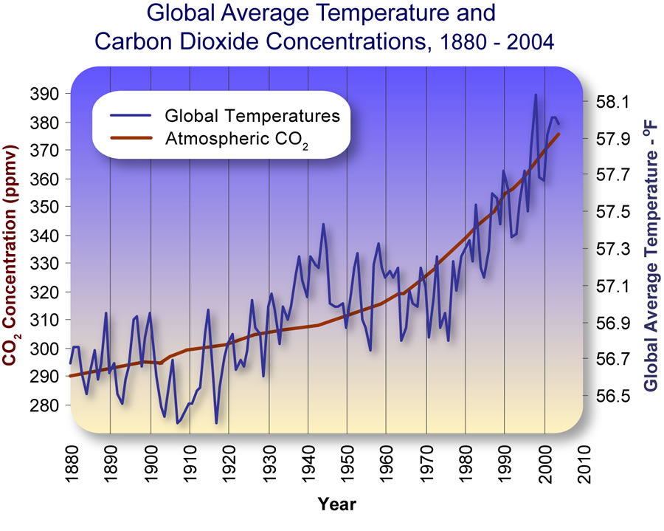
Overlaying two graphs

Slide 20
Can we calculate the effect of CO₂ on the temperature of the earth?
This is hard, because of feedback effects. The temperature rise is small, because CO₂ is only a small part of the greenhouse effect, and the CO₂ concentration hasn’t increased much … yet.

Slide 21
Apparently, the earth is getting warmer
It amounts to about 1 Celsius degree over the last century.
However, the theory says that increasing CO₂ concentration in the atmosphere is inevitable and permanent, and that this should lead to a permanent temperature rise. It is a distant but unstoppable problem for our descendants.

Slide 22
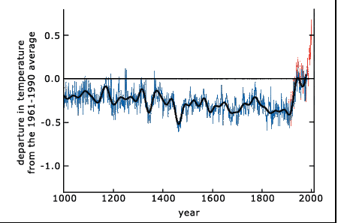
History of the earth’s temperature

Slide 23

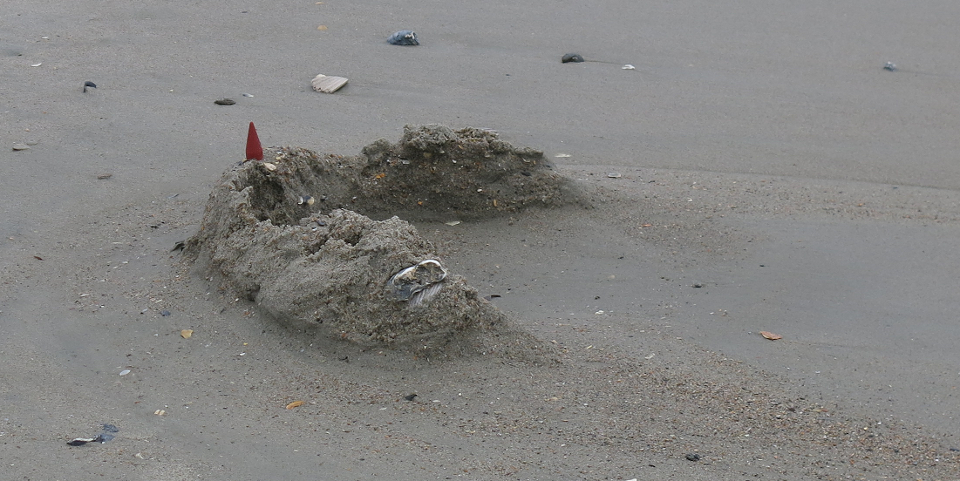
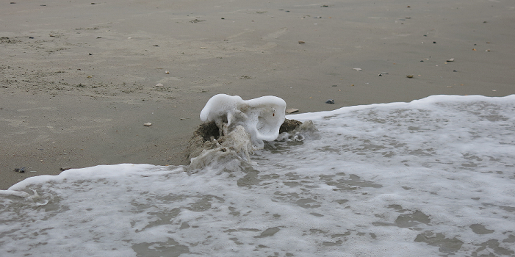

Why do we care about climate change?

Slide 24
Summary
The earth has definitely gotten warmer in the last century
The increase in carbon dioxide in the atmosphere is the likely cause; this theory implies that the rising temperature is irreversible and will continue in the future.
We need to agree that there is a problem, discuss the implications, and develop a plan.

Slide 25
Part of our job
Explain current science issues to the public
The natural gas liquids pipeline
Radioactivity
Nuclear power
Alternate energy schemes
Carbon dioxide capture
Global warming/climate change

