Slide 1
Can Renewable Energy Replace Fossil Fuels?
Burning fossil fuels is increasing the CO₂ content of the atmosphere. This may lead to climate change. How hard will it be to convert to a renewable energy economy? I’ll discuss the issues that are involved.

Slide 2
The role of the university
*Teach the students, to produce a new generation of scientists, teachers, and technologically competent people.
*Discover stuff. Develop ideas. Create things.
*Educate the public, to help them understand problems that have science content, and propose and explain possible solutions.

Slide 3



Inspired by two books …

Slide 4
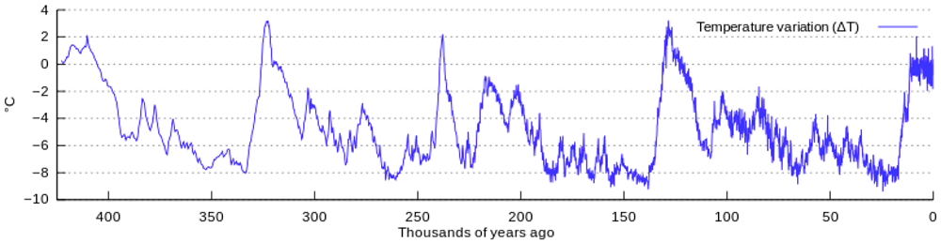
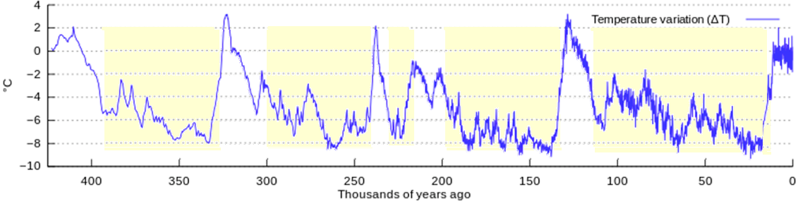
History of the Earth’s Temperature

Slide 5
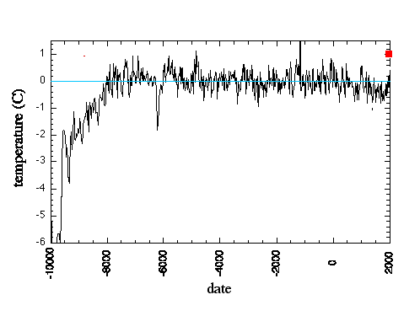
History of the earth’s temperature

Slide 6
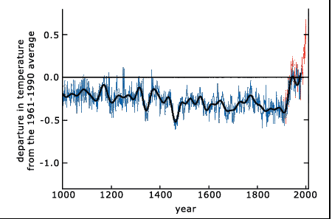
History of the earth’s temperature

Slide 7
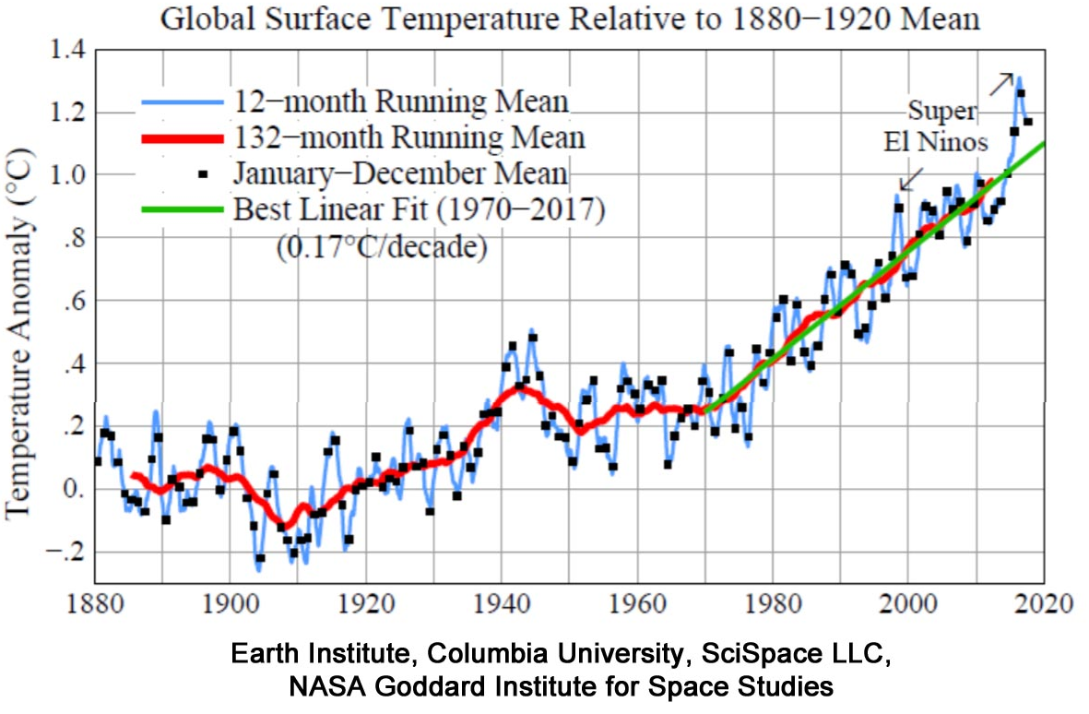
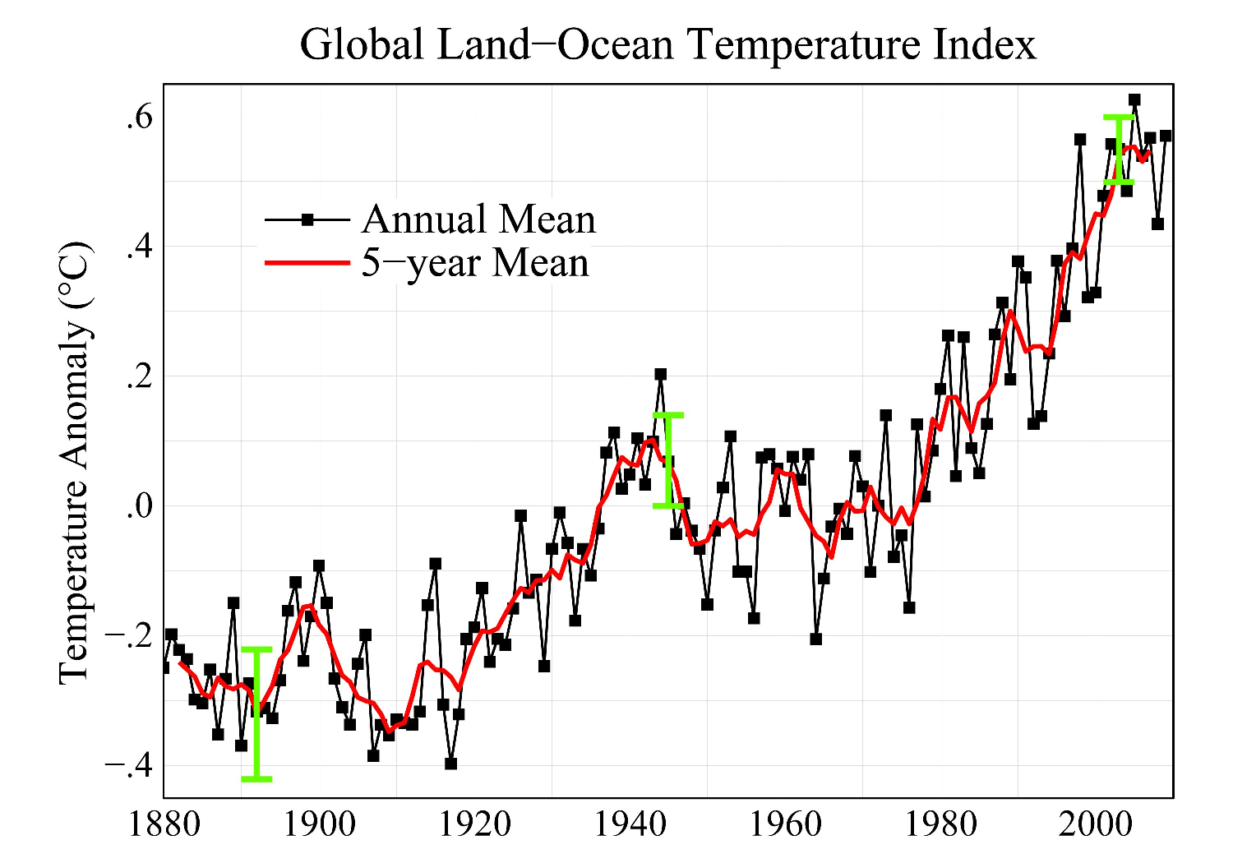
The temperature is rising “rapidly”?

Slide 8
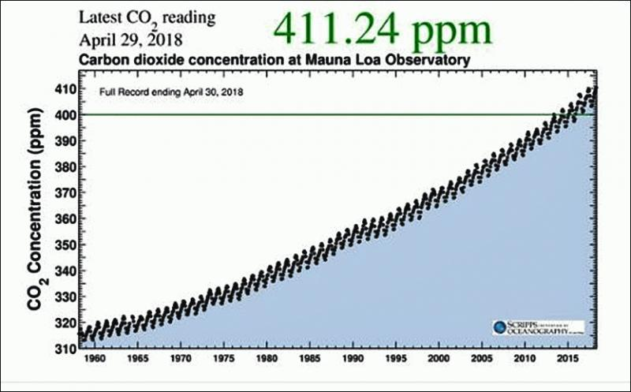
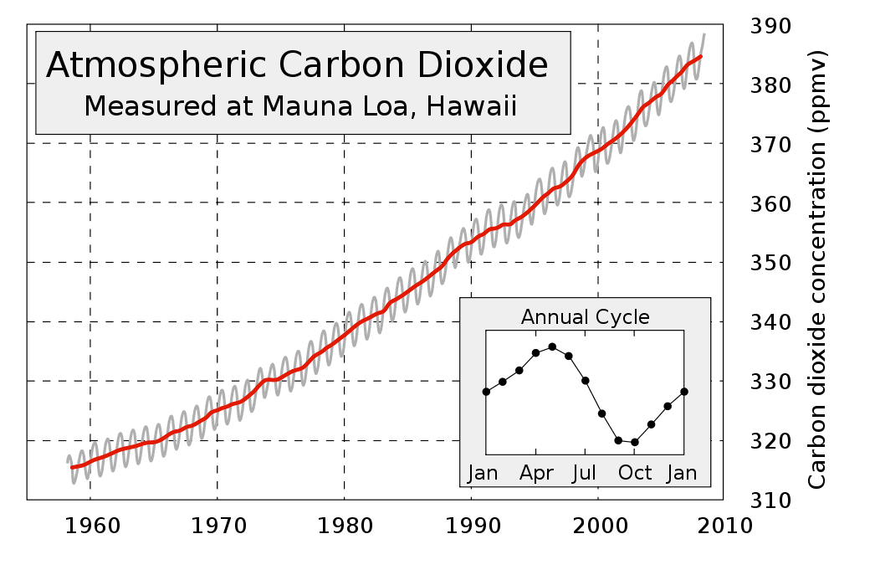
Increasing carbon dioxide

Slide 9
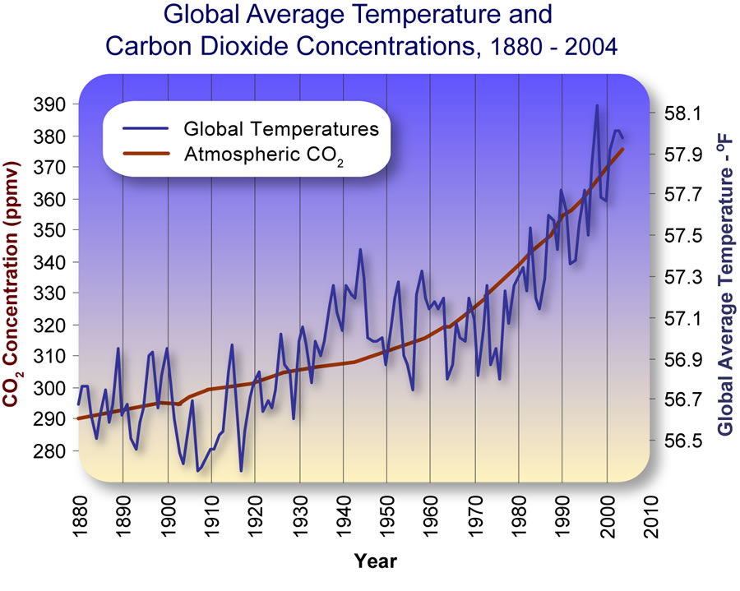
Overlaying two graphs

Slide 10
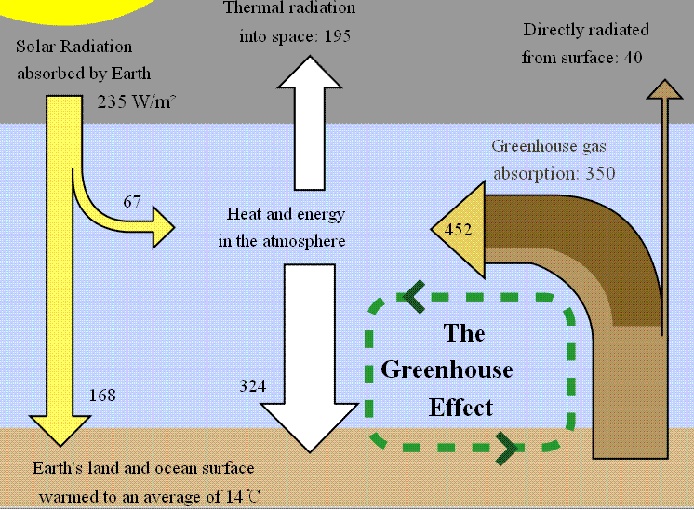
Greenhouse effect

Slide 11
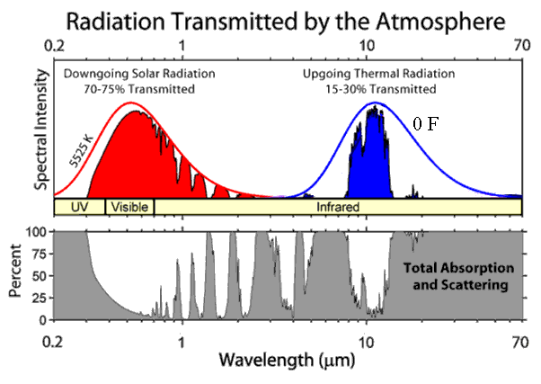
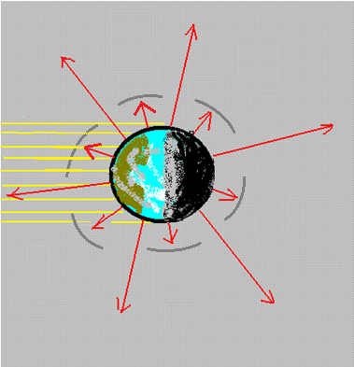
The effect of carbon dioxide
The atmosphere is transparent in the visible, but not in the infrared. This is due to the presence of “greenhouse gases”:

Slide 12
The greenhouse effect
The earth is warmer than expected, because some of the energy emitted from the ground is absorbed by the atmosphere (plugging part of the “leak”). But the visible light from the sun is not affected. This raises the temperature of the earth from 0 F to 55 F.

Slide 13
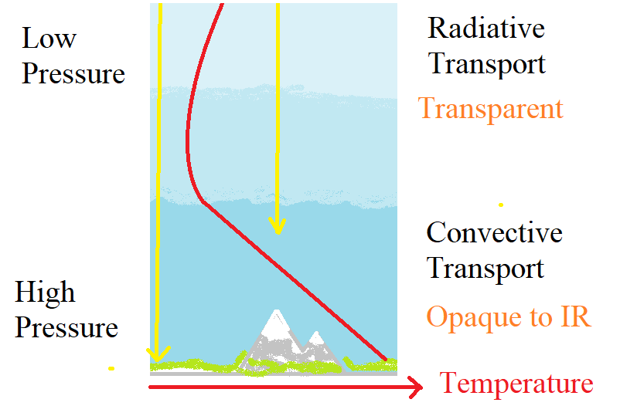
Temperature structure of the atmosphere
Above, the air is transparent to infrared; below, it is opaque. The dividing line is the bottom of the stratosphere. The temperature there (-55 C) is determined by equality of radiation out and radiation in.

Slide 14
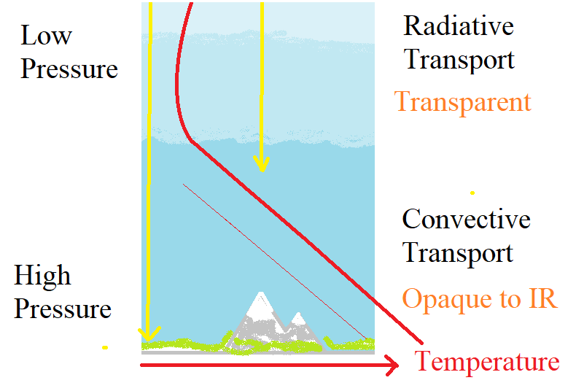
Why CO₂ makes the earth warmer
Carbon dioxide (and methane and water vapor) make the air more opaque to IR. It raises the height of the bottom of the stratosphere. Then the lower branch of the temperature graph moves up, and the surface gets warmer.

Slide 15
Implications of the theory
The CO₂ content of the atmosphere is cumulative of all burning of fossil fuels.
The amount of CO₂ in the atmosphere is steadily rising, and this will continue as long as we continue to burn fossil fuels.
It is a permanent change (on a 500-year time scale).
The temperature of the earth will rise along with the CO₂ content. This is also a permanent change.

Slide 16
Why do we care?
Areas that are hot now could get hotter.
Areas with poor rainfall now might get drier.
People, plants, and insects are accommodated to the climate they now have.
Sea level change could affect a lot of people.
We don’t know what is going to happen.

Slide 17
The role of the university
Educate the public, to help them understand the problem and the possible solutions.
Tell people
Global warming is real, it is problem, and we need to do something about it.

Slide 18
Can we stop using fossil fuels?

Slide 19
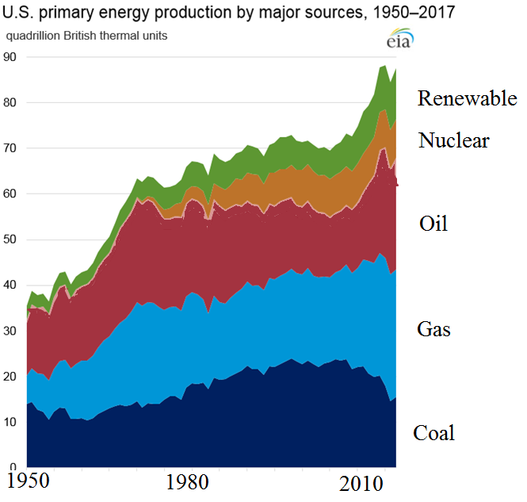

Slide 20
Electricity production in the US, 2018
All utility-scale electricity generation 4,178 Terawatthours (TWh) facilities: ($400 billion)
Nuclear power 807 TWh (19%)
Wind power 275 TWh (6.6%)
PV power plants 63 TWh (1.5%)
small-scale grid-connected PV systems 30 TWh

Slide 21
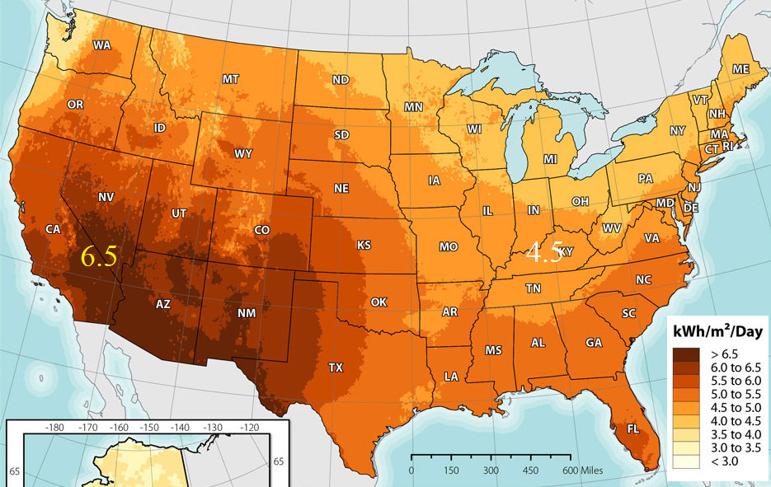

Solar power: kWh/m²/day

Slide 22
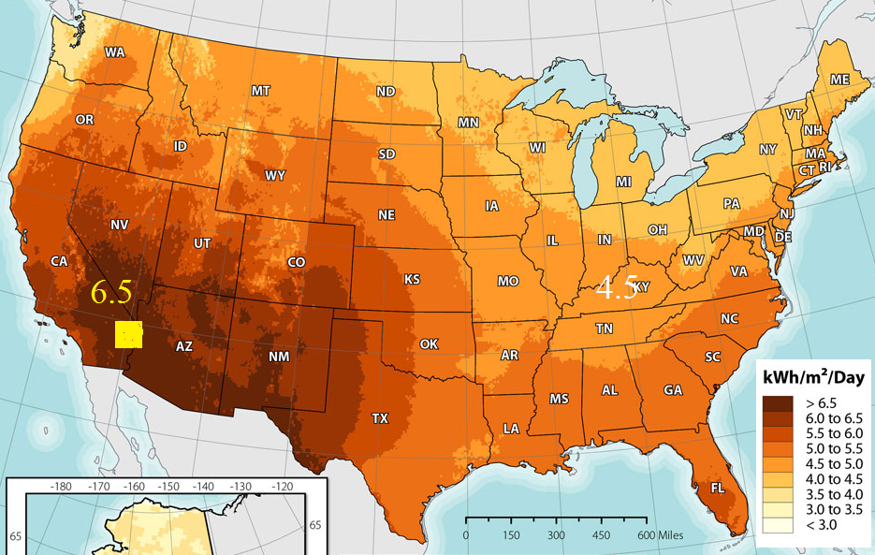
Power the US with (150 km)²!

Slide 23
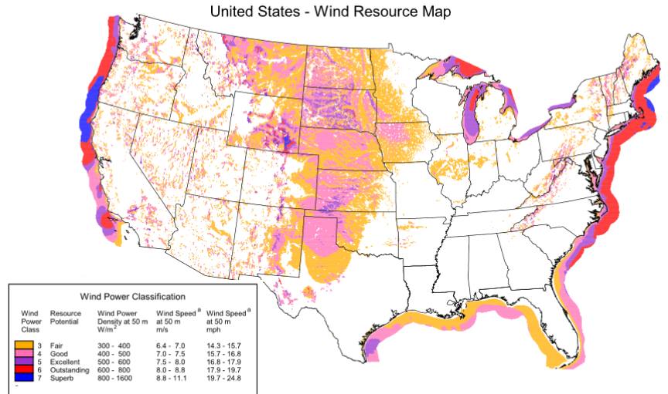
Wind resource

Slide 24
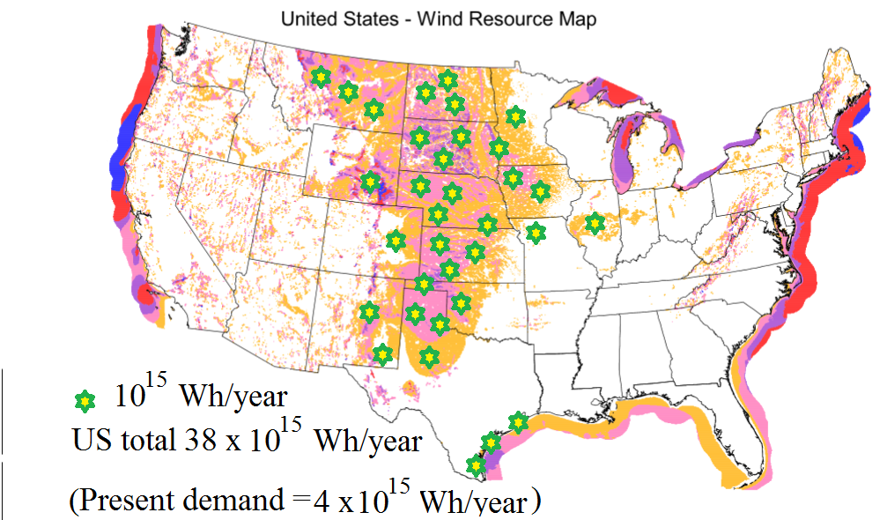
Wind resource

Slide 25
Wind resource numbers
1 large wind turbine has “name plate” capacity 2.5 MW.
It will collect 5 billion Watt-hours per year.
We would need about 3 million of these to meet the US electricity demand entirely with wind (we have already built 40,000).
The power per unit area contained in 20 mph wind = 1200 W/m², about the same as the power per unit area delivered by sunlight (1000 W/m² at noon in Arizona). The price of the device is about $1 per Watt, also about the same as a solar panel.

Slide 26
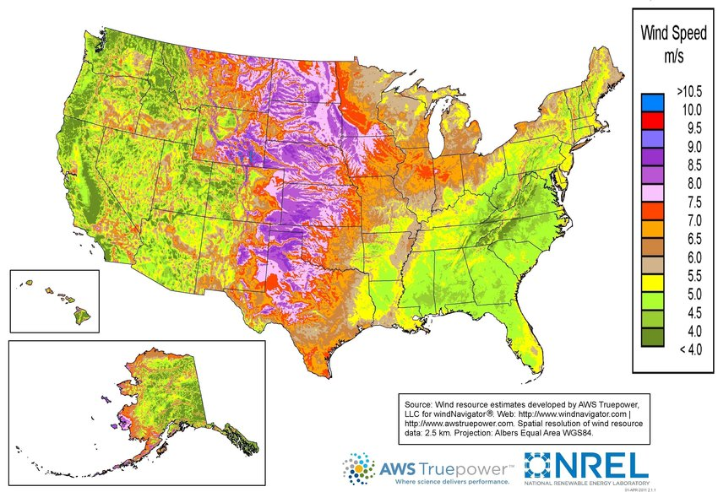

Slide 27


Advantages of solar power
It’s better distributed geographically
Total available resource = 14,000 x 10¹⁵ Wh/year
Compare wind resource = 38 x 10¹⁵ Wh/year
Current demand = 4 x 10¹⁵ Wh/year
It’s more predictable, and better aligned with the daily cycle.
The technology and economics are rapidly improving.
It can be distributed at small scale.

Slide 28
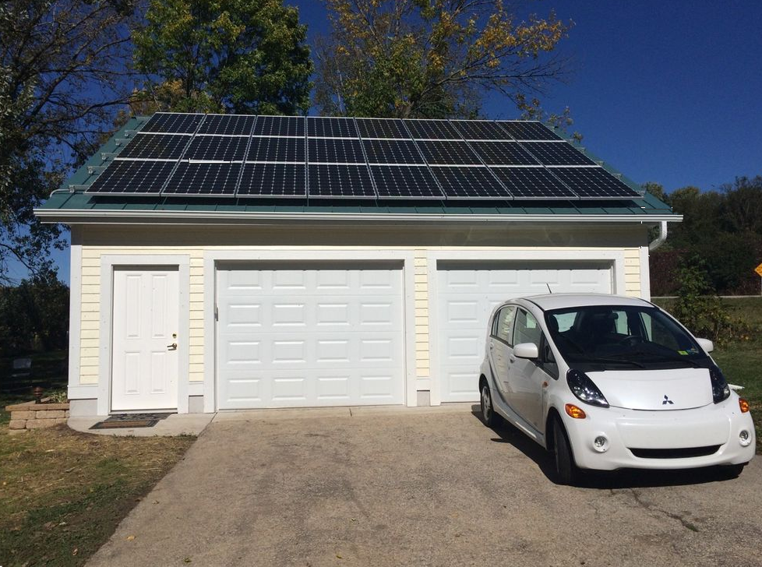
Solar power can be distributed in a way that wind power cannot

Slide 29
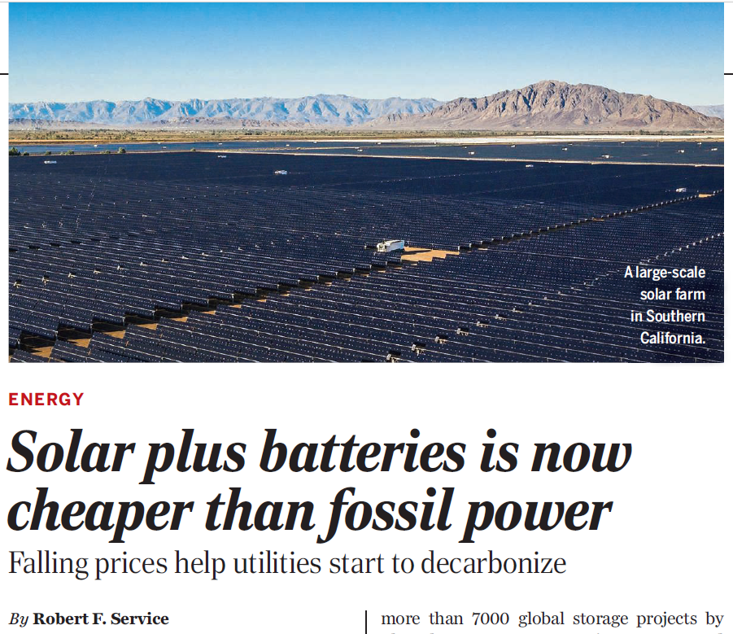

Slide 30
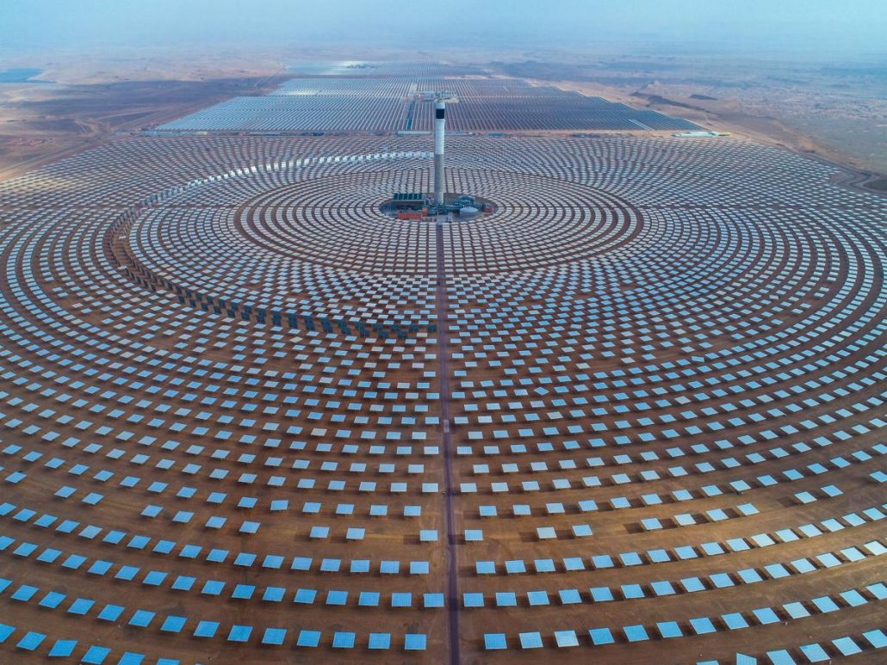
Concentrating Solar Power

Slide 31
The advantages of wind power
Wind turbines are 19th century technology (21st century engineering)!. Solar photovoltaic technology is still being invented.
For physics reasons, the efficiency of a wind turbine (fraction of the available resource captured) is higher than that of a PV collector.
The wind blows at night, and a lot in the winter: the capacity factor is larger than for a solar collector.
The power comes to the turbine, sweeping power from a larger region. Geography can help concentrate the wind power. Solar collectors only collect from the area they cover.

Slide 32
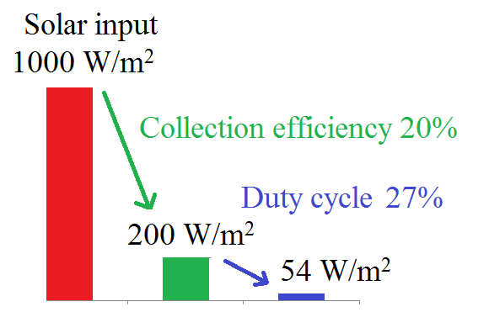
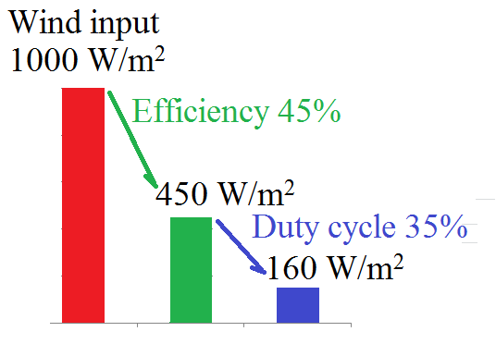
Solar vs. Wind

Slide 33
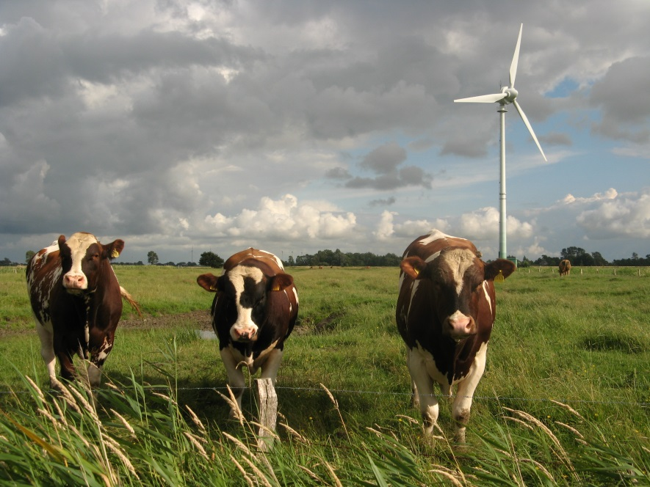
The advantages of wind power
Wind power is compatible with other land uses.
…However, if you have an area with a lot of sun and not much wind, that isn’t good for much else …

Slide 34
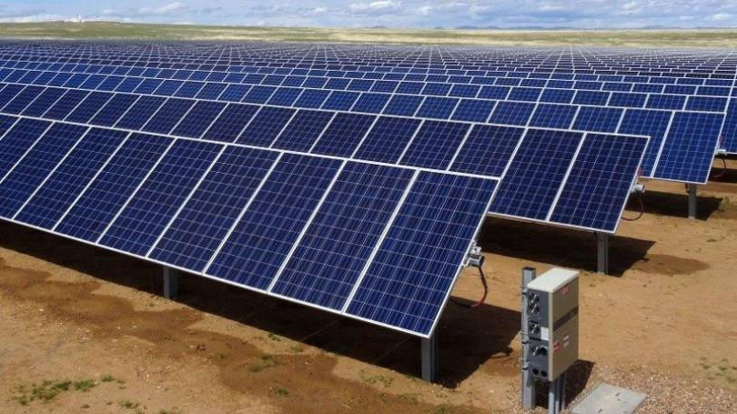

Slide 35
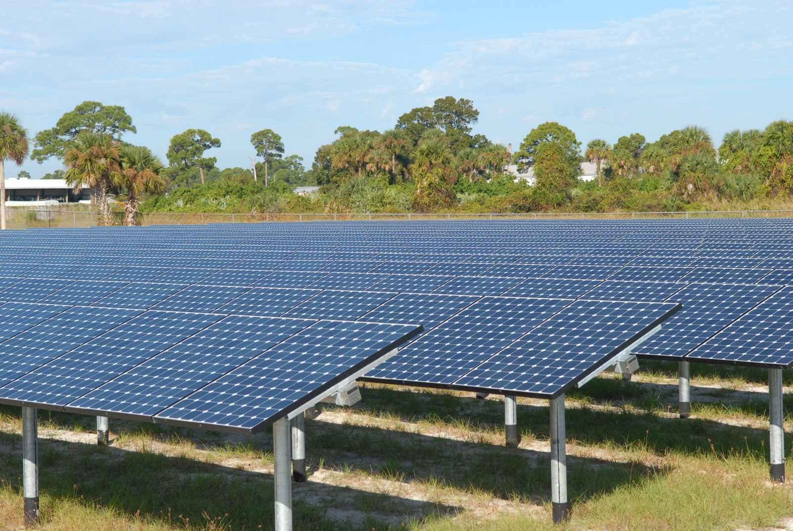
A solar farm takes up land

Slide 36
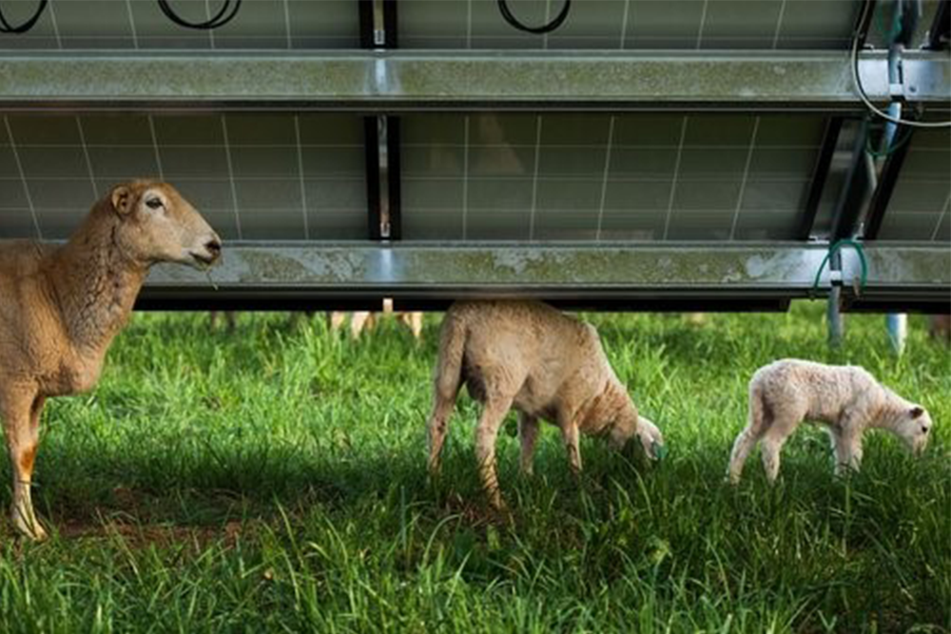
But apparently grass will grow under the panels!

Slide 37
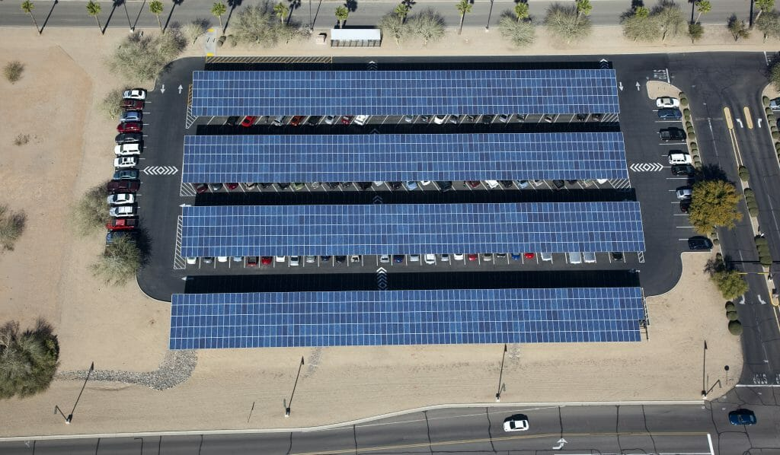
Solar power can be distributed in a way that wind power cannot

Slide 38
Scale-up problems
Solar and wind power production are variable and can change rapidly.
There aren’t good ways to store energy at grid scale. Solar and wind have to be used as they are generated. Conventional power plants can be turned on and off, up and down.

Slide 39
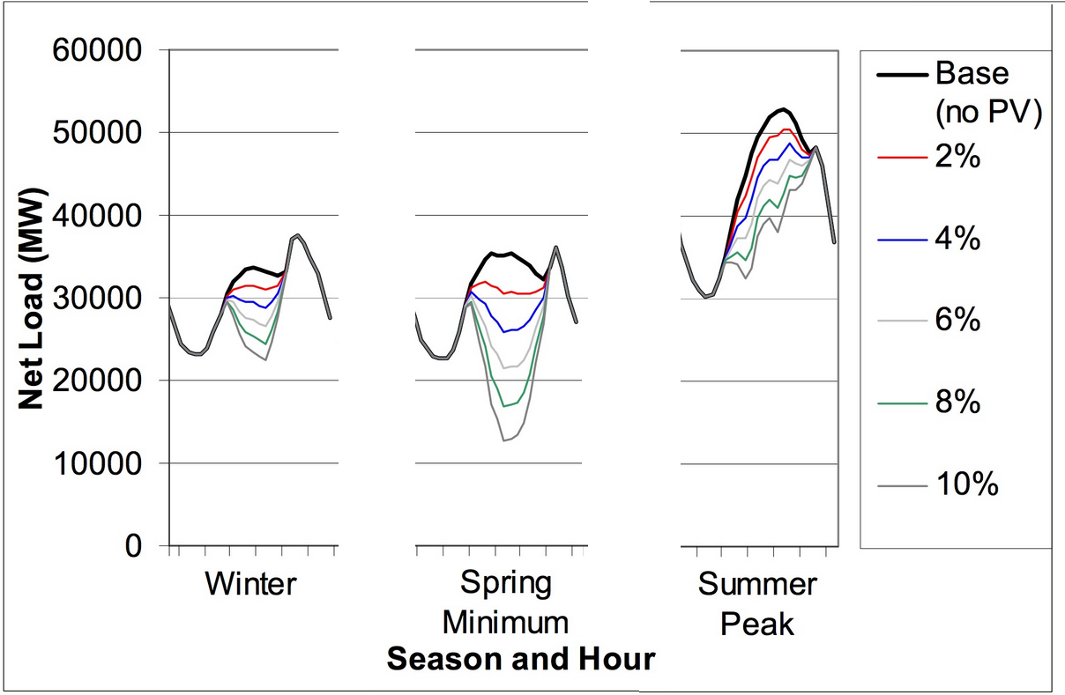
Problems in scaling up: solar overproduces during the day

Slide 40
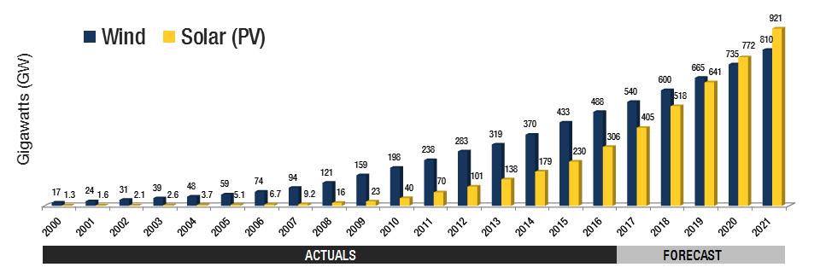
Global Wind and Solar “Capacity”

Slide 41

Solar vs. Wind -- economics
Both solar and wind farms cost about $1 per Watt, installed. Nuclear power plants cost $2/Watt. But the “watt” assumes design conditions: sun shining, wind blowing.
The wholesale price of electricity is $0.045 per kilowatt-hour.

Slide 42
Power the US with (150 km)²!
At current price for solar collectors, it will cost $3 trillion.

Slide 43
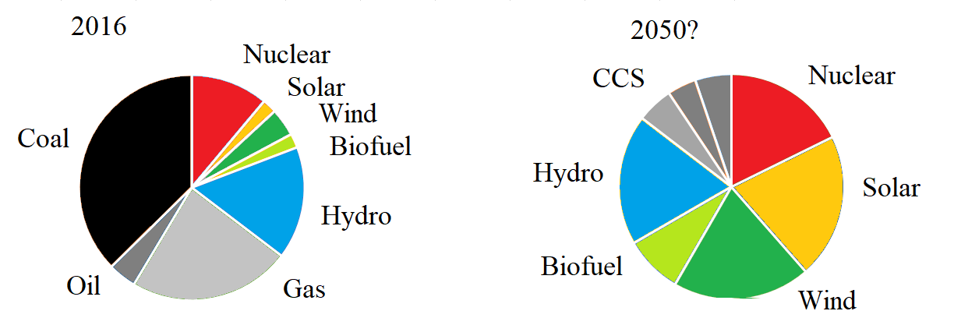
Global Electrical Energy, now and in the future
From Sivaram’s book

Slide 44
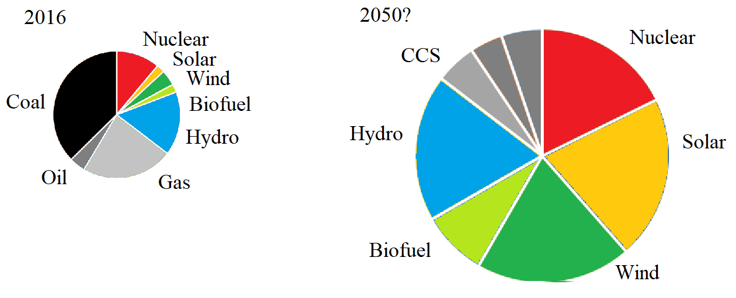
Global Electrical Energy, now and in the future
From Sivaram’s book

Slide 45
Can renewable energy replace fossil fuels?
Science says we can do it, and it’s getting easier all the time.
Economics says we can do it, though it will be a large infrastructure investment.
Politics (what people believe and expect) … .

Slide 46
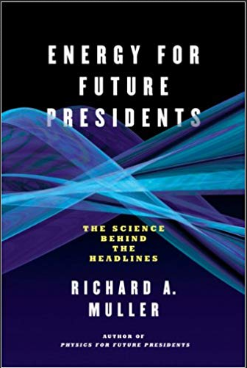
Another useful reference

Slide 47
The role of the university
Educate the public, to help them understand the problem and the possible solutions.
Tell people
Global warming is real, it is problem, and we need to do something about it
Nuclear power is safe, and one of the best options for replacing fossil fuels
Solar and wind power will need to be developed wherever it is feasible

Slide 48
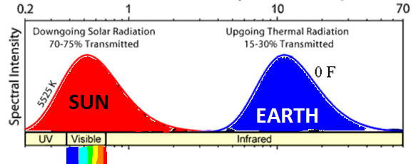
The temperature of the earth
Energy comes from the sun in the form of visible light, and leaves in the form of infrared light..
This determines the average temperature of the earth

Slide 49
Greenhouse gases
Water vapor -- 2/3 of the effect
Carbon dioxide (CO₂) -- 1/4
Methane and other gases -- 1/10

Slide 50
Any questions?

Slide 51
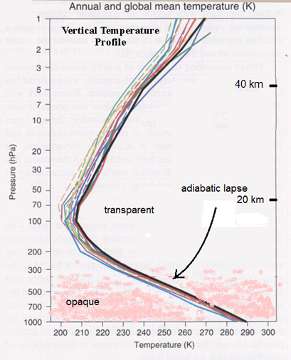
Atmospheric temperature profile
The temperature of the atmosphere decreases with altitude due to adiabatic expansion as air is carried upwards.

Slide 52
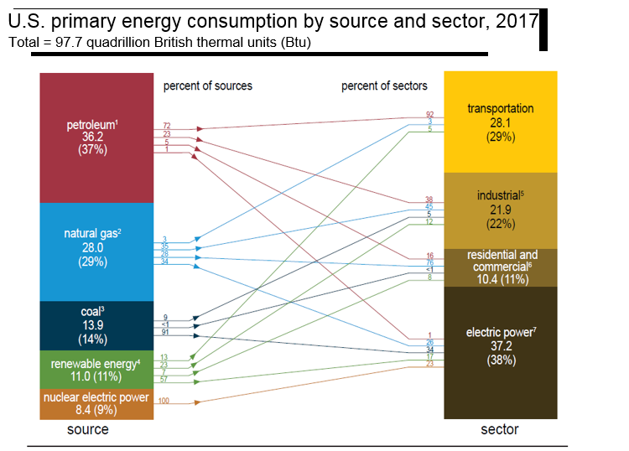

Slide 53
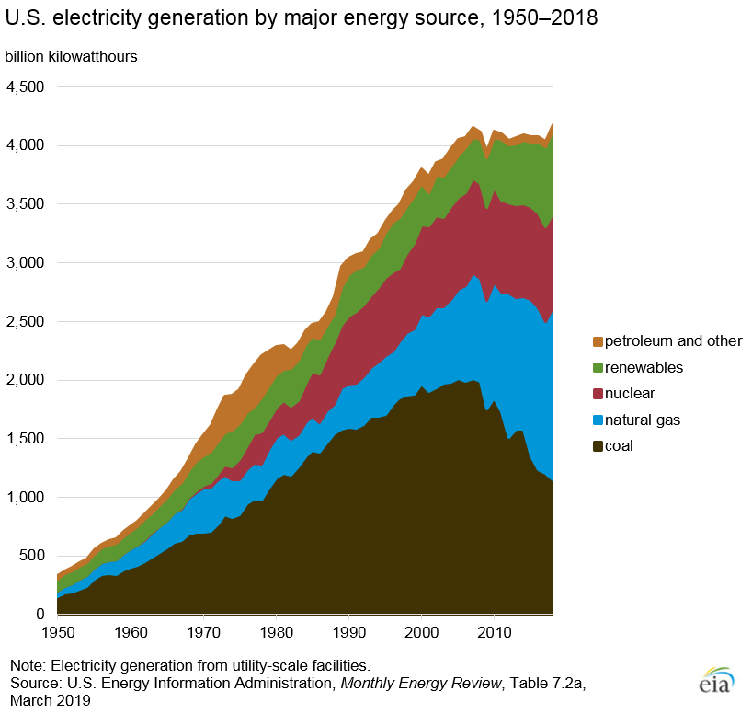
US electricity generation

Slide 54
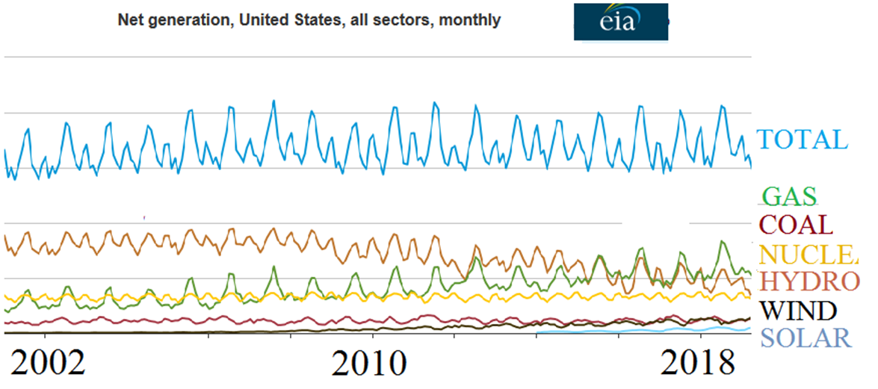
Electricity

Slide 55
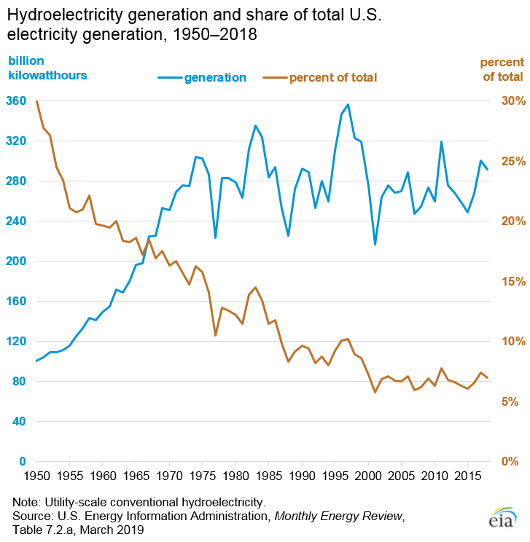

Slide 56
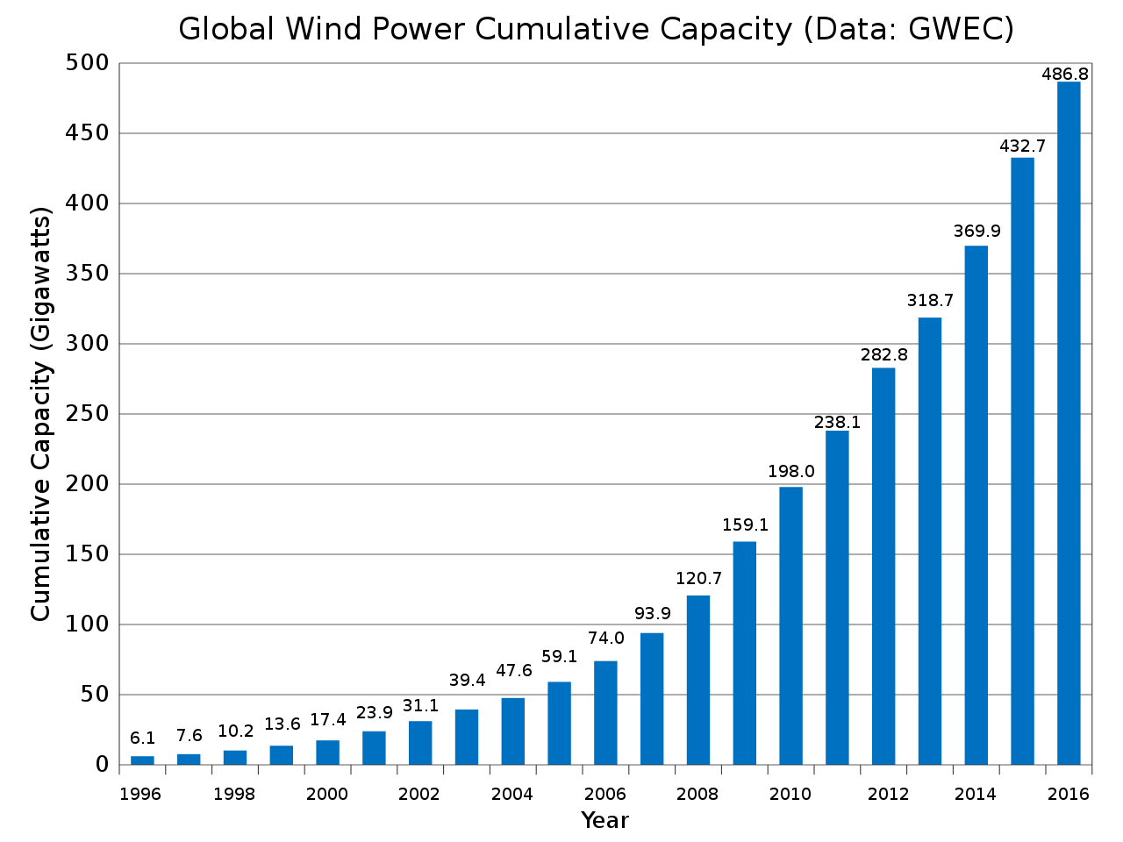

Slide 57
