Slide 1
Can Renewable Energy Replace Fossil Fuels? Joseph P. Straley University of Kentucky
Burning fossil fuels is increasing the CO₂ content of the atmosphere. This may lead to climate change. How hard will it be to convert to a renewable energy economy? I’ll discuss the issues that are involved.

Slide 2
The role of the university
*Teach the students, to produce a new generation of scientists, teachers, and technologically competent people.
*Discover stuff. Develop ideas. Create things.
*Educate the public, to help them understand problems that have science content, and propose and explain possible solutions.

Slide 3

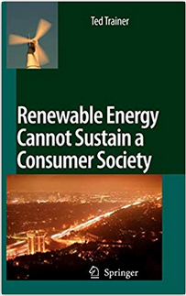

Inspired by two books …

Slide 4
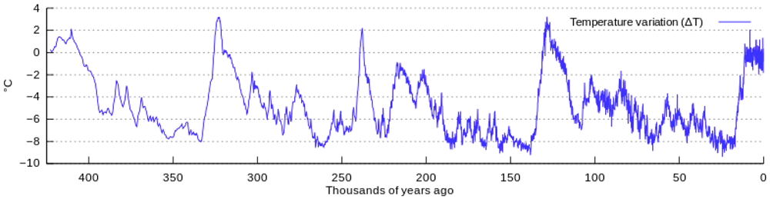
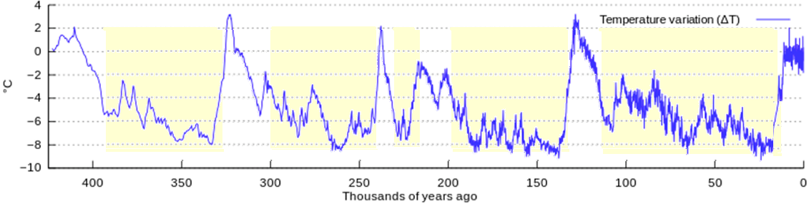
History of the Earth’s Temperature

Slide 5
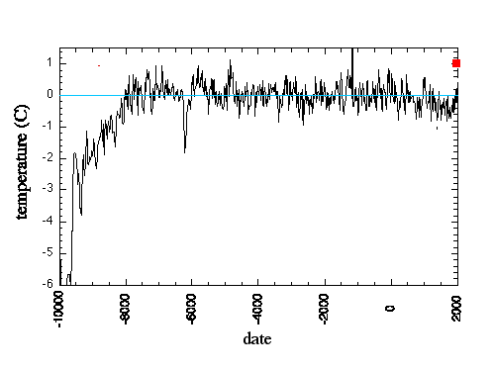
History of the earth’s temperature

Slide 6
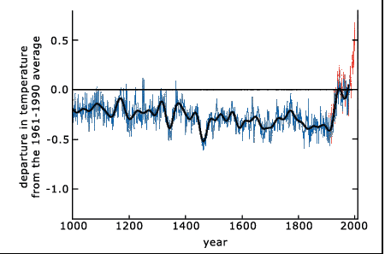
History of the earth’s temperature

Slide 7
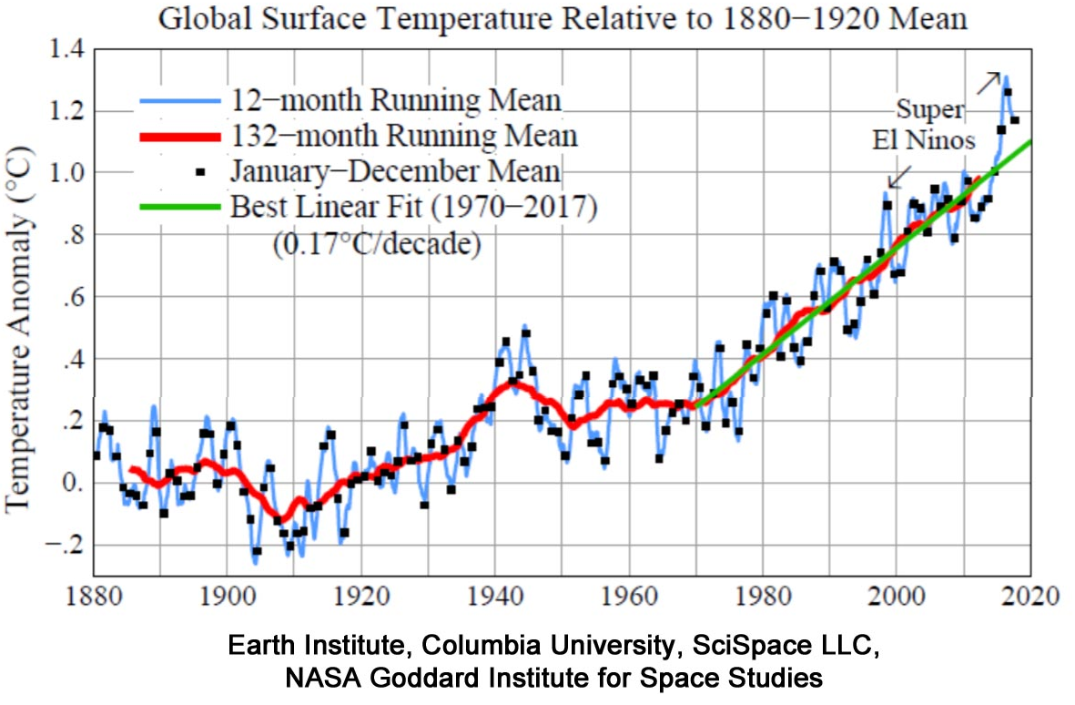
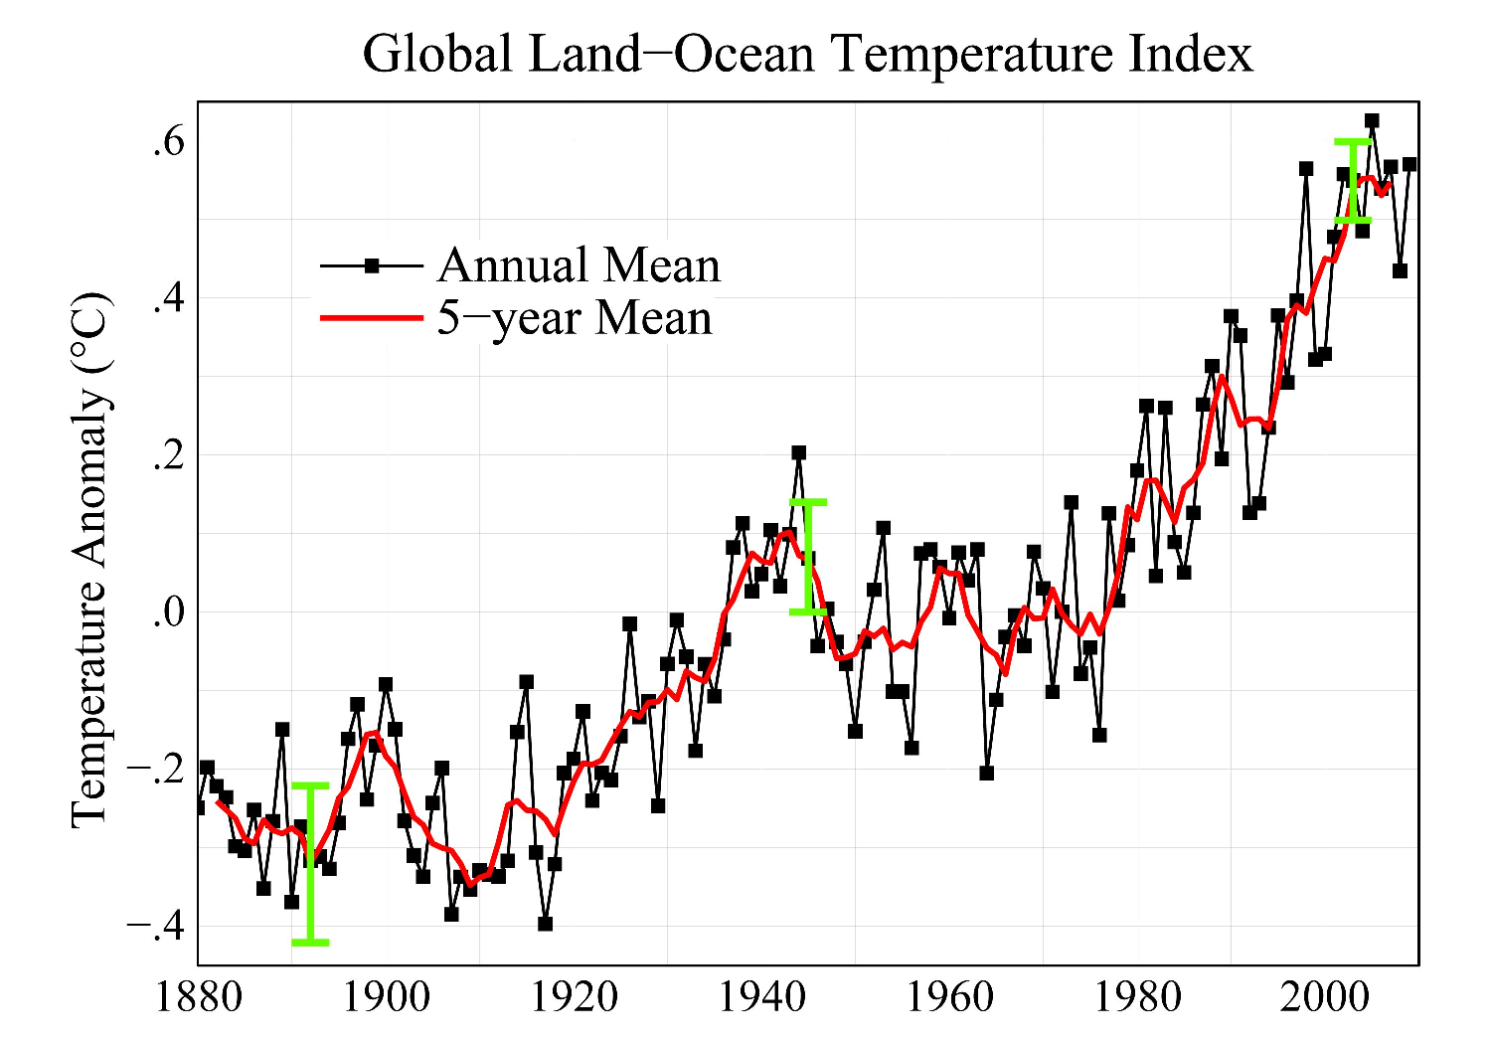
The temperature is rising “rapidly”?

Slide 8
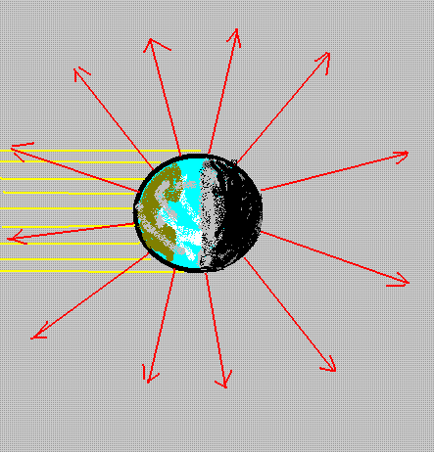
The temperature of the earth
Energy comes from the sun in the form of visible light
All of this energy is reemitted, so that the energy of the earth stays the same from day to day.
Both input and output are nearly constant in time.
This determines the average temperature of the earth

Slide 9
Radiation cools the earth
Energy comes from the sun in the form of visible light, during the daylight hours.
Energy leaves the earth all the time, in the form of infrared light.

Slide 10
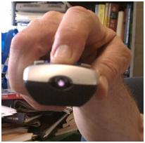
Infrared light
The colors of a rainbow come in the order they do –
Red, orange, yellow, green, blue …
Because that is the order of decreasing “wavelength” (a measurably physics property). There are kinds of light that are longer wavelength than visible light (“infrared light”) and of shorter wavelength than visible light (“ultraviolet light”).
Although our eyes can’t see these extra kinds of light, a camera sometimes can.
This is how a TV remote talks to the TV:

Slide 11
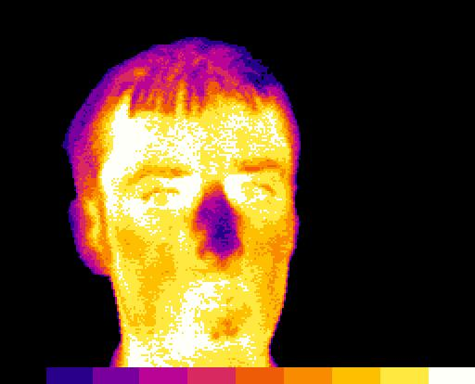
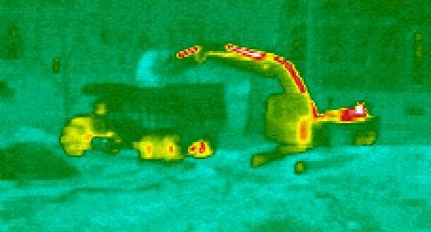
Infrared light
Very hot objects emit visible light (“red hot” “white hot”). Warm objects emit infrared light.

Slide 12
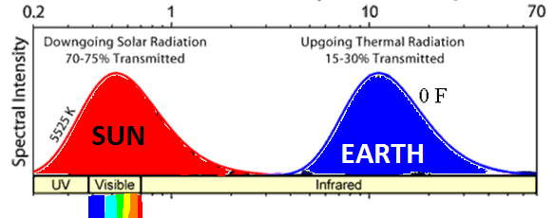
The temperature of the earth
Energy comes from the sun in the form of visible light, and leaves in the form of infrared light..
This determines the average temperature of the earth

Slide 13
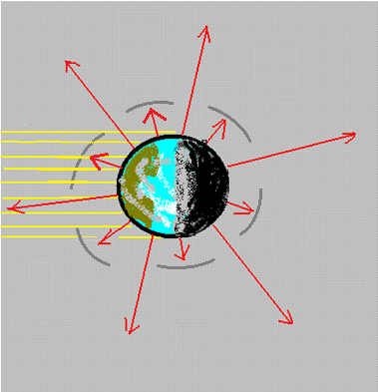
The temperature of the earth
There’s a problem with the theory: It predicts that the earth should be much colder (about 0 F, instead of 55 F) than it is. Energy is not leaking away as fast as it should
This means that something hindering the outgoing radiation.

Slide 14
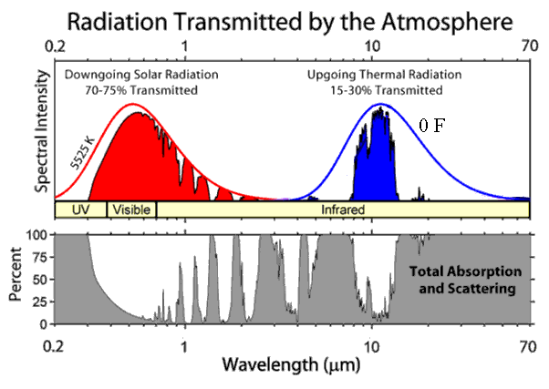
The effect of carbon dioxide
The atmosphere is transparent in the visible, but not in the infrared. This is due to the presence of “greenhouse gases”:

Slide 15
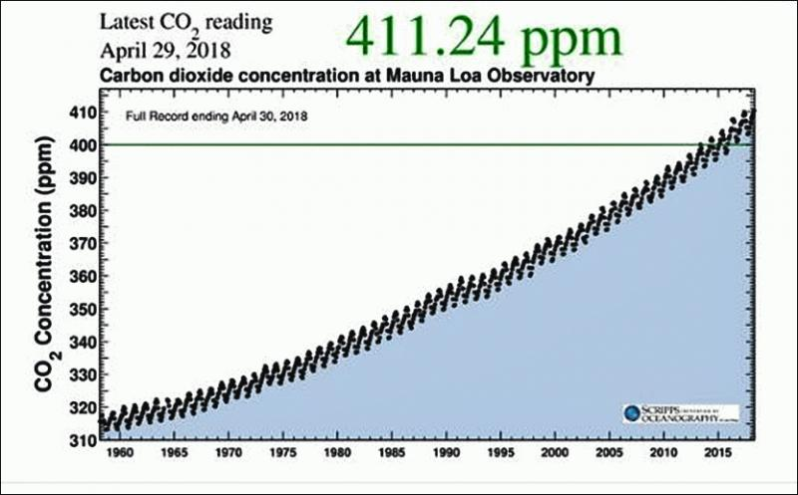
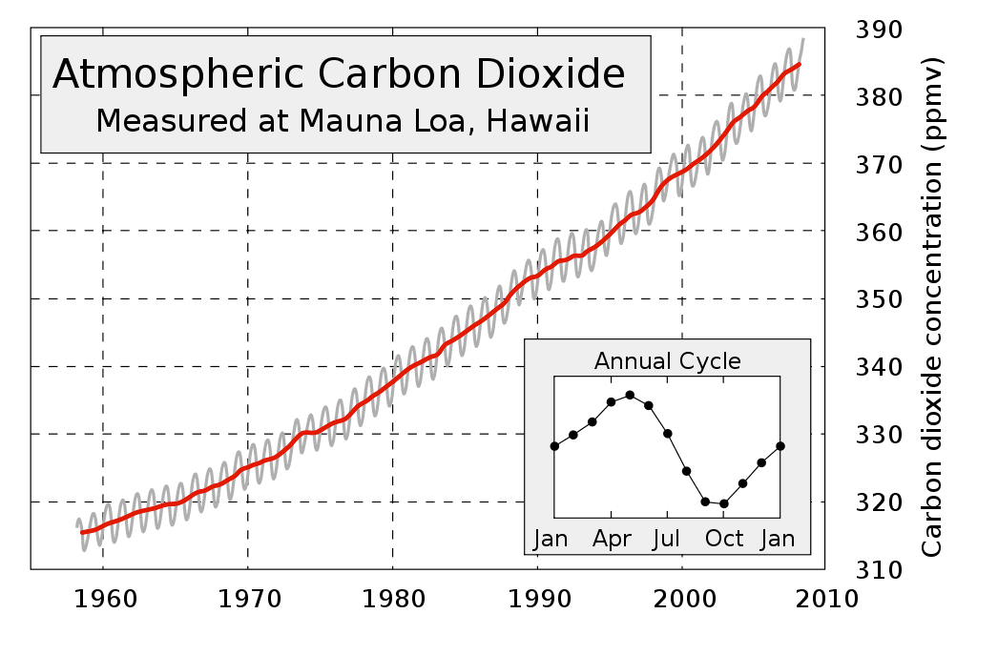
Increasing carbon dioxide

Slide 16
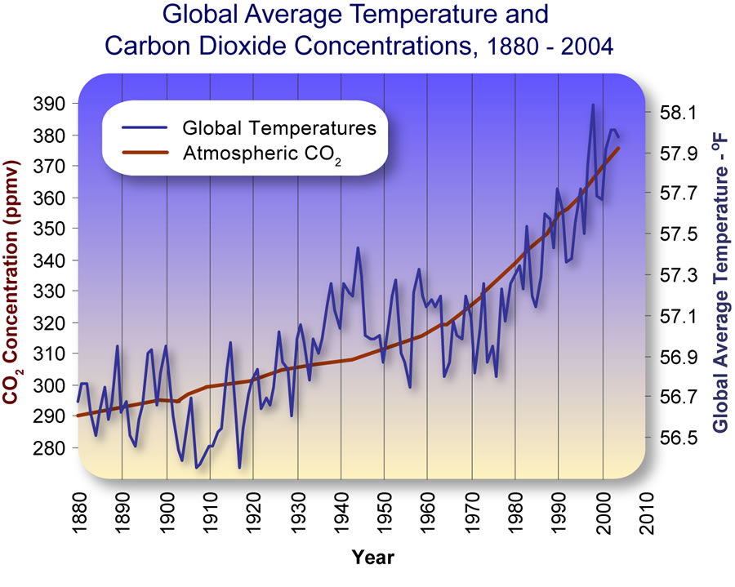
Overlaying two graphs

Slide 17
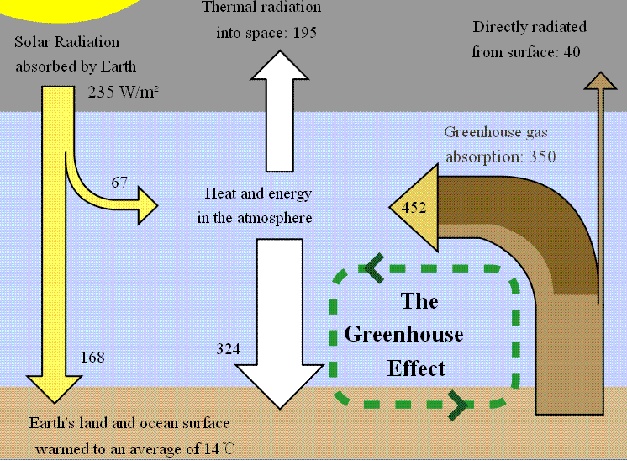
Greenhouse effect

Slide 18
The greenhouse effect
The earth is warmer than expected, because some of the energy emitted from the ground is absorbed by the atmosphere (plugging part of the “leak”). But the visible light from the sun is not affected. This raises the temperature of the earth from 0 F to 55 F.

Slide 19
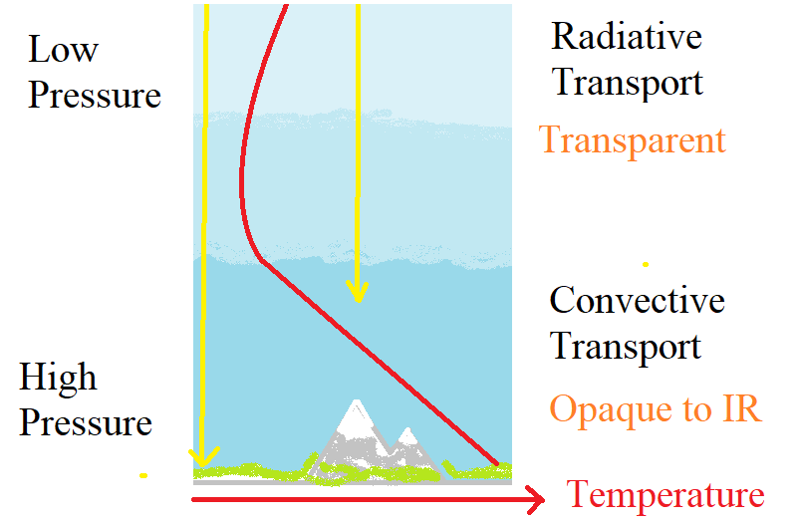
Temperature structure of the atmosphere
Above, the air is transparent to infrared; below, it is opaque. The dividing line is the bottom of the stratosphere. The temperature there (-55 C) is determined by equality of radiation out and radiation in.

Slide 20
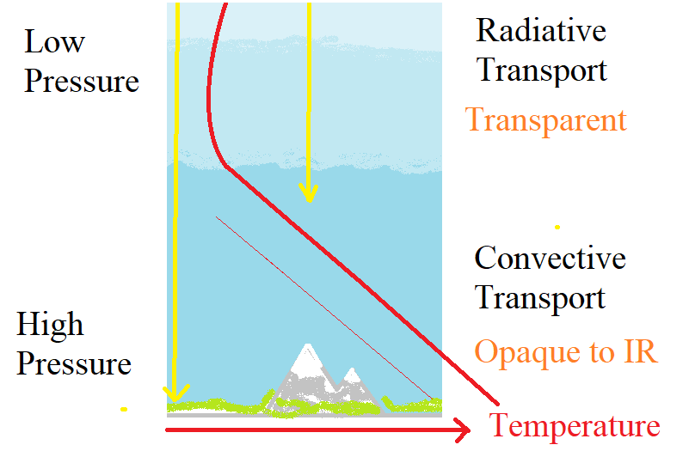
Why CO₂ makes the earth warmer
Carbon dioxide (and methane and water vapor) make the air more opaque to IR. It raises the height of the bottom of the stratosphere. Then the lower branch of the temperature graph moves up, and the surface gets warmer.

Slide 21
Burning fossil fuels makes CO₂. What happens to it?
It stays in the atmosphere
It dissolves in the ocean surface water
Plants take it up
The atmosphere and the ocean surface water are closely coupled: CO₂ freely moves among them, and is shared in a fixed proportion.
The CO₂ taken up by plants usually is returned to the atmosphere after the plant dies.

Slide 22
Implication of the theory
The CO₂ content of the atmosphere is proportional to the total of all fossil fuels that have been burned. It is a permanent change (on a 500-year time scale). The amount of CO₂ in the atmosphere should be steadily rising, and this will continue as long as we continue to burn fossil fuels.

Slide 23
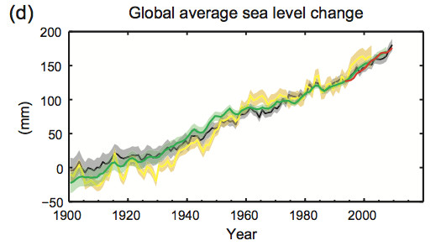
Sea level is increasing

Slide 24
Why do we care?
Areas that are hot now could get hotter.
Areas with poor rainfall now might get wetter, or might get drier.
People, plants, and insects are accommodated to the climate they now have.
Sea level change could affect a lot of people.
We don’t know what is going to happen.

Slide 25
Any questions?

Slide 26
The role of the university
Educate the public, to help them understand the problem and the possible solutions.
Tell people
Global warming is real, it is problem, and we need to do something about it.

Slide 27
Can we stop using fossil fuels?

Slide 28
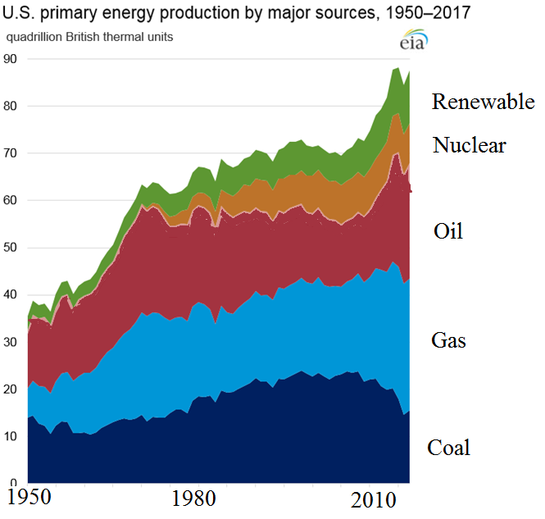

Slide 29
Electricity production in the US, 2018
All utility-scale electricity generation 4,178 Terawatthours (TWh) facilities: ($400 billion)
Nuclear power 807 TWh (19%)
Wind power 275 TWh (6.6%)
PV power plants 63 TWh (1.5%)
small-scale grid-connected PV systems 30 TWh

Slide 30
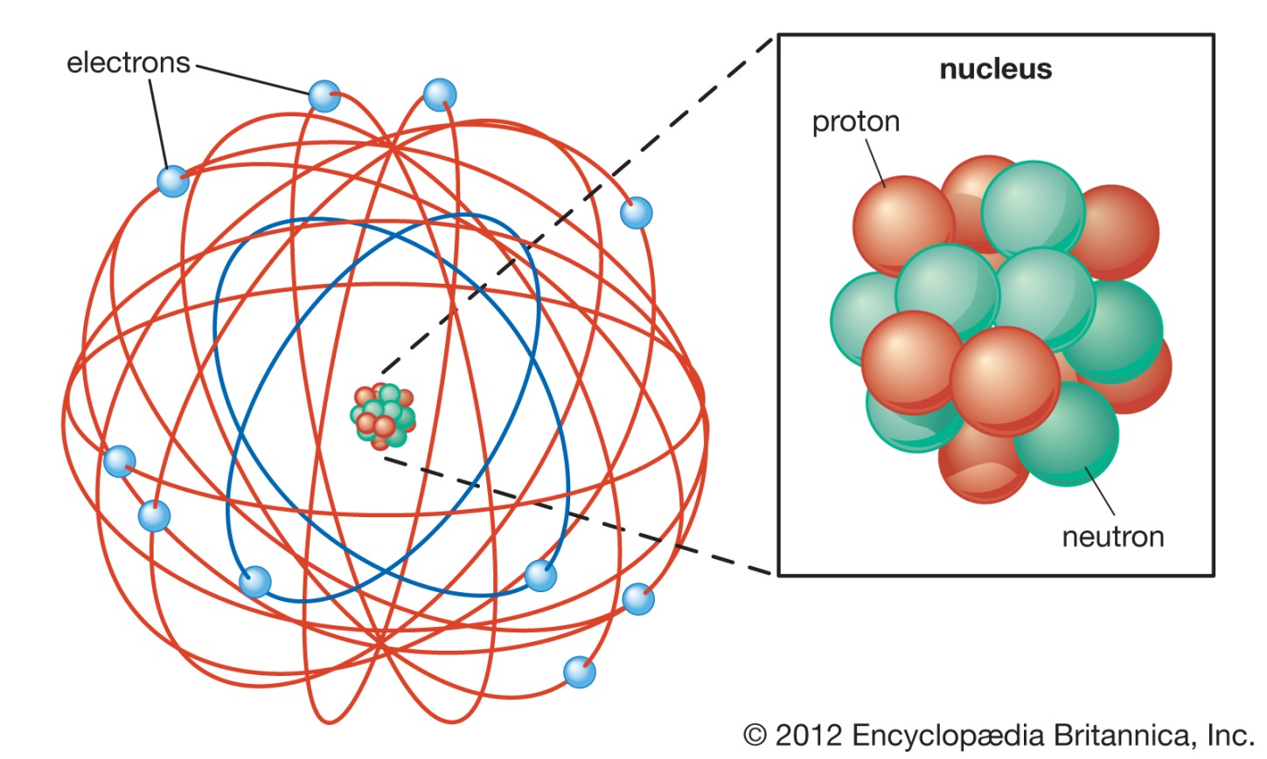
The nucleus
At the center of an atom is a small, heavy object that is actually holding the atom together: the nucleus. It has almost all of the mass of the atom. It is made of a mixture of two kinds of particles: protons and neutrons. Using different numbers of these particles gives different elements.

Slide 31
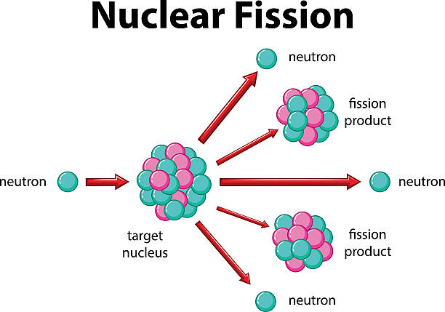
Nuclear fission
Uranium and plutonium have a special property: if the nucleus absorbs a neutron, it falls apart.
Several neutrons come out of the wreckage, as well as a lot of energy.

Slide 32
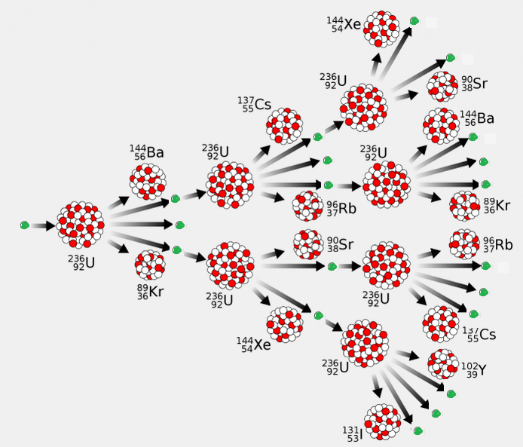
Chain reaction
This leads to the possibility of each fission event causing more:
A chain reaction.
Neutrons are like “fire” that causes the uranium to “burn.”

Slide 33
Nuclear power
By running a controlled chain reaction, a tremendous amount of energy can be released from a small amount of uranium. A ton of uranium is equivalent to 16,000 tons of coal.
In normal operation, practically nothing comes out of the reactor except electrical power and hot water.

Slide 34
Problems with nuclear power
The broken uranium nuclei are radioactive: they emit high energy particles for a long time (centuries). It’s very important that these not be released to the environment.
There have been a few accidents where this happened. (Three Mile Island, Chernobyl, Fukushima).
Radioactivity is too easy to detect.
People are very afraid of nuclear power. At Three Mile Island and Fukushima, this did more damage than the radioactivity release.

Slide 35
Solving the problems
Although the contents of a nuclear reactor are extremely dangerous, there isn’t very much of it (a few tons). It’s not too hard to control this.
US power plants put the reactor in a steel tank that is inside a concrete building with 3-foot-thick walls. This system has never failed. No one was hurt at all by the Three Mile Island accident.
Fukushima failed because a tsunami had struck. The tsunami killed 20,000 people. The failing reactor killed no one, and probably no one will ever suffer health effects due to it.
Chernobyl …

Slide 36
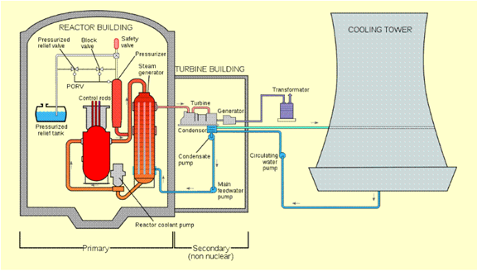
Nuclear power plant (US design)

Slide 37
Nuclear power in the US
There are 98 nuclear power plants in the US, which generate almost 20% of the electricity. There are two new ones being built.
France, Ukraine, and Hungary get more than half of their electricity from nuclear power plants, and there are many other countries where nuclear power plays a major role.
In normal operation, they are extremely low polluting.

Slide 38
The future of nuclear power
If people weren’t afraid of it, this would be all we needed to supply electricity. Electricity could replace almost all of our power needs, with a few exceptions (transportation, mainly).

Slide 39
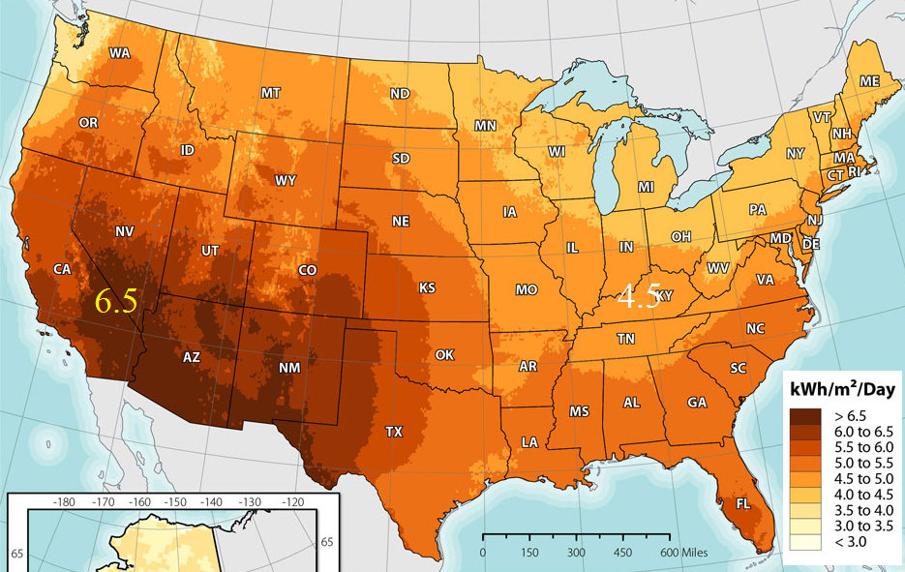

Solar power: kWh/m²/day

Slide 40
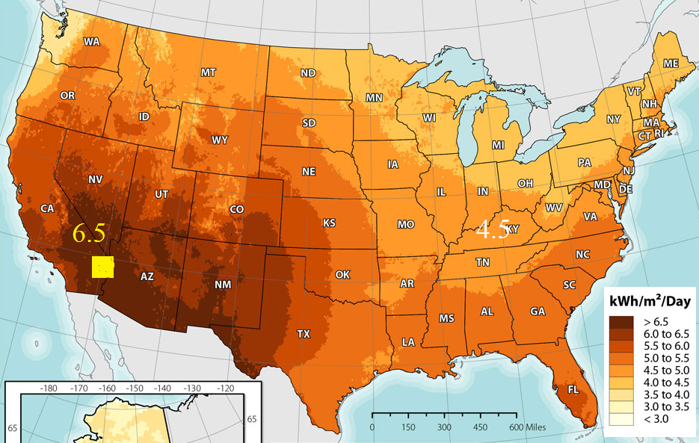
Power the US with (150 km)²!

Slide 41
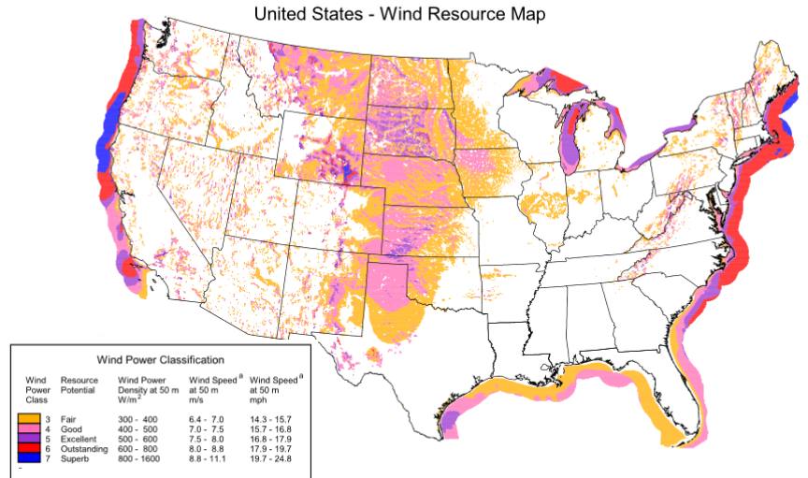
Wind resource

Slide 42
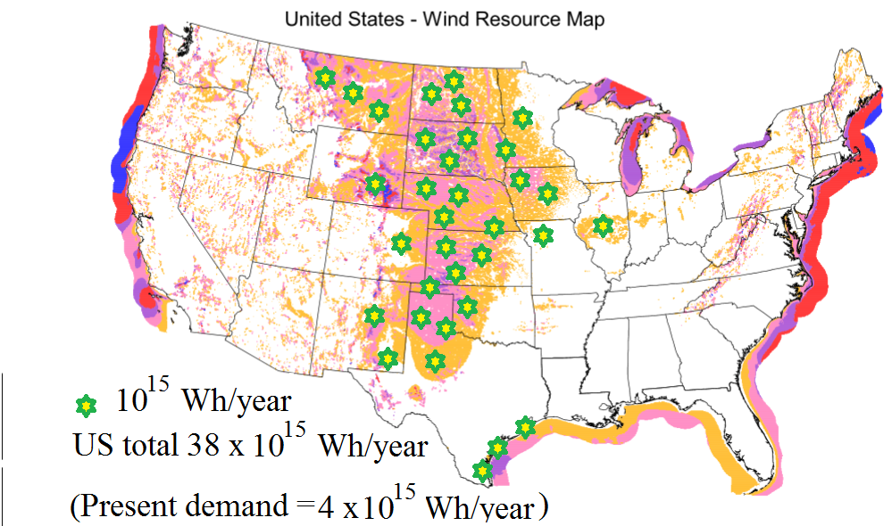
Wind resource

Slide 43
Wind resource numbers
1 large wind turbine has “name plate” capacity 2.5 MW.
It will collect 5 billion Watt-hours per year.
We would need about 3 million of these to meet the US electricity demand entirely with wind (we have already built 40,000).
The power per unit area contained in 20 mph wind = 1200 W/m², about the same as the power per unit area delivered by sunlight (1000 W/m² at noon in Arizona). The price of the device is about $1 per Watt, also about the same as a solar panel.

Slide 44


Advantages of solar power
It’s better distributed geographically
Total available resource = 14,000 x 10¹⁵ Wh/year
Compare wind resource = 38 x 10¹⁵ Wh/year
Current demand = 4 x 10¹⁵ Wh/year
It’s more predictable, and better aligned with the daily cycle.
The technology and economics are rapidly improving.
It can be distributed at small scale.

Slide 45
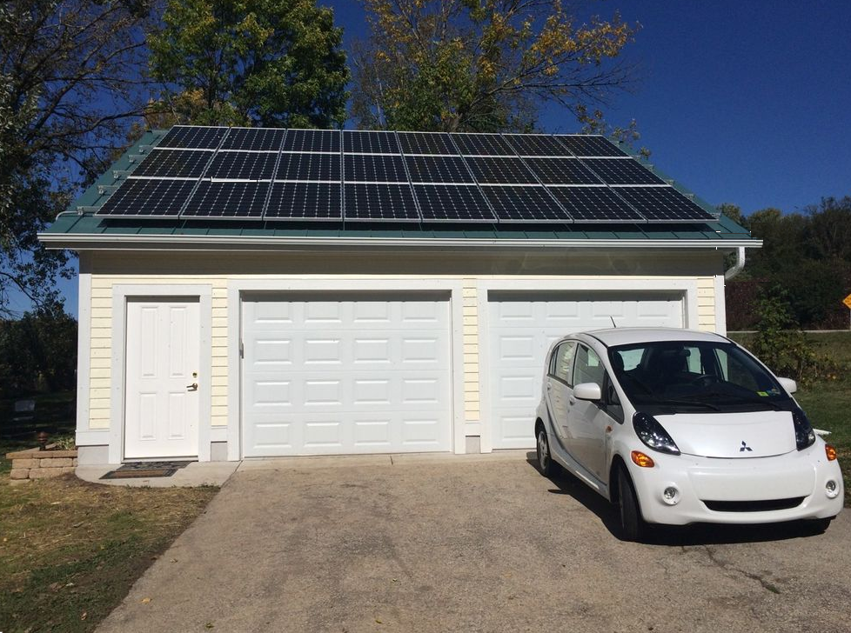
Solar power can be distributed in a way that wind power cannot

Slide 46
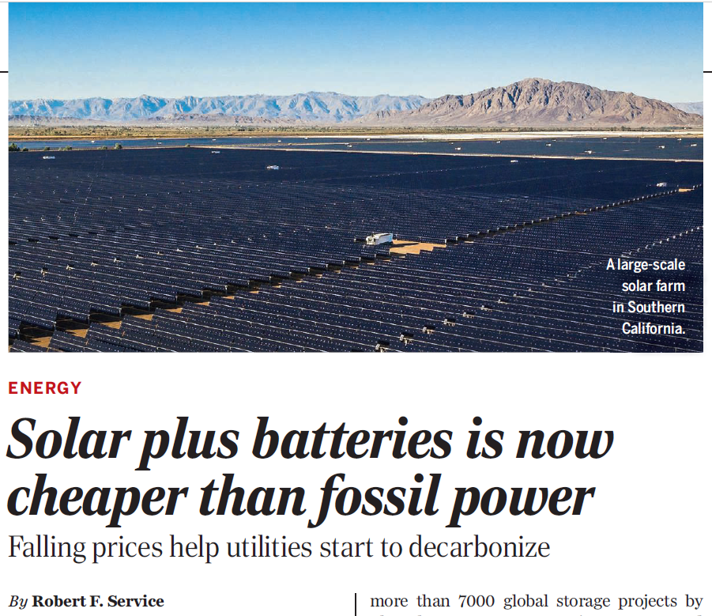

Slide 47
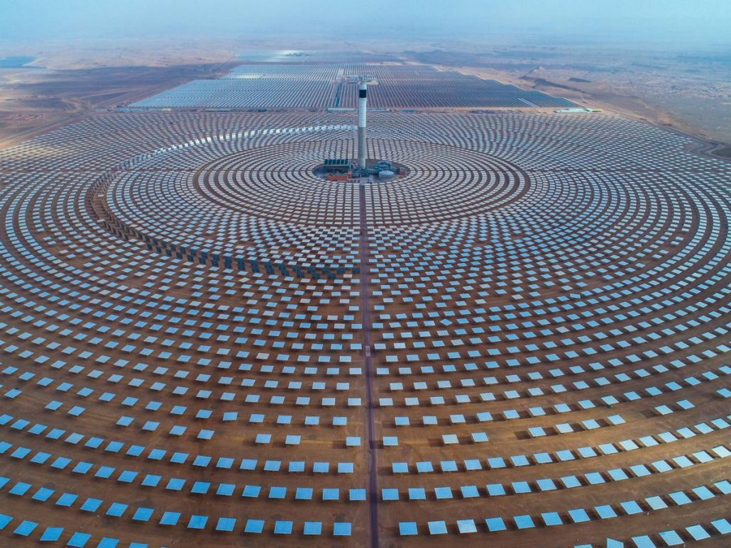
Concentrating Solar Power

Slide 48
The advantages of wind power
Wind turbines are 19th century technology (21st century engineering)!. Solar photovoltaic technology is still being invented.
For physics reasons, the efficiency of a wind turbine (fraction of the available resource captured) is higher than that of a PV collector.
The wind blows at night, and a lot in the winter: the capacity factor is larger than for a solar collector.
The power comes to the turbine, sweeping power from a larger region. Geography can help concentrate the wind power. Solar collectors only collect from the area they cover.

Slide 49
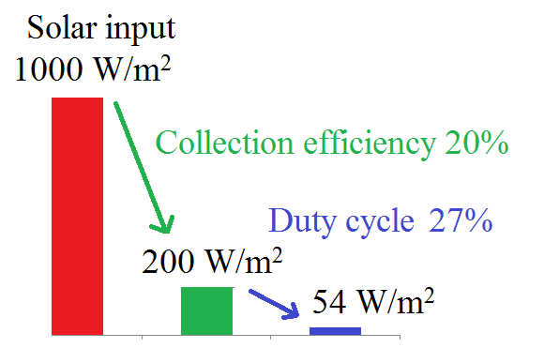
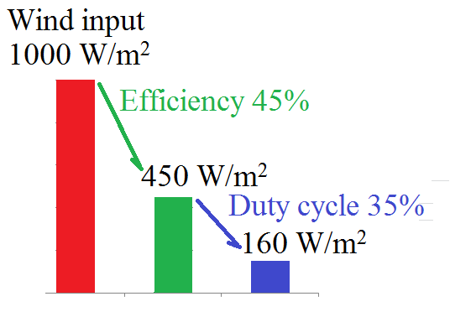
Solar vs. Wind

Slide 50
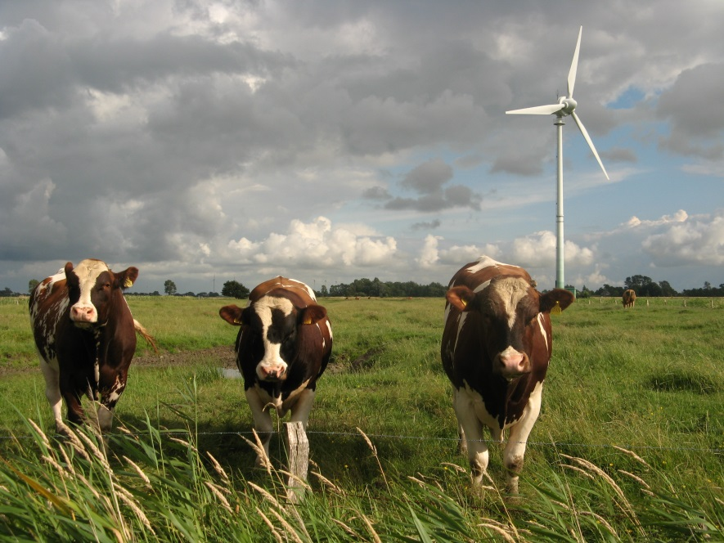
The advantages of wind power
Wind power is compatible with other land uses.
…However, if you have an area with a lot of sun and not much wind, that isn’t good for much else …

Slide 51
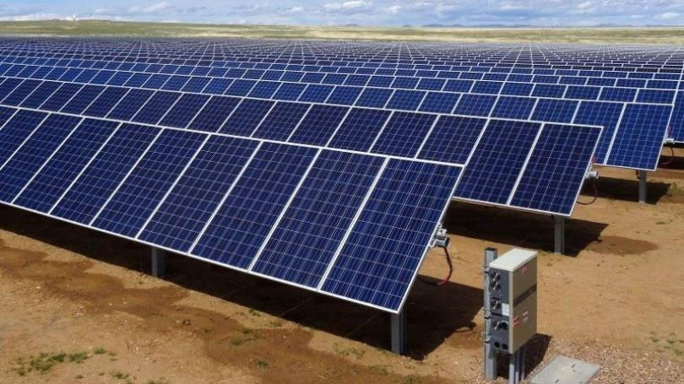

Slide 52
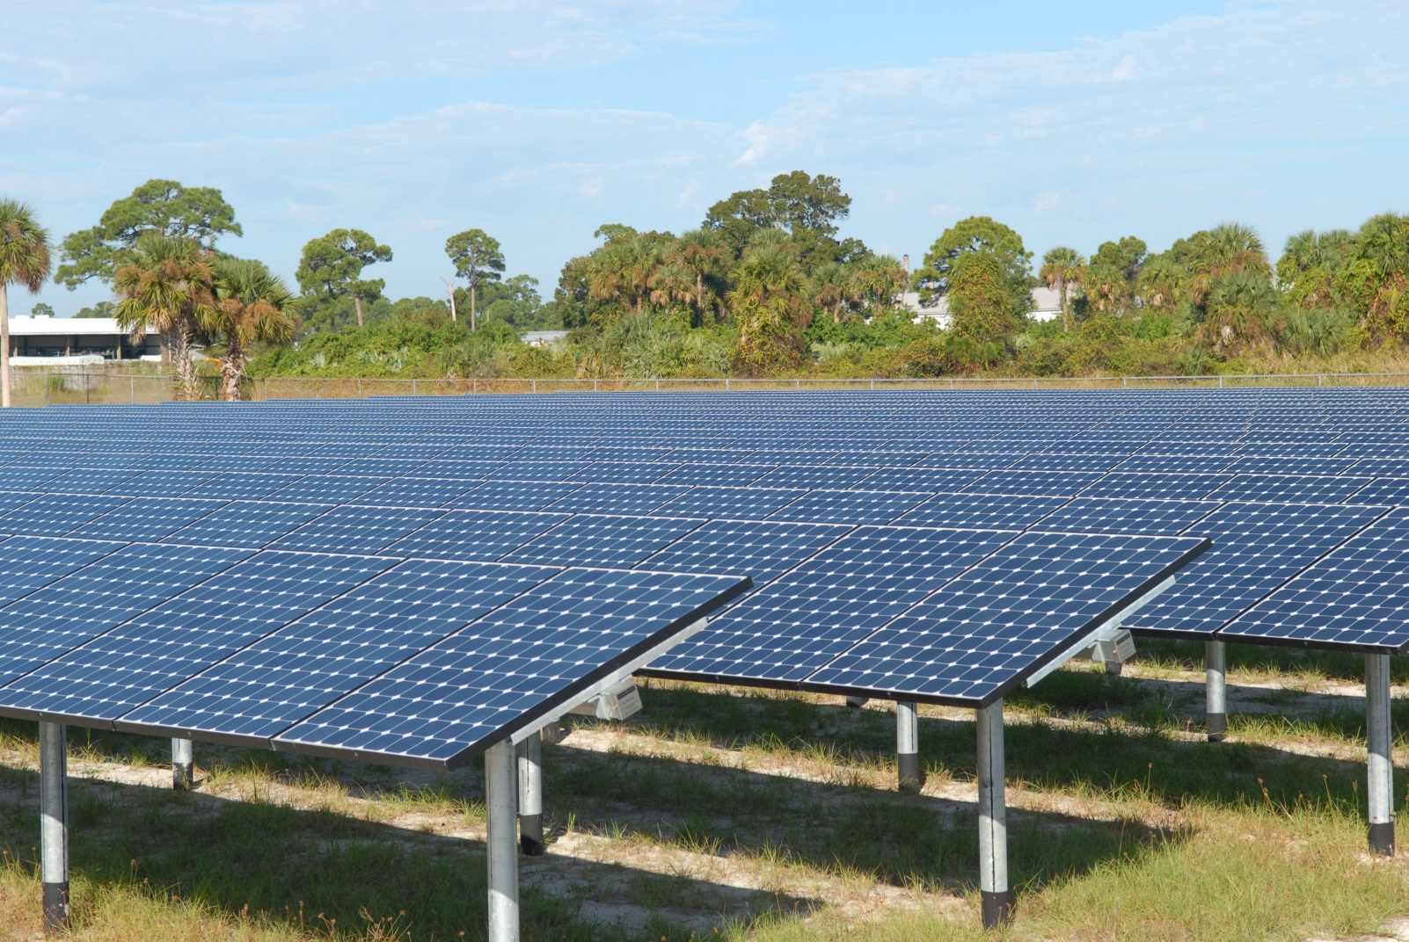
A solar farm takes up land

Slide 53
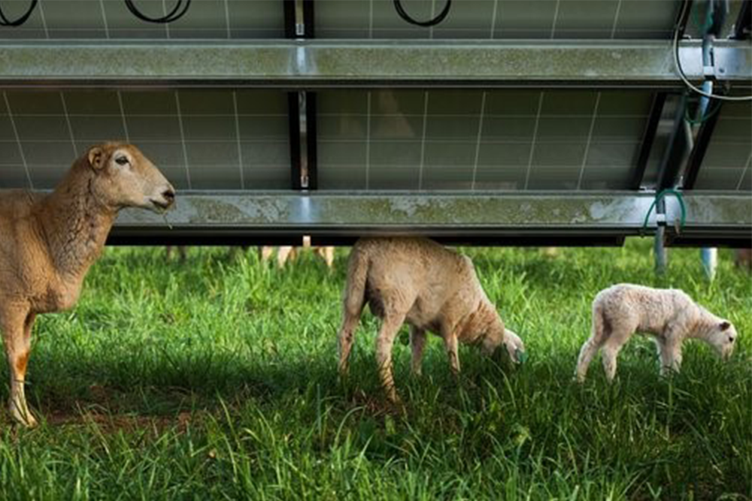
But apparently grass will grow under the panels!

Slide 54
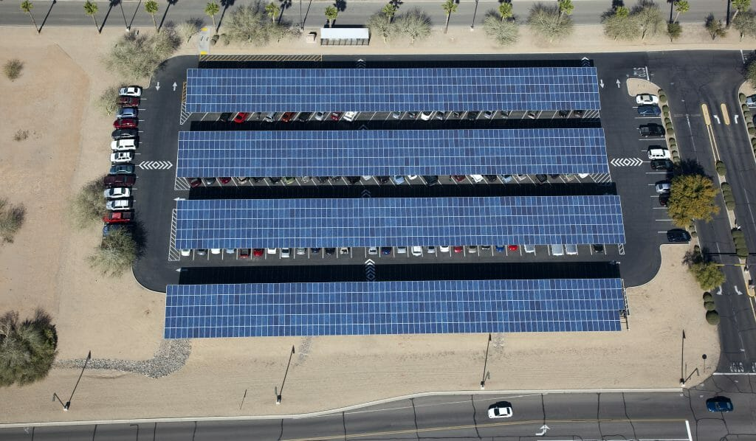
Solar power can be distributed in a way that wind power cannot

Slide 55
Scale-up problems
Solar and wind power production are variable and can change rapidly.
There aren’t good ways to store energy at grid scale. Solar and wind have to be used as they are generated. Conventional power plants can be turned on and off, up and down.

Slide 56
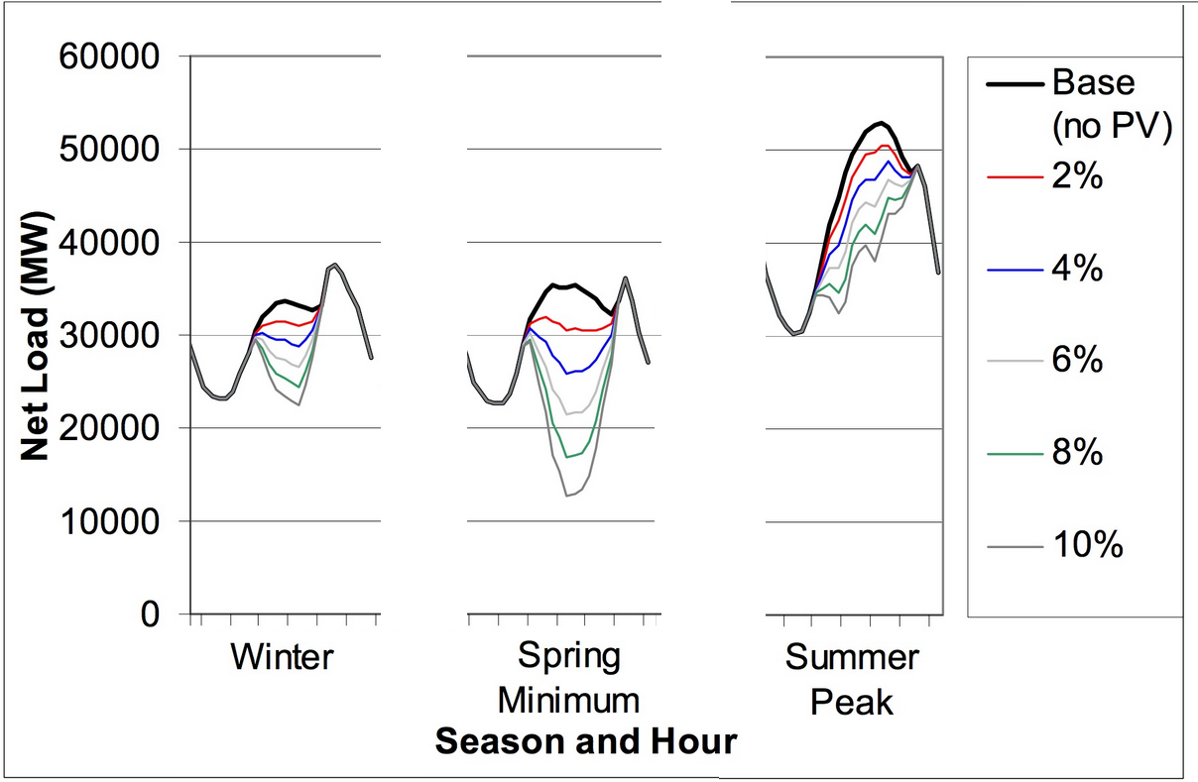
Problems in scaling up: solar overproduces during the day

Slide 57

Solar vs. Wind -- economics
Both solar and wind farms cost about $1 per Watt, installed. Nuclear power plants cost $2/Watt. But the “watt” assumes design conditions: sun shining, wind blowing.
The wholesale price of electricity is $0.045 per kilowatt-hour.

Slide 58
Power the US with (150 km)²!
At current price for solar collectors, it will cost $3 trillion.

Slide 59
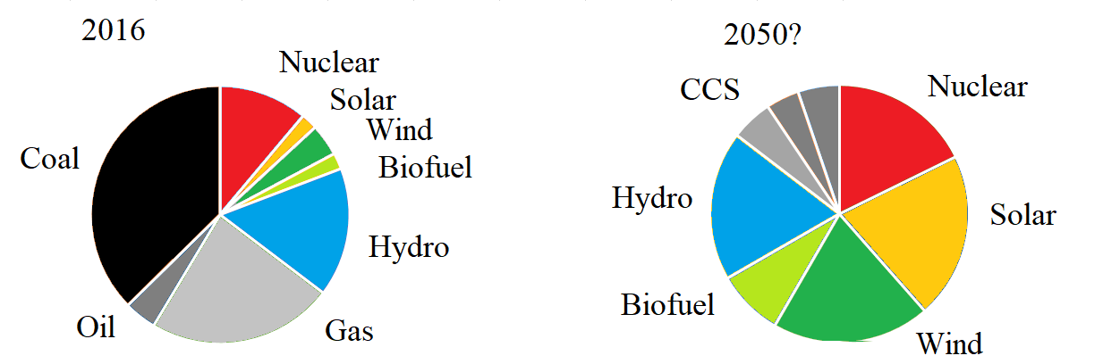
Global Electrical Energy, now and in the future
From Sivaram’s book

Slide 60
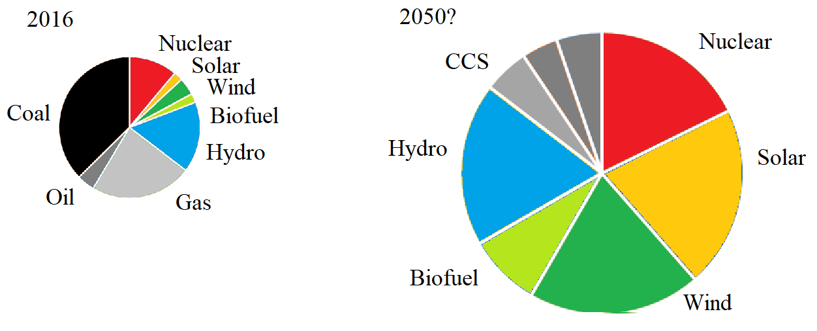
Global Electrical Energy, now and in the future
From Sivaram’s book

Slide 61
Can renewable energy replace fossil fuels?
Science says we can do it, and it’s getting easier all the time.
Economics says we can do it, though it will be a large infrastructure investment.
Politics (what people believe and expect) … .

Slide 62
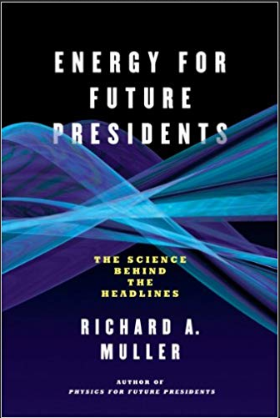
Another useful reference

Slide 63
Questions?

Slide 64
The role of the university
Educate the public, to help them understand the problem and the possible solutions.
Tell people
Global warming is real, it is problem, and we need to do something about it
Nuclear power is safe, and one of the best options for replacing fossil fuels
Solar and wind power will need to be developed wherever it is feasible

Slide 65
The temperature of the earth
Energy comes from the sun in the form of visible light, and leaves in the form of infrared light..
This determines the average temperature of the earth

Slide 66
Greenhouse gases
Water vapor -- 2/3 of the effect
Carbon dioxide (CO₂) -- 1/4
Methane and other gases -- 1/10

Slide 67
Any questions?

Slide 68
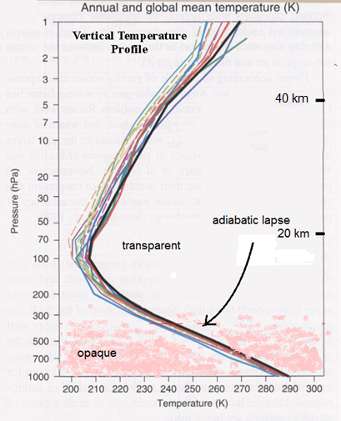
Atmospheric temperature profile
The temperature of the atmosphere decreases with altitude due to adiabatic expansion as air is carried upwards.

Slide 69
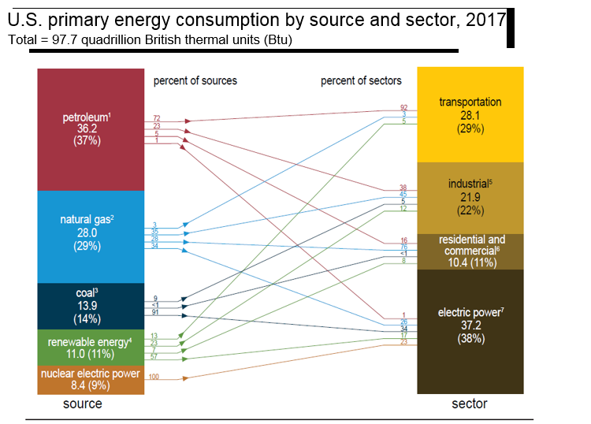

Slide 70
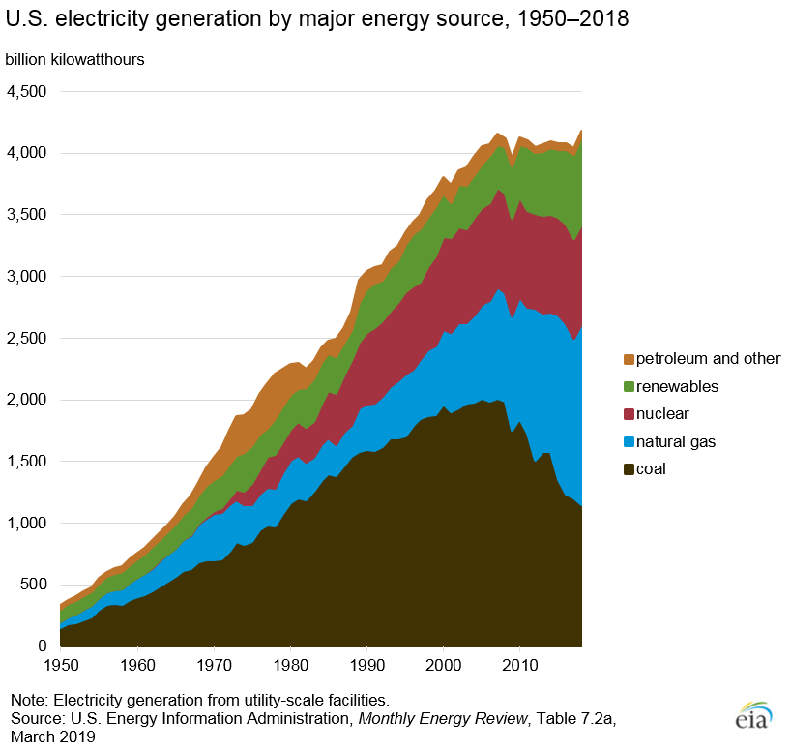
US electricity generation

Slide 71
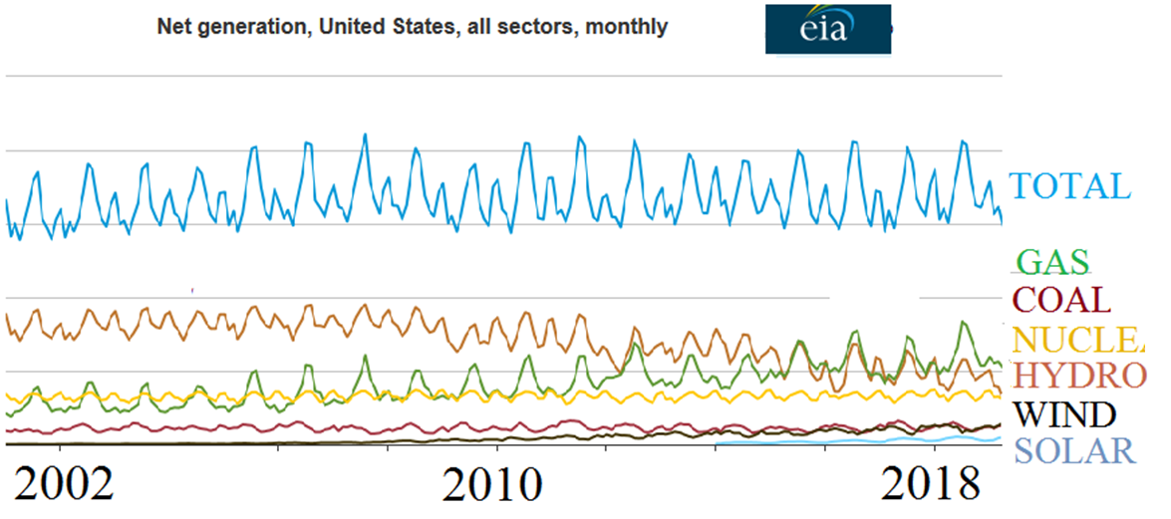
Electricity

Slide 72
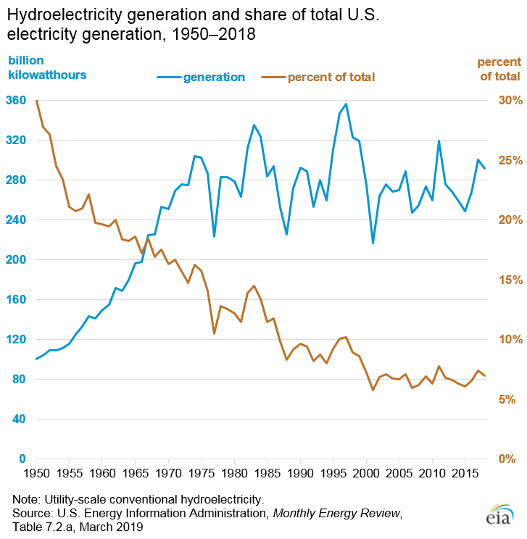

Slide 73
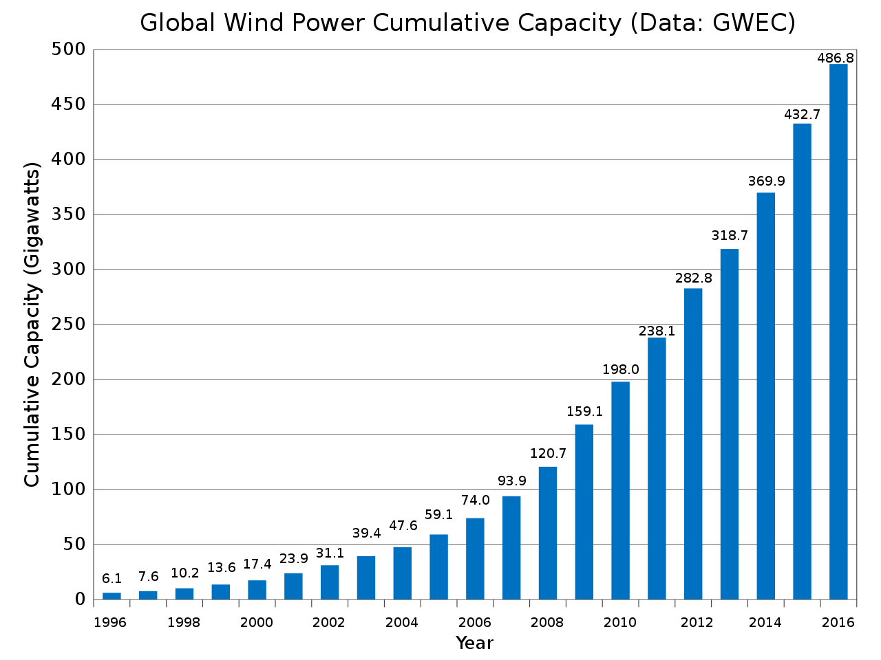

Slide 74


