Slide 1
What can we say/what should we say about global warming?
Joseph P. Straley
University of Kentucky

Slide 2
The global warming issue
People ask
What is this new thing I’m supposed to worry about?
Is this really happening?
Does it matter?
Is there anything we can do about it?
Is there anything I can do about it?

Slide 3
The global warming issue
It starts as a physics problem.
This is a “teachable moment.”
Can we leave it to the “experts” to explain?

Slide 4
The expert you need
… is you.

Slide 5
My version

Slide 6
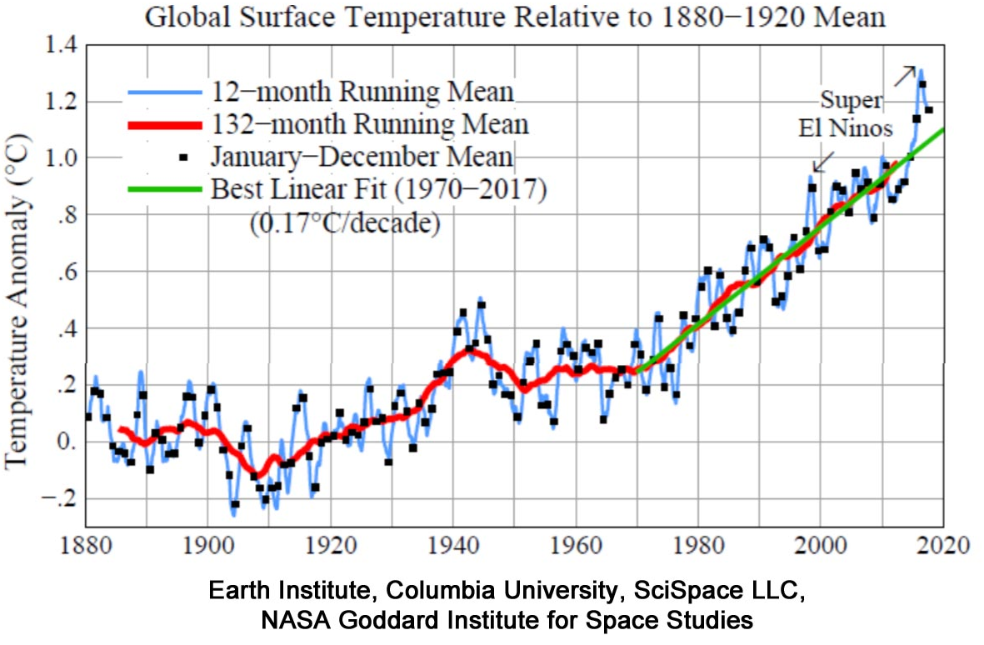
The average temperature is going up

Slide 7
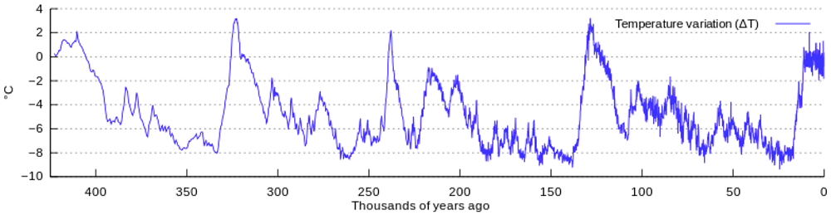
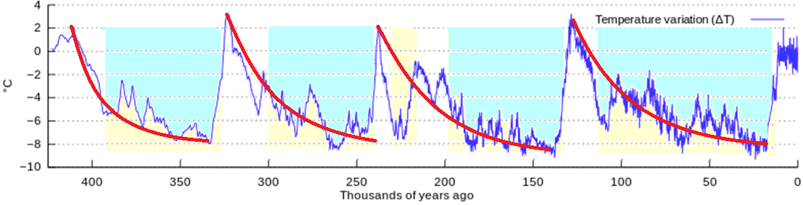
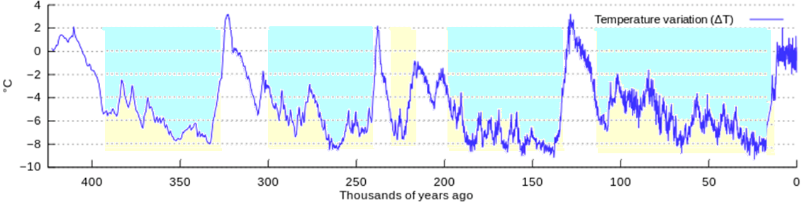
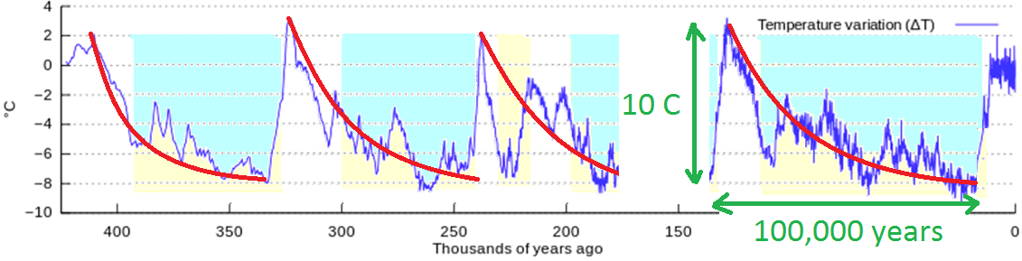
History of the Earth’s Temperature

Slide 8
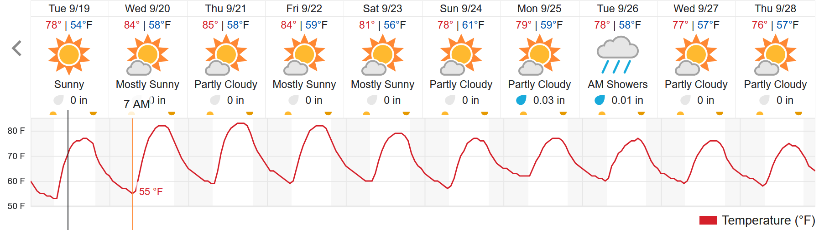
Why does it get cold at night?
Notes:
The temp. goes up during the day, because the sun is delivering energy. At night, the energy leaves again.

Slide 9
Why does it get cold at night?

Slide 10
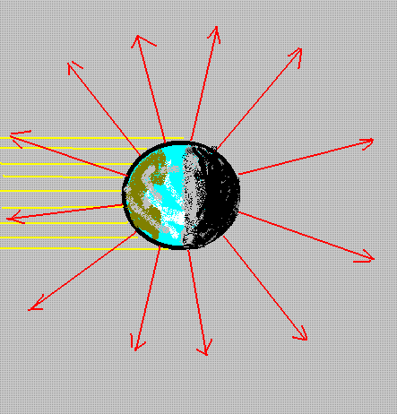
Radiation cools the earth
Energy comes from the sun in the form of visible light, during the daylight hours.
Energy leaves the earth all the time, in the form of infrared light.
The expected temperature of the earth is about 0⁰ F

Slide 11
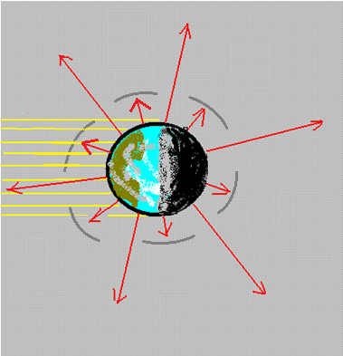
The earth is warmer than expected
The earth is warmer than expected, because some of the energy emitted from the ground is absorbed by the atmosphere. The light coming from the sun is not affected. This raises the temperature of the earth from 0 F to 55 F.
(-15 C to 15 C)

Slide 12
Greenhouse gases
The atmosphere is transparent in the visible, but not in the infrared. This is due to the presence of “greenhouse gases”:
Water vapor -- 2/3 of the effect
Carbon dioxide (CO₂) – 1/4

Slide 13
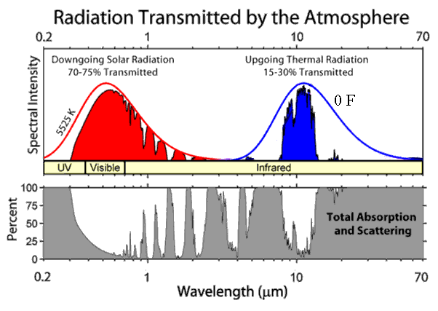
The effect of greenhouse gases
The atmosphere is transparent in the visible, but not in the infrared. This is due to the presence of “greenhouse gases”:

Slide 14
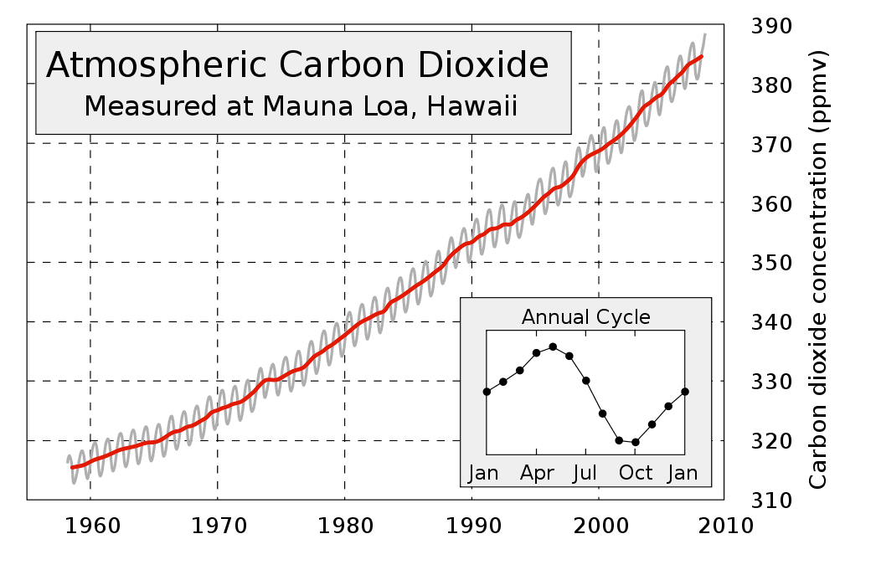
Increasing carbon dioxide
This will increase the amount of absorption of infrared light, which decreases the rate that it escapes from earth.

Slide 15
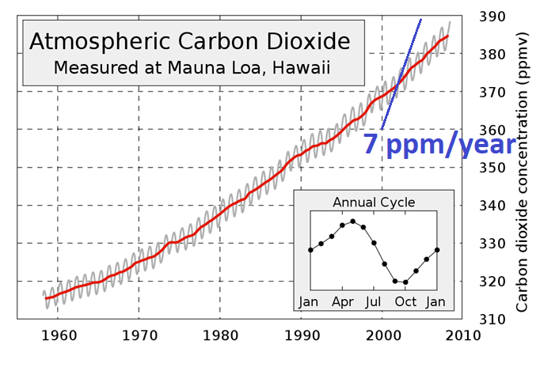
Did humans cause the increase?
It seems likely. We know how much coal and oil we burn in a year.
Notes:
The blue line represents the rate of increase if all the CO2 we produce stayed in the atmosphere.

Slide 16
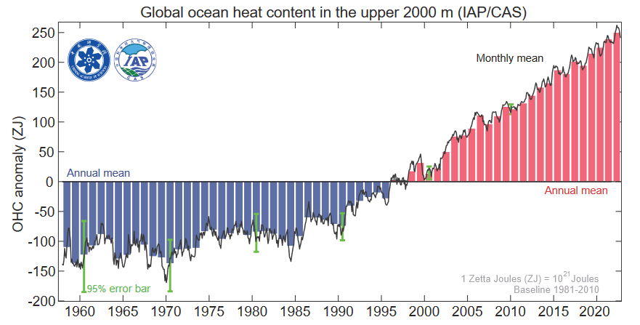

Slide 17
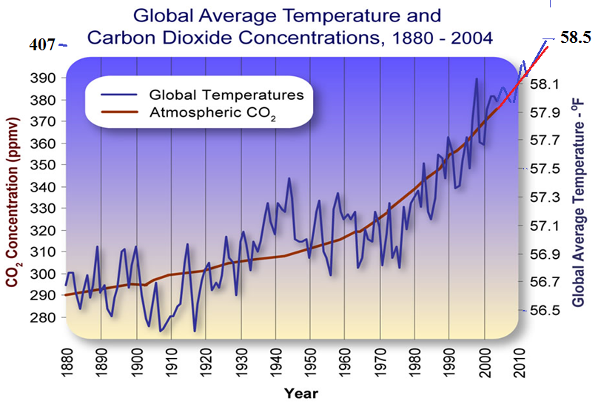
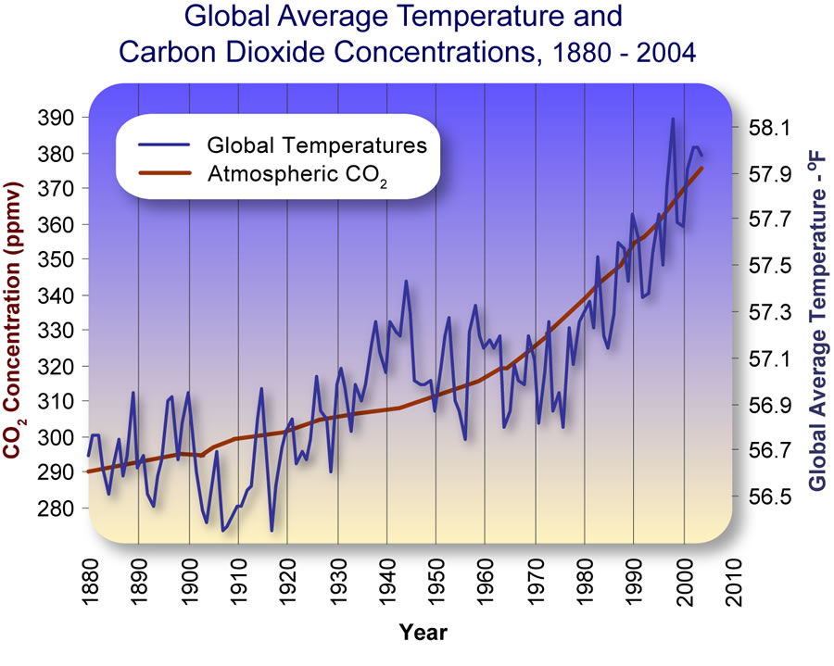
Overlaying two graphs

Slide 18
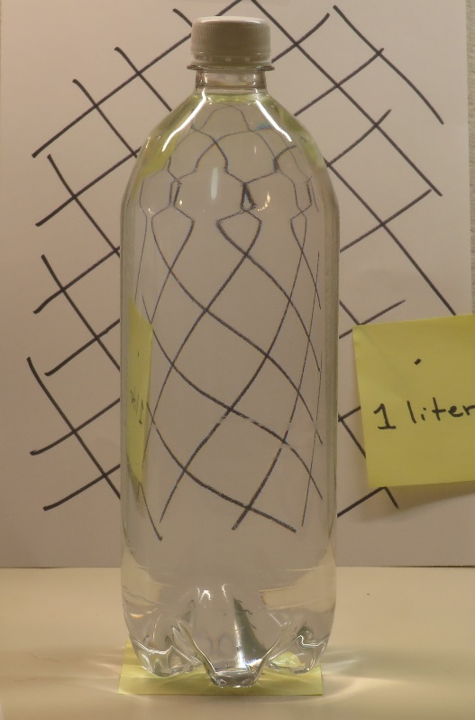
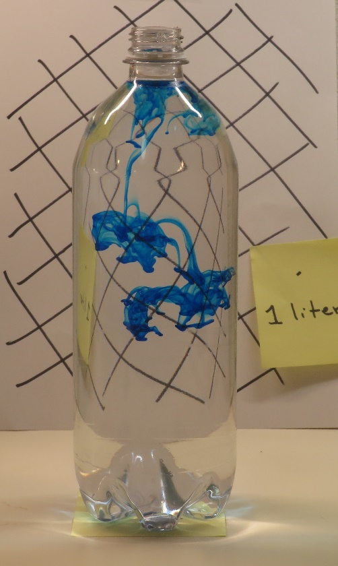
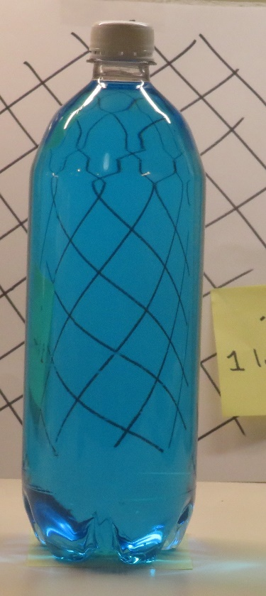
How much is 200 ppm?
1000 ml of water
+ 1 drop (0.2 ml) of food color
0.2 ml/1000 ml = 200 ppm

Slide 19
CO₂ stays the atmosphere for a long time
Ocean surface water can’t absorb more. The deep ocean can absorb more.
Weathering of rocks permanently removes CO₂
These are both slow processes, with time scales of thousands of years. The CO₂ we add to the atmosphere is permanently resident, so far as human time scales are concerned.

Slide 20
Plants take up CO₂
That’s why there is an oscillation in the CO₂ concentration.
But plants die, leaves rot: it gets returned to the atmosphere. Carbon is not being removed rom the atmosphere.

Slide 21
Greenhouse gases, again
The amount of water in the atmosphere is determined by the temperature. It isn’t changing significantly.
Methane doesn’t last very long (a few years).
Carbon dioxide dissolves in the ocean, but has saturated the surface water.
Carbon dioxide is taken up by plants, but this doesn’t give long-term storage.

Slide 22
It’s a theory
The CO₂ content of the atmosphere is cumulative of all burning of fossil fuels.
The amount of CO₂ in the atmosphere is steadily rising, and this will continue as long as we continue to burn fossil fuels.
It is a permanent change (on a 500-year time scale).
The average temperature of the earth is increasing.
The temperature of the earth will continue to rise along with the CO₂ content. This is also a permanent change.

Slide 23
Is this a problem?

Slide 24
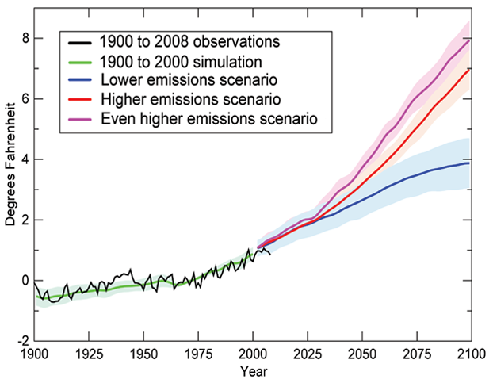
Intergovernmental Panel on Climate Change 2009 Temperature Predictions
Cutting back a little, the temperature “only” rises 2⁰ C.
Continuing growth of fossil energy use gives 5⁰ increase.

Slide 25
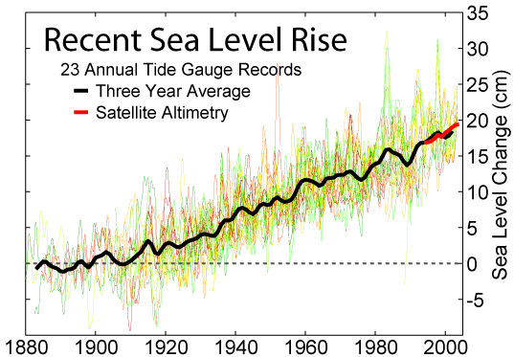
What are the implications of temperature change?
Sea level changes
Changes in weather
Changes in rainfall patterns
New weeds, new insects, new diseases
Need new crops

Slide 26
Why do we care?
People, plants, and insects are accommodated to the climate they now have.
Sea level change could affect a lot of people.
We don’t know what is going to happen. There could be significant change within your lifetime.

Slide 27
Heat waves? Forest fires? Hurricanes?
…Maybe.
Sea Level rising? Changing ecology?
… It seems likely

Slide 28
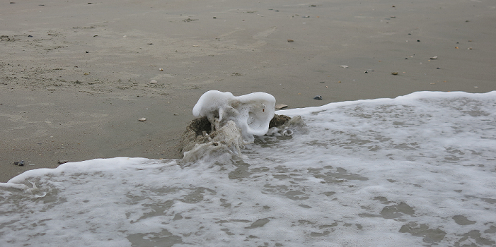
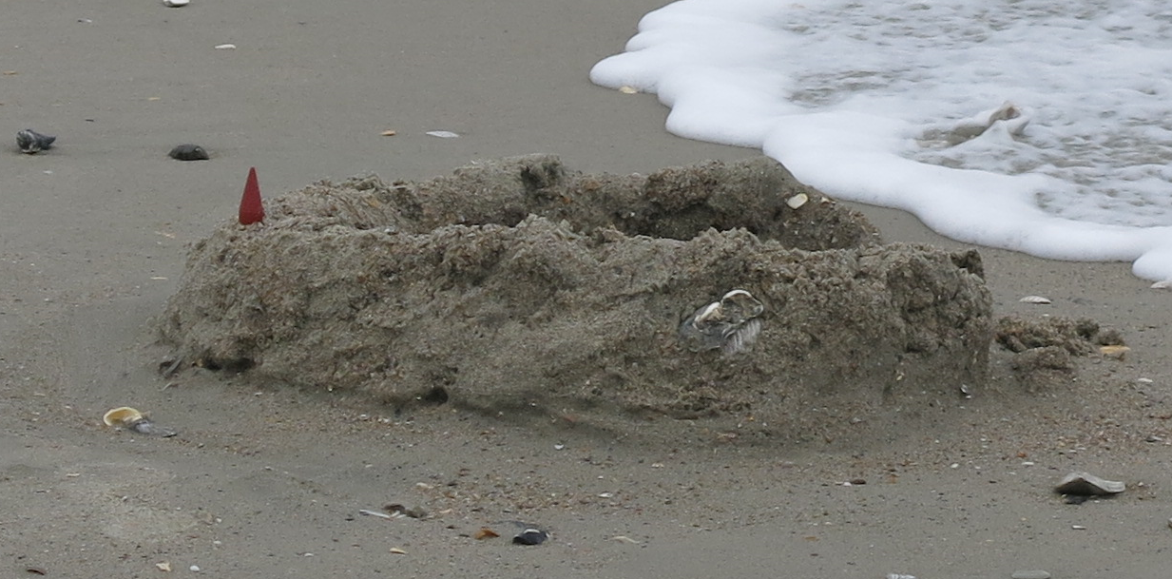
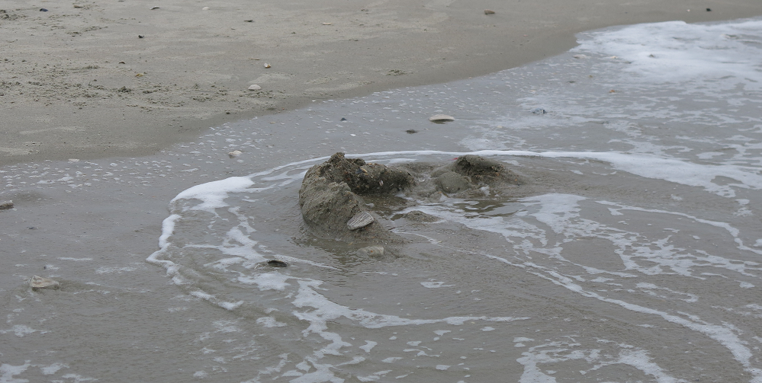
Sandcastle history
Notes:
The sandcastle was destroyed by a wave. But the real cause was the rising tide.

Slide 29
What can we say? What should we say?
Keep it short, logical, accessible
Don’t even try to master all the details
Get your argument clear in your mind
Don’t overstate the case: be credible

Slide 30
The expert you need
… is you.
IPCC reports
(Intergovernmental Panel on Climate Change)
https://climate.nasa.gov

Slide 31
Questions?

Slide 32
Intergovernmental Panel on Climate Change 2009 Temperature Predictions
If we stop burning fossil fuels tomorrow, the temperature will rise a little more to a final value.

Slide 33
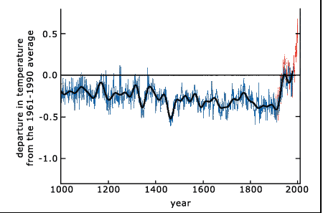
History of the earth’s temperature

Slide 34
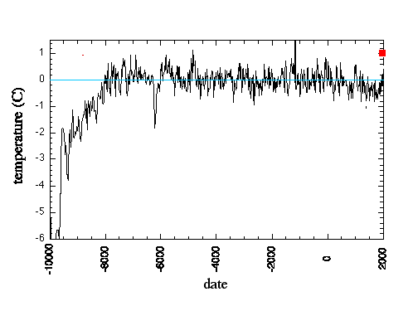
History of the earth’s temperature

Slide 35
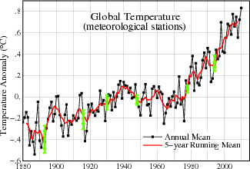
Is the temperature increasing?

Slide 36
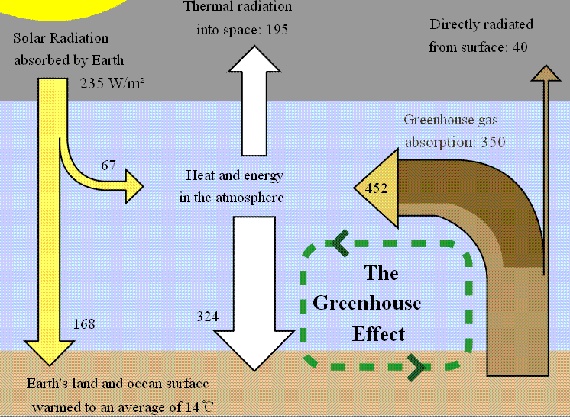
Greenhouse effect

Slide 37
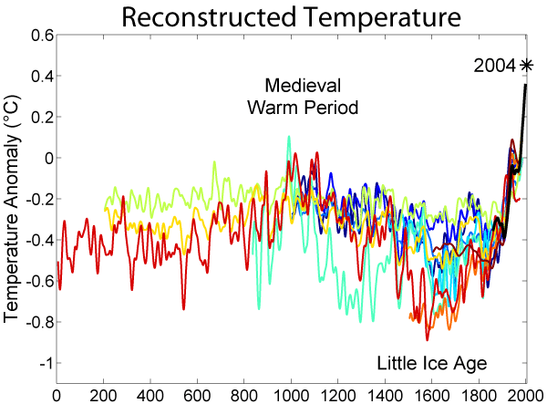
Is the temperature increasing?

Slide 38
Apparently, the earth is getting warmer
It amounts to about 2 Fahrenheit degrees over the last century; but the earth seems to be warmer than it has been over the last 10000 years, and most of the increase came recently.
This might mean that the greenhouse effect is increasing, or that sun is getting brighter, or that the earth is absorbing sunlight more – or that the measurements are wrong.

Slide 39
The effect of greenhouse gases
The atmosphere is transparent in the visible, but not in the infrared. This is due to the presence of “greenhouse gases”:

Slide 40
Can we calculate the effect of CO₂ on the temperature of the earth?
This is hard, because of feedback effects.
Increasing temperature → more water vapor
Increasing water vapor → more clouds
Increasing temperature → less snow and ice
Increasing temperature → more CO₂
The temperature rise is slow, because we have to warm the whole ocean and melt a lot of ice

Slide 41
Feedback
“Positive feedback”
Increasing the temperature of the Arctic Ocean causes the surface ice to melt. Open water absorbs sunlight, ice reflects it: this increases the amount of power going into the Arctic Ocean, and makes it still warmer.

Slide 42
Feedback
“Negative feedback”
Increasing the temperature of the Caribbean Sea causes more water to evaporate. Later, this water condenses to form clouds. Clouds refect sunlight, decreasing the amount of power someplace.

Slide 43
Feedback
Negative feedback makes a system more stable: every change is opposed.
Positive feedback amplifies the effect of external forcings, and makes it less stable.
Increase = forcing + C* increase
Increase = forcing/(1 – C)
If C becomes larger than 1, the system is unstable.

Slide 44
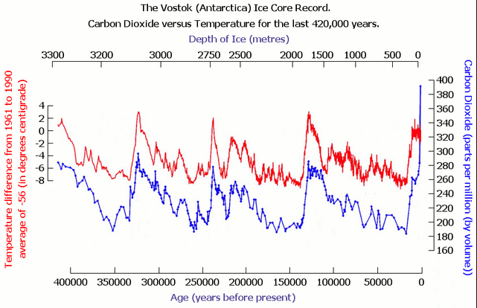
History of the earth’s temperature

Slide 45
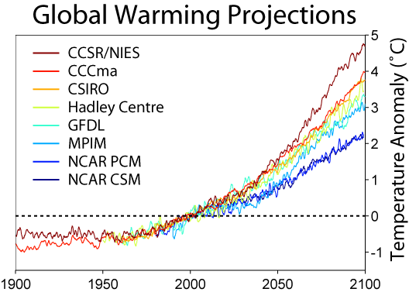
Temperature predictions

Slide 46
Greenhouse effect

Slide 47
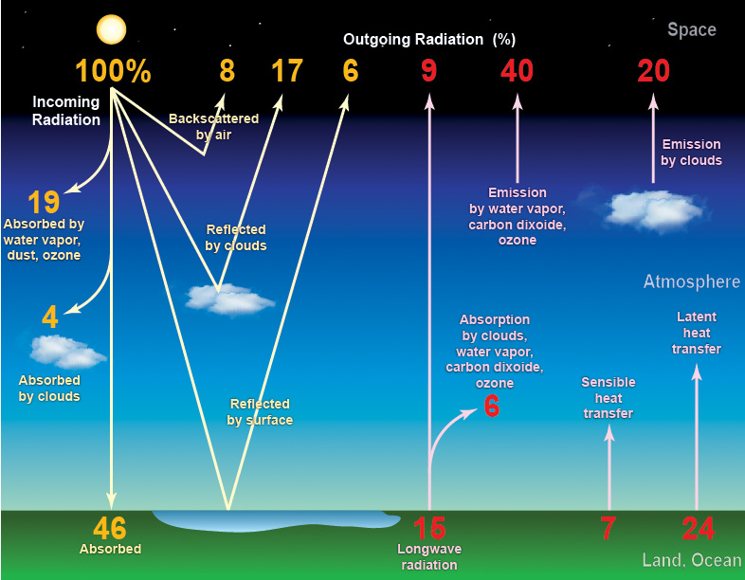
Energy balance of the earth

Slide 48
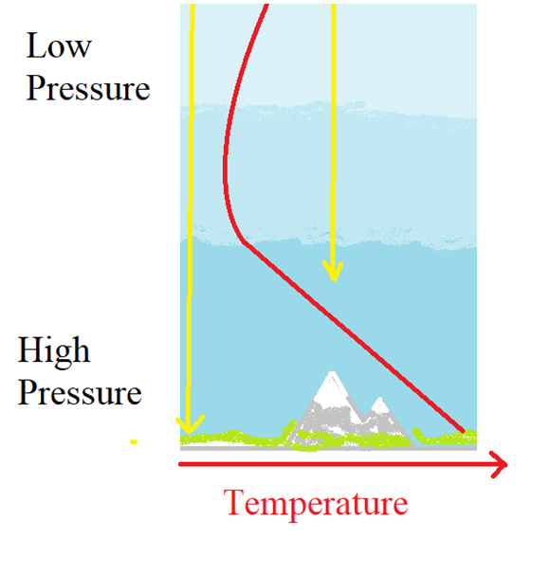
Adiabatic lapse
The atmosphere is heated from below. “Warm air rises” so this can be unstable.
But when air rises, it expands and cools. This counteracts the instability, if the temperature gradient is small.
In reality, the atmosphere is at the edge of stability: dT/dz = -10 C⁰/km

Slide 49
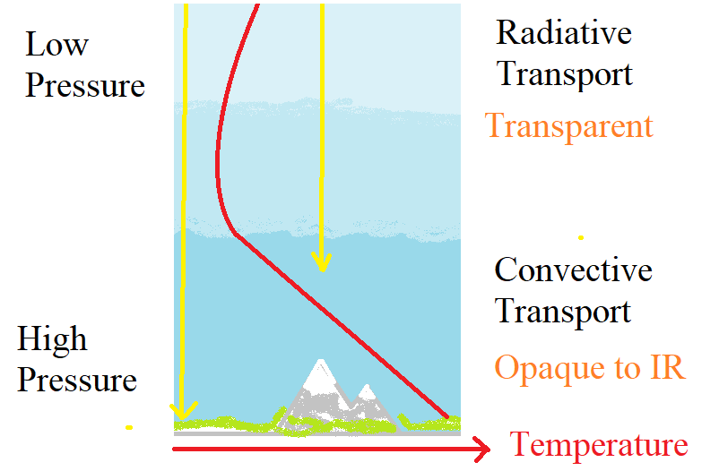
Optical depth for infrared
Above, the air is transparent to infrared; below, it is opaque. The dividing line is the bottom of the stratosphere. The temperature there
(-55 C) is determined by equality of radiation out and radiation in.

Slide 50
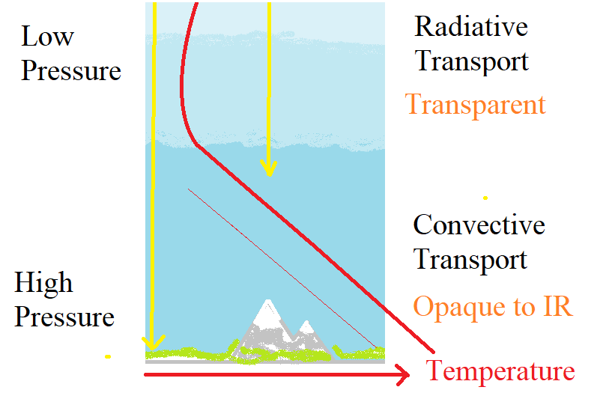
Why CO₂ makes the earth warmer
Carbon dioxide (and methane and water vapor) make the air more opaque to IR. It raises the height at which the atmosphere becomes opaque. The lower branch of the temperature graph moves up, and the surface gets warmer.

