Slide 1
Symmetry in Physics

Slide 2



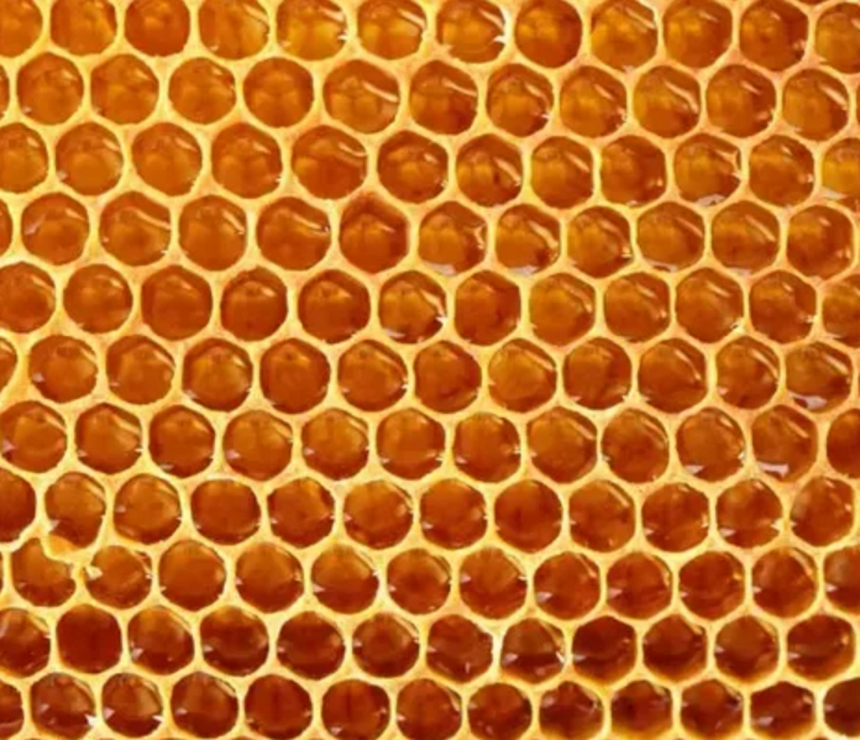


Symmetry in space

Slide 3
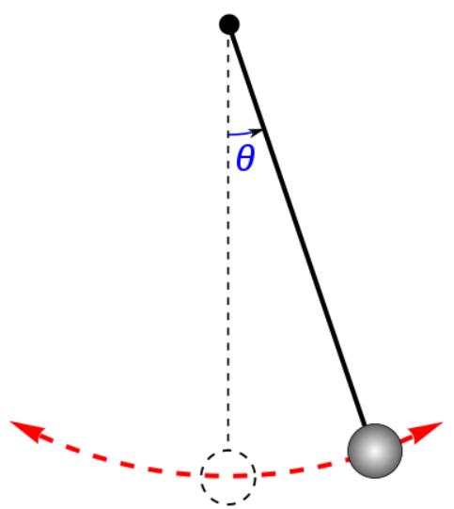
Symmetry sometimes makes things easier
Average of sin(ϴ) as the pendulum swings
Average of cos(ϴ)
Even function: f(x) = f(-x)
Odd function: f(x) = -f(-x)
This happens when there is a symmetry operator A such that A² = 1

Slide 4

Other symmetries:
What if A³ = 1?
What of A⁵ = 1?

Slide 5
Group theory
There is a branch of mathematics which studies the implications of symmetry. It leads to a very useful classification of groups and group operators.
Group theory has played important roles in solid state physics and in high energy physics.

Slide 6
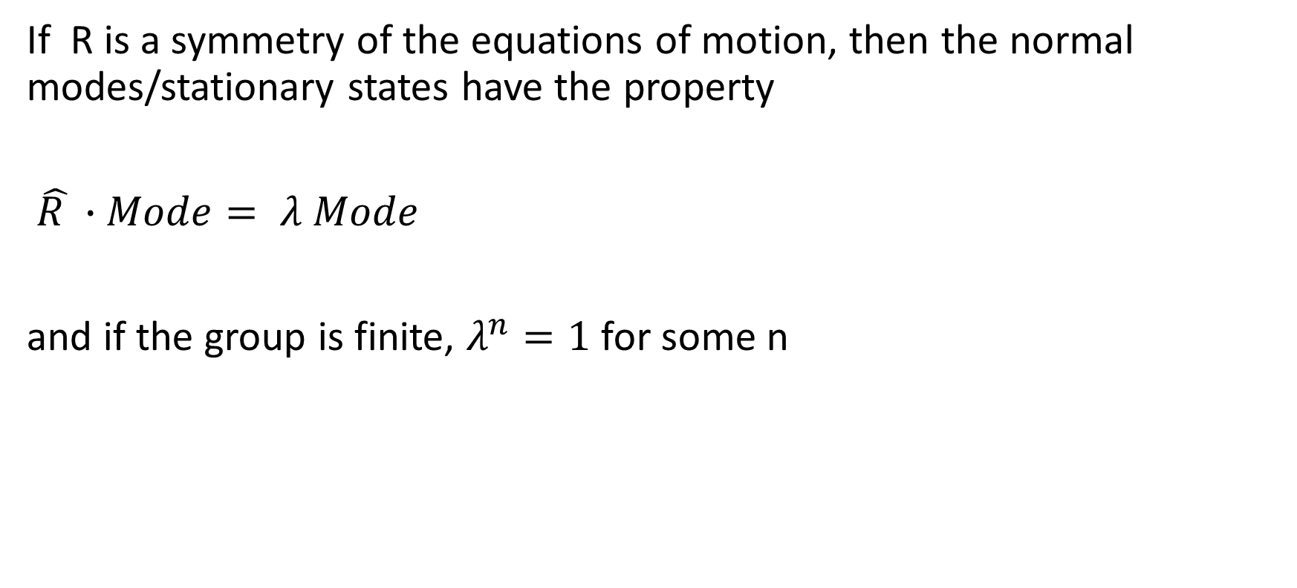
A general property
If R is a symmetry of the equations of motion, then the normal modes/stationary states have the property
$\hat{R }∙Mode= λ Mode$
and if the group is finite, $λ^{n}=1$ for some n

Slide 7
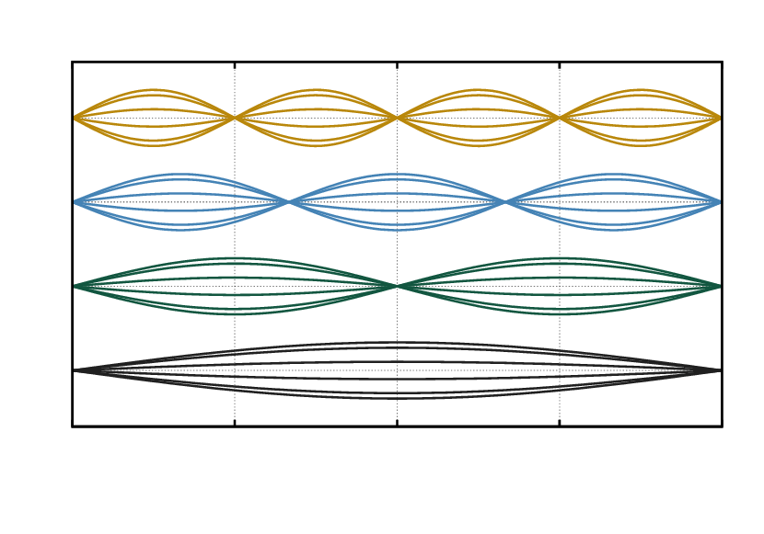
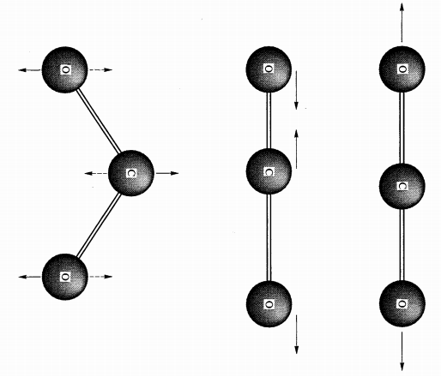
Symmetry sometimes makes things easier
Vibrating string: the middle point of the string must be a node or an antinode
Vibrational modes of a molecule

Slide 8
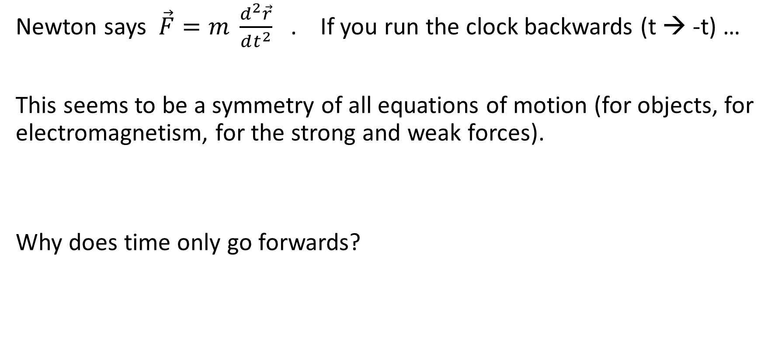
Time reversal
Newton says $\vec{F}=m \frac{d^{2}\vec{r}}{dt^{2}}$ . If you run the clock backwards (t → -t) …
This seems to be a symmetry of all equations of motion (for objects, for electromagnetism, for the strong and weak forces).
Why does time only go forwards?

Slide 9
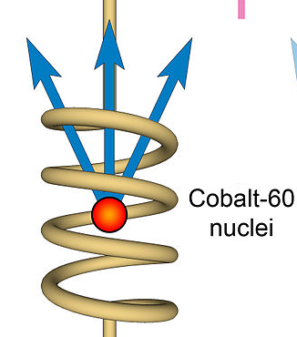

Parity
If you replace $\vec{r}$ by -$\vec{r}$ (which is a mirror reflection + a 180º rotation).
Vectors reverse direction. But cross products $\vec{A} × \vec{B}$ don’t.
Newton’s laws, gravity, electromagnetism, and the strong force don’t care about the parity transformation.
But the weak interaction does! In fact, all neutrinos are “left-handed.”

Slide 10
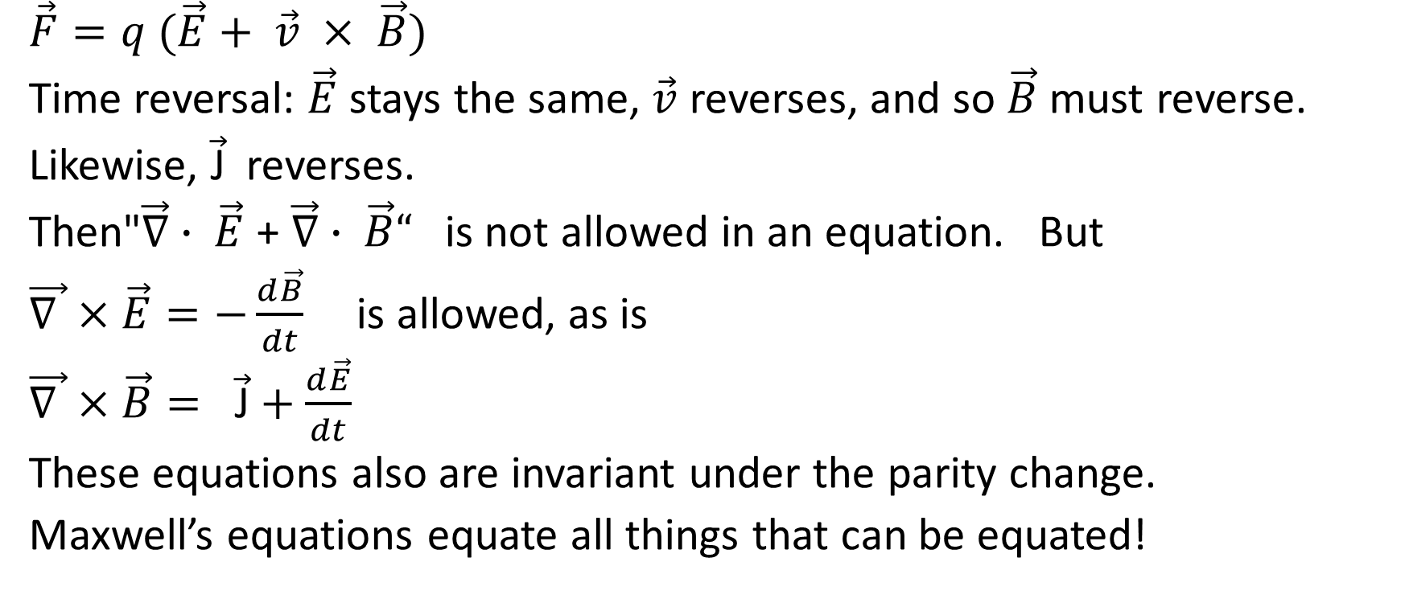
Example: Electromagnetism
$\vec{F}=q (\vec{E}+ \vec{v} × \vec{B})$
Time reversal: $\vec{E}$ stays the same, $\vec{v}$ reverses, and so $\vec{B}$ must reverse.
Likewise, $\vec{\text{J}}$reverses.
Then"$\vec{∇}∙ \vec{E}$ + $\vec{∇}∙ \vec{B}“$ is not allowed in an equation. But
$\vec{∇ }×\vec{E}=−\frac{d\vec{B}}{dt}$ is allowed, as is
$\vec{∇ }×\vec{B}= \vec{\text{J}}+\frac{d\vec{E}}{dt}$
These equations also are invariant under the parity change.
Maxwell’s equations equate all things that can be equated!

Slide 11
Another symmetry
Every particle has a corresponding antiparticle. They have opposite charge, the opposite parity; an positron can be regarded to be a time-reversal electron.
We imagine a “mirror” which turns particles into antiparticles.
Is the antineutrino its own antiparticle? We don’t know yet!

Slide 12
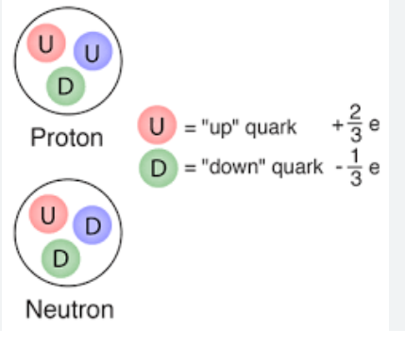
Another (almost) symmetry
The mass of the neutron and the proton are almost the same. Perhaps they are different states of the same particle?
The quark model: there are two particles, U and D, which are “mirror images” in a new kind of mirror.

Slide 13
Why is the universe made of matter, with no antimatter?
Perhaps there is a decay process which is different for matter and antimatter: it breaks charge-reversal symmetry.
Perhaps the situation is like a magnet: the symmetry is broken by its history. Then there might be antimatter universes, somewhere beyond the event horizon.

Slide 14
Continuous symmetries
All the previous symmetries were “discrete” just a few possible operators.
There are “continuous” symmetries:
*Space translation (changing origin of the coordinate system)
*Time translation (resetting the clock)
*Rotation (changing the reference for angle)
Physics often has these symmetries

Slide 15
Noether theorem
Every continuous symmetry creates a conserved quantity:
*Translation in space → conservation of momentum
*Translation in time →conservation of energy
*Rotational symmetry → conservation of angular momentum
*”Gauge symmetry” → conservation of charge

Slide 16

Exchange symmetry
Microscopic physics is described by a “wavefunction” Ψ.
|Ψ|² tells you the probability of a configuration
Identical particles have “exchange symmetry”
>> Ψ(x₁,x₂, …) = Ψ(x₂,x₁, …) boson
>> Ψ(x₁,x₂, …) = - Ψ(x₂,x₁, …) fermion

Slide 17
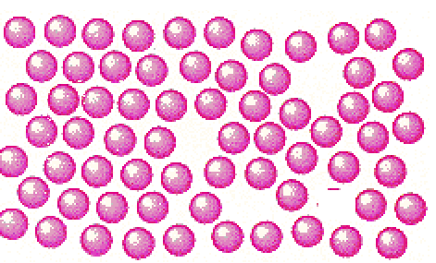
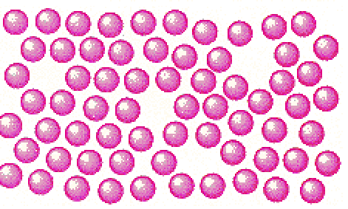
Exchange symmetry
Weakly interacting bosons can have a wavefunction made of just one single-particle state
Ψ(x₁,x₂,x₃,… ) = f(x₁) f(x₂) f(x₃) …
… as long as the particles don’t overlap

Slide 18
Sometimes symmetry makes physics harder
Microscopic physics is described by a “wavefunction” Ψ.
|Ψ|² tells you the probability of a configuration
Identical particles have “exchange symmetry”
>> Ψ(x₁,x₂, …) = Ψ(x₂,x₁, …) boson
>> Ψ(x₁,x₂, …) = - Ψ(x₂,x₁, …) fermion

Slide 19
Exchange symmetry
Fermions have to be more complicated, because
Ψ(x₁,x₂, … ) = 0 whenever x₁ = x₂.
Informally, each fermion must be doing something different or be at a different place: The Pauli Exclusion Principle
This is not an interaction. It is a symmetry.

Slide 20
This symmetry makes things more complicated
For two noninteracting particles, choose wavefunctions f(x) and g(x).
Ψ(x₁,x₂) = f(x₁) g(x₂) - f(x₂) g(x₁)
For three noninteracting particles,
Ψ(x₁,x₂,x₃) = f(x₁) g(x₂) h(x₃) + g(x₁) h(x₂) f(x₃) + h(x₁) f(x₂) g(x₃)
- g(x₁) f(x₂) h(x₃) - f(x₁) h(x₂) g(x₃) - h(x₁) g(x₂) f(x₃)
For ten noninteracting particles,
Ψ(x₁,x₂,x₃,… ) = 3,628,800 terms …..

Slide 21
Who’s a fermion?
Electrons
Protons
Neutrons
Neutrinos
Nuclei with odd mass number
Atoms with an odd number of electrons + protons + neutrons
Bosons: photons , nuclei and atoms with an even number of particles, and excitations of matter that leave all the particles in place, such as phonons.

Slide 22
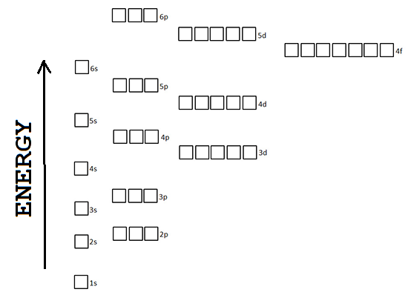
A familiar example
The single-particle states of an atom
Each electron goes in a different state – the lowest energy available.
A complication: there are two kinds of electrons.
This explains a lot about the chemical properties of different elements.

Slide 23
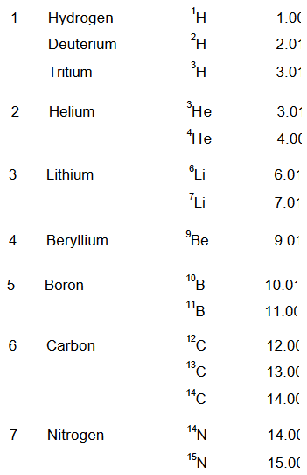
Stable isotopes
Chemically identical elements with different atomic weights.
What is the rule that explains which combinations of charge and mass are allowed?
Nuclei are made of protons and neutrons.

Slide 24
Stable isotopes
Chemically identical elements with different atomic weights.
What is the rule that explains which combinations of charge and mass are allowed?
E = mc²
→low mass means low energy

Slide 25
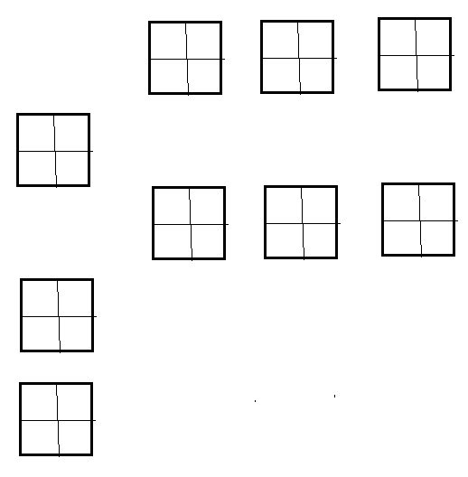
Stable isotopes
There’s a similar diagram!
But now there are two kinds of fermions involved:
Proton has charge
Neutron does not
But their masses are almost the same.
Neutrons can turn into protons by radioactive decay when this decreases the atomic mass.

Slide 26
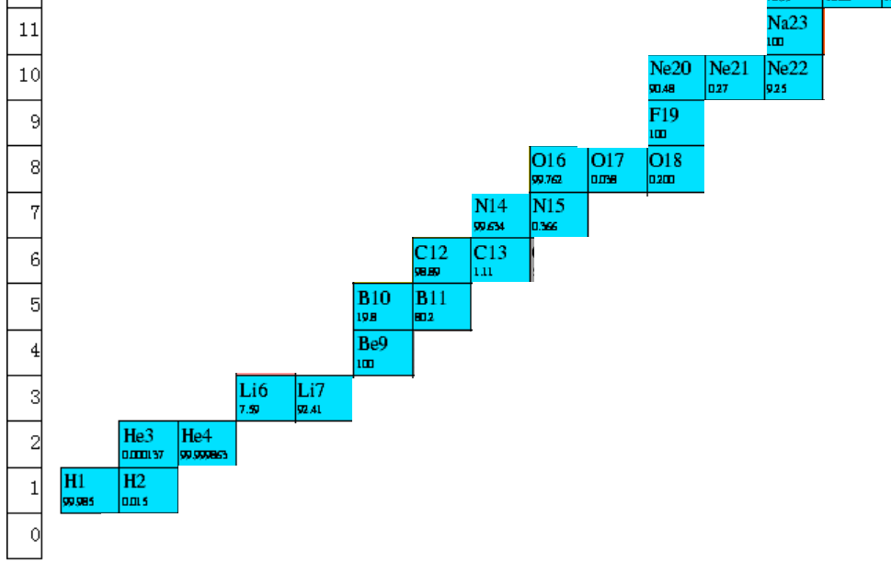
Isotope chart

Slide 27
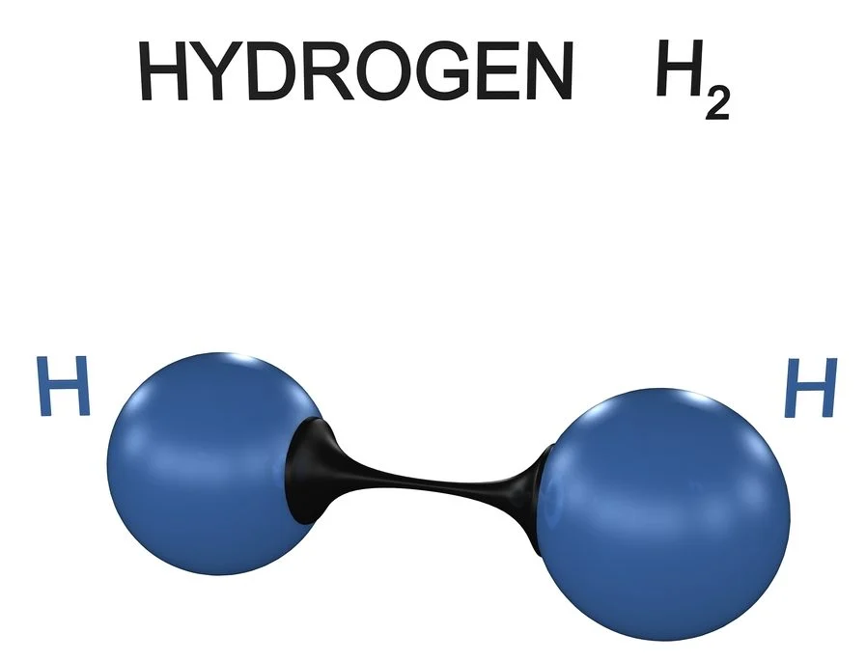
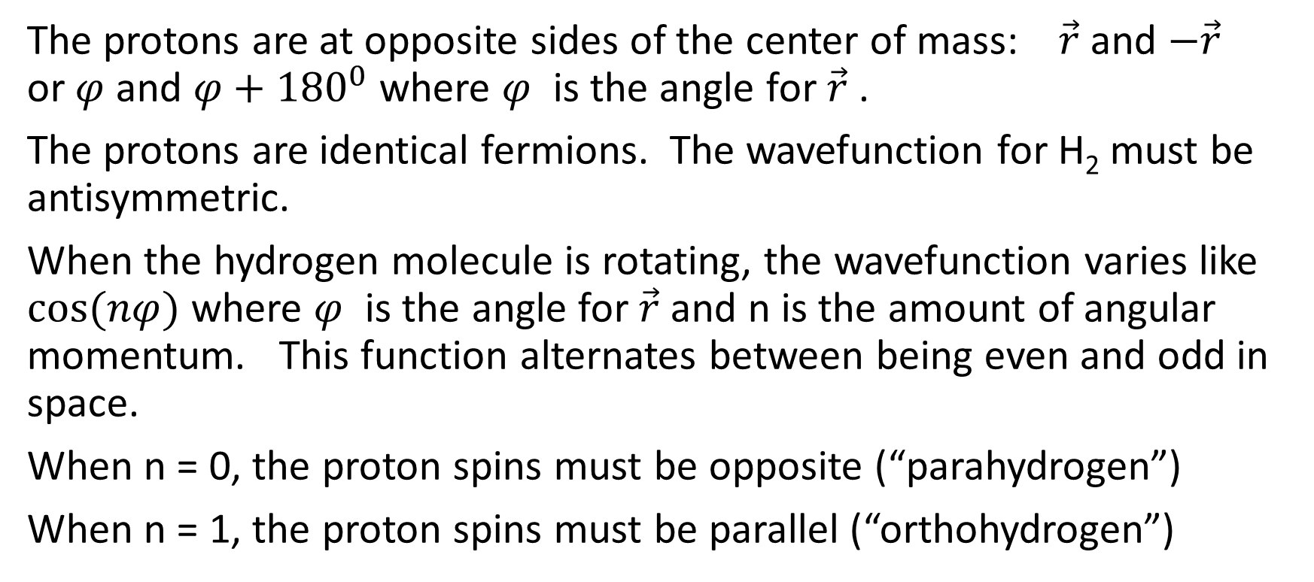
Rotating hydrogen molecule H₂
The protons are at opposite sides of the center of mass: $\vec{r}$ and $−\vec{r}$ or $φ$and $φ+{180}^{0}$where $φ$ is the angle for $\vec{r}$ .
The protons are identical fermions. The wavefunction for H₂ must be antisymmetric.
When the hydrogen molecule is rotating, the wavefunction varies like $cos⁡(nφ)$ where $φ$ is the angle for $\vec{r}$ and n is the amount of angular momentum. This function alternates between being even and odd in space.
When n = 0, the proton spins must be opposite (“parahydrogen”)
When n = 1, the proton spins must be parallel (“orthohydrogen”)

Slide 28
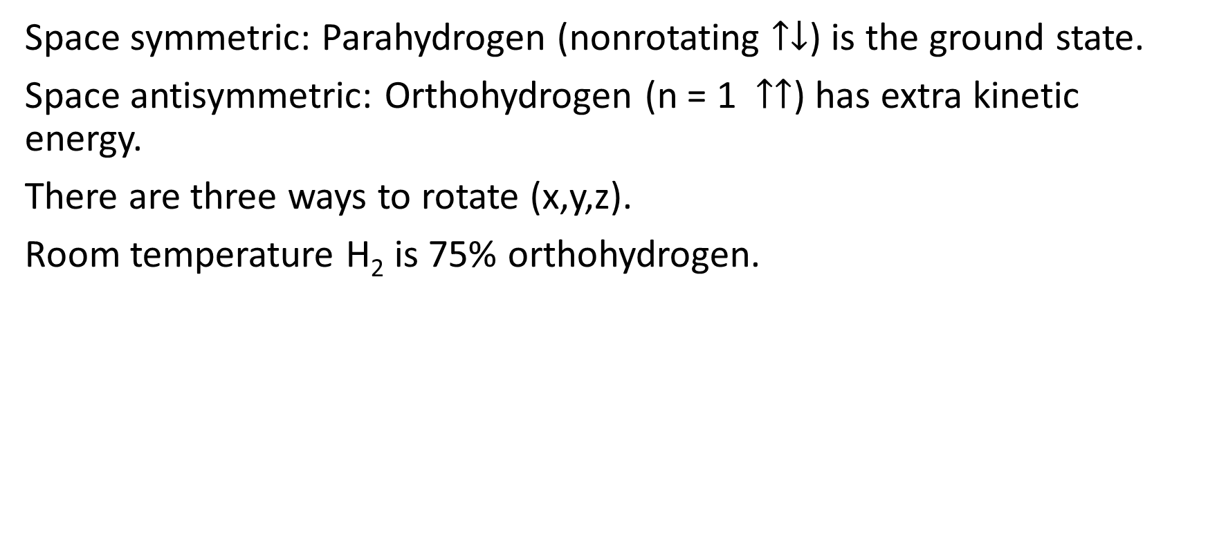
Parahydrogen and ortho hydrogen
Space symmetric: Parahydrogen (nonrotating $↑↓$) is the ground state.
Space antisymmetric: Orthohydrogen (n = 1 $↑↑$) has extra kinetic energy.
There are three ways to rotate (x,y,z).
Room temperature H₂ is 75% orthohydrogen.

Slide 29
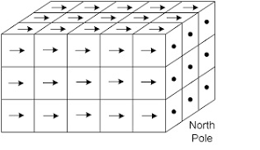
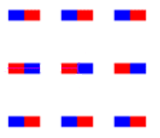
Magnetism
The magnetic field of a magnet is due to the magnetic fields of the spinning electrons, which are all spinning in the same direction.
Thinking of the electrons as tiny magnets, they have aligned their dipoles.
The magnetic field is not strong enough to cause this: so why do they order?

Slide 30
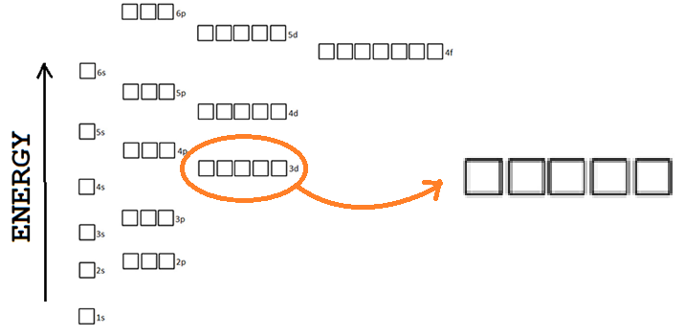
Hund’s rules
The spins align to decrease the Coulomb interaction.

Slide 31
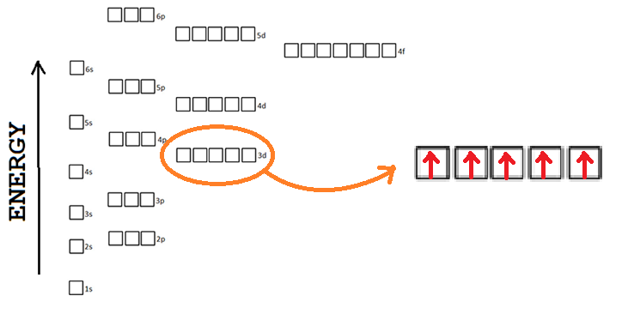
Hund’s rules
The spins align to decrease the Coulomb interaction.

Slide 32
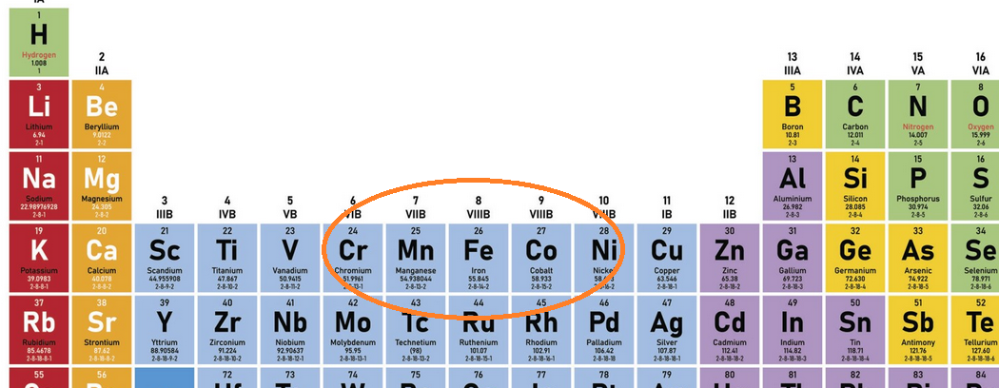
Band magnetism
Narrow bands with high degeneracy (f shell) will have the largest magnetic moment near half-filling: 5 electrons per atom in that shell

Slide 33
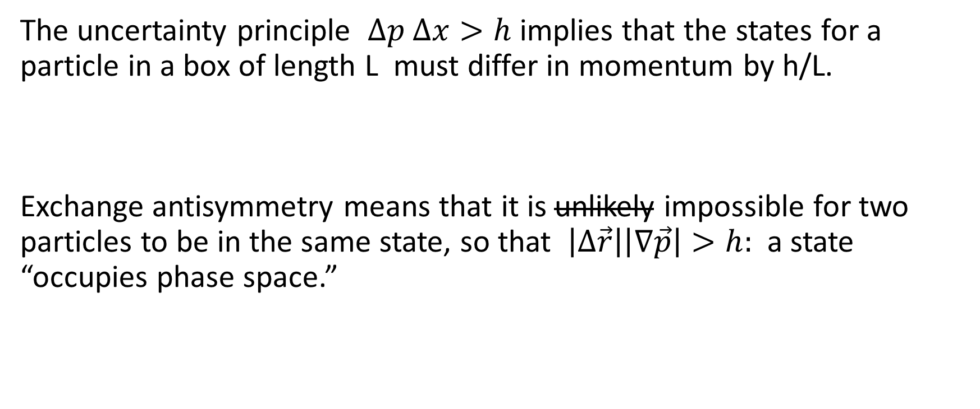
Distinguishing quantum states
The uncertainty principle $∆p ∆x>h$ implies that the states for a particle in a box of length L must differ in momentum by h/L.
Exchange antisymmetry means that it is unlikely impossible for two particles to be in the same state, so that $\left|∆\vec{r}\right|\left|∇\vec{p}\right|>h:$ a state “occupies phase space.”

Slide 34
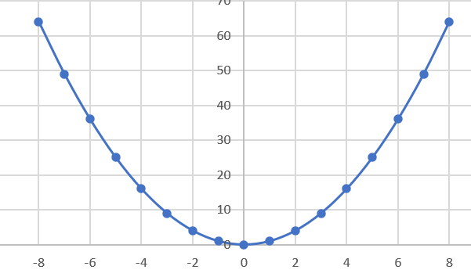
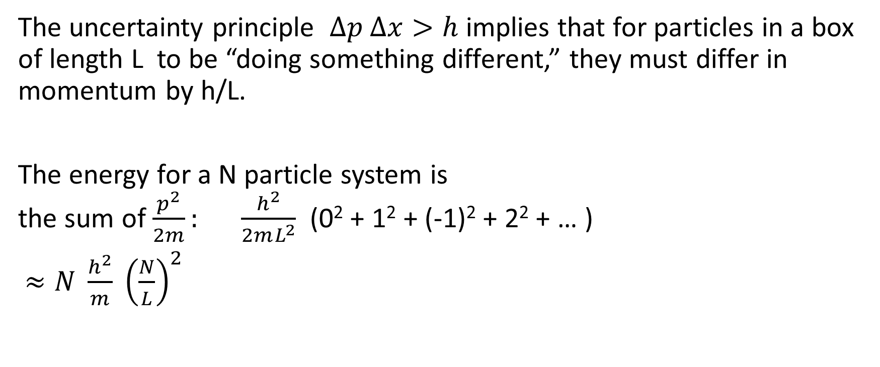
One dimensional fermion gas
The uncertainty principle $∆p ∆x>h$ implies that for particles in a box of length L to be “doing something different,” they must differ in momentum by h/L.
The energy for a N particle system is the sum of $\frac{p^{2}}{2m}: \frac{h^{2}}{2mL^{2}}$ (0² + 1² + (-1)² + 2² + … )
$≈N \frac{h^{2}}{m} {\left(\frac{N}{L}\right)}^{2}$

Slide 35
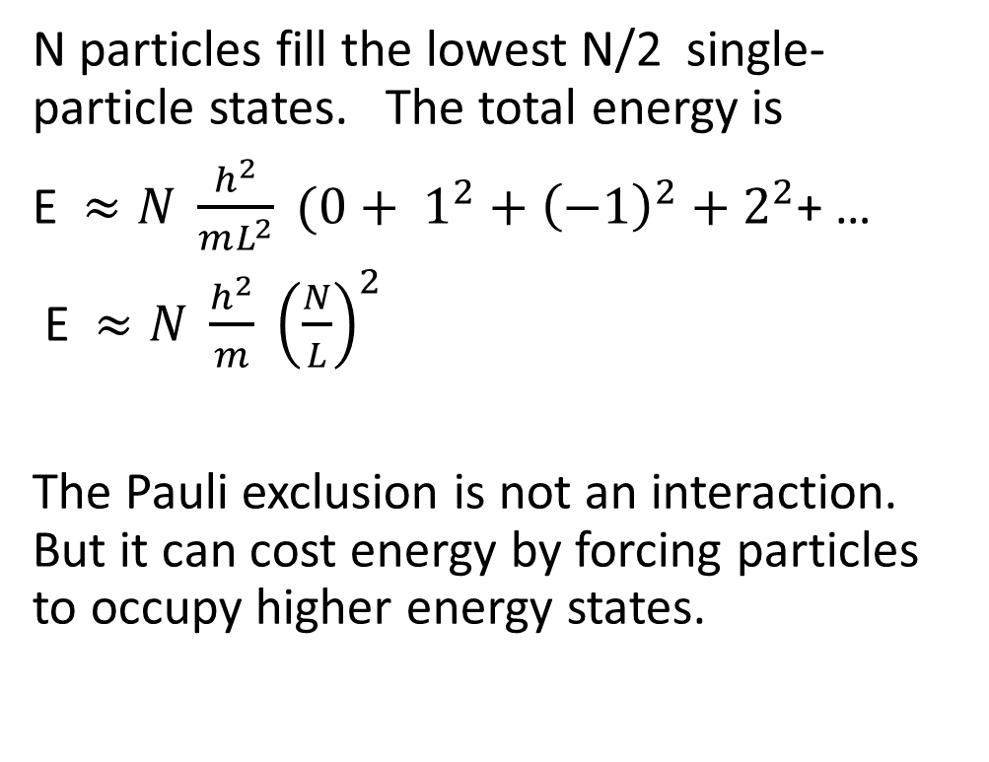
Total energy
N particles fill the lowest N/2 single-particle states. The total energy is
E $≈N \frac{h^{2}}{mL^{2}} (0+ 1^{2}+{\left(−1\right)}^{2}+2^{2}$+ …
E $≈N \frac{h^{2}}{m} {\left(\frac{N}{L}\right)}^{2}$
The Pauli exclusion is not an interaction. But it can cost energy by forcing particles to occupy higher energy states.

Slide 36
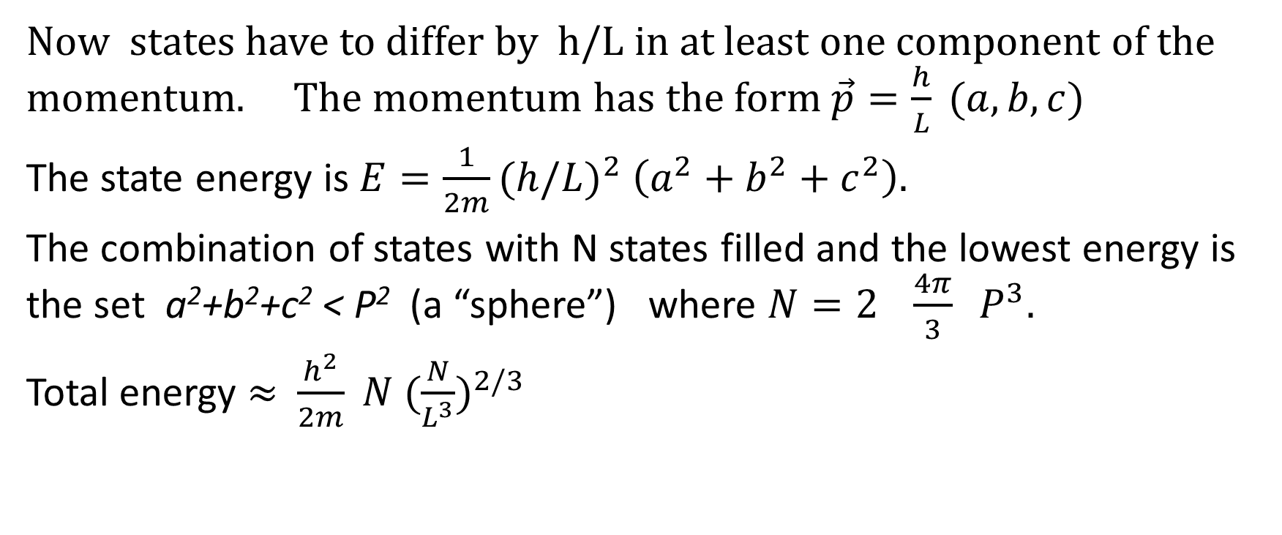
Three-dimensional fermion gas in a LxLxL box
Now states have to differ by h/L in at least one component of the momentum. The momentum has the form $\vec{p}=\frac{h}{L} (a,b,c)$
The state energy is $E=\frac{1}{2m}{(h/L)}^{2} \left(a^{2}+b^{2}+c^{2}\right).$
The combination of states with N states filled and the lowest energy is the set a²+b²+c² < P² (a “sphere”) where $N=2 \frac{4π}{3} P^{3}.$
Total energy ≈$\frac{h^{2}}{2m} N {(\frac{N}{L^{3}})}^{2/3}$

Slide 37
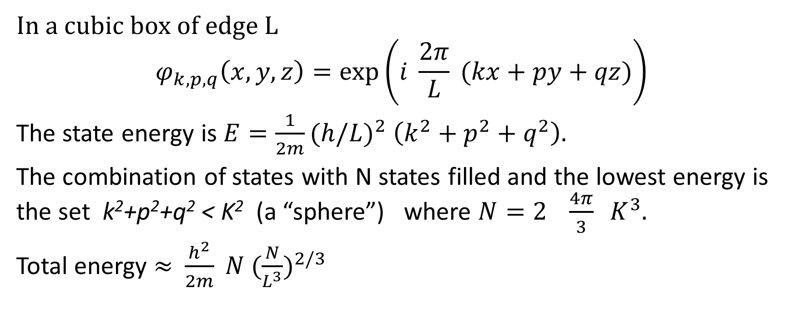
Three-dimensional fermion gas
In a cubic box of edge L
$$φ_{k,p,q}\left(x,y,z\right)=\exp\left(i \frac{2π}{L} (kx+py+qz)\right)$$
The state energy is $E=\frac{1}{2m}{(h/L)}^{2} \left(k^{2}+p^{2}+q^{2}\right).$
The combination of states with N states filled and the lowest energy is the set k²+p²+q² < K² (a “sphere”) where $N=2 \frac{4π}{3} K^{3}.$
Total energy ≈$\frac{h^{2}}{2m} N {(\frac{N}{L^{3}})}^{2/3}$

Slide 38
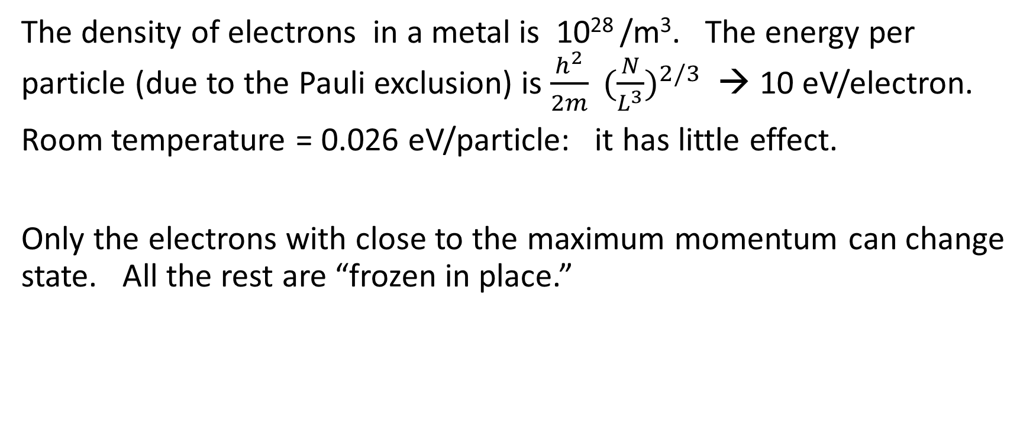
Metals
The density of electrons in a metal is 10²⁸ /m³. The energy per particle (due to the Pauli exclusion) is $\frac{h^{2}}{2m} {(\frac{N}{L^{3}})}^{2/3}$ → 10 eV/electron.
Room temperature = 0.026 eV/particle: it has little effect.
Only the electrons with close to the maximum momentum can change state. All the rest are “frozen in place.”

Slide 39
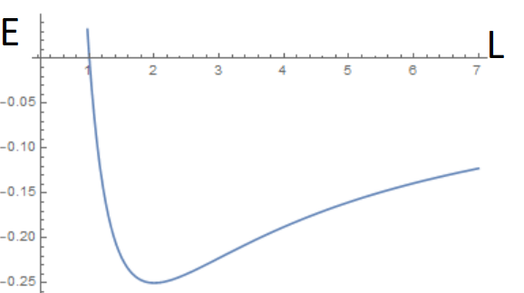

Minimum size for a star
A star is a gas of protons and electrons – both fermions. Ignoring the protons and the thermal energy,
Total energy $≈ \frac{h^{2}}{2m} N {(\frac{N}{L^{3}})}^{2/3}$ - $G \frac{N^{2}M^{2}}{L}$
This has a minimum as a function of the size L, for L ≈ N^{-1/3}

Slide 40
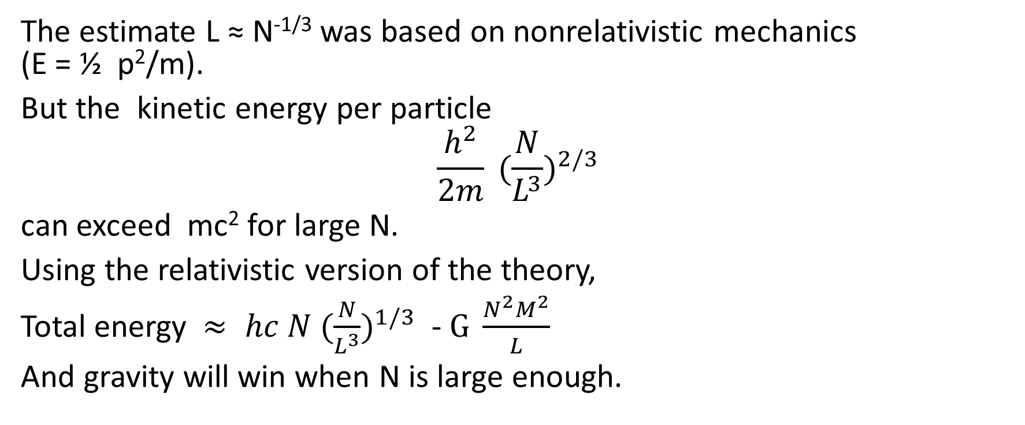
Supernova
The estimate L ≈ N^{-1/3} was based on nonrelativistic mechanics (E = ½ p²/m).
But the kinetic energy per particle
$$\frac{h^{2}}{2m} {(\frac{N}{L^{3}})}^{2/3}$$
can exceed mc² for large N.
Using the relativistic version of the theory,
Total energy $≈ hc N {(\frac{N}{L^{3}})}^{1/3}$ - $G \frac{N^{2}M^{2}}{L}$
And gravity will win when N is large enough.

Slide 41

Neutron star
The electrons and protons combine to make neutrons. These are also fermions. The theory for the minimum star size can be used again.
Total energy $≈ \frac{h^{2}}{2M} N {(\frac{N}{L^{3}})}^{2/3}$ - $G \frac{N^{2}M^{2}}{L}$

Slide 42
Still more stories!
The Pauli exclusion principle helps explain
Why some things are metals and some are not
How semiconductors work
Why magnets exist
Why there are two kinds of hydrogen gas

Slide 43
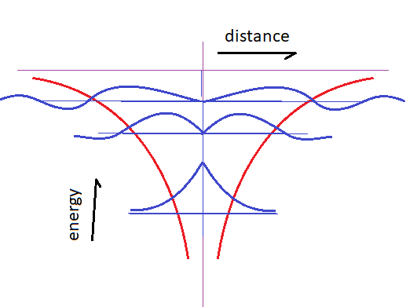
Atomic wavefunctions
The electron mostly stays in the low potential area, but there is a small probability that it is outside of it.

Slide 44
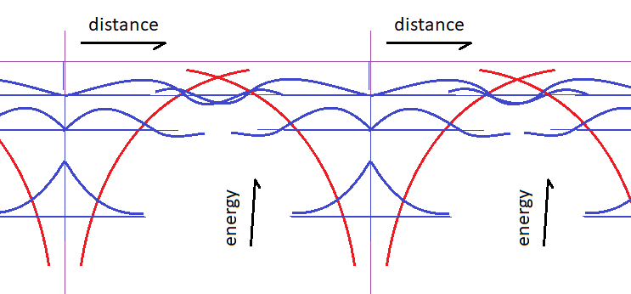
Crystal wavefunctions
The wavefunctions for neighboring atoms overlap, allowing the electrons to move from one to another.
The energy levels broaden into “bands.”

Slide 45

State counting
The total number of states stays the same as a level becomes a band.
In an N-atom crystal, a single state of one atom becomes a band that can hold 2N electrons.
The bands are wider when the wavefunctions overlap more.

Slide 46
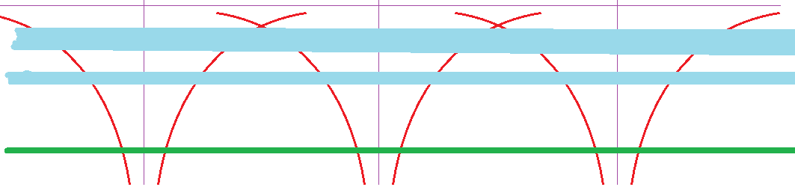
State counting
If there are two electrons per atom, the first level is filled.
This is an insulator. The electrons can’t respond to an electric field or temperature.

Slide 47
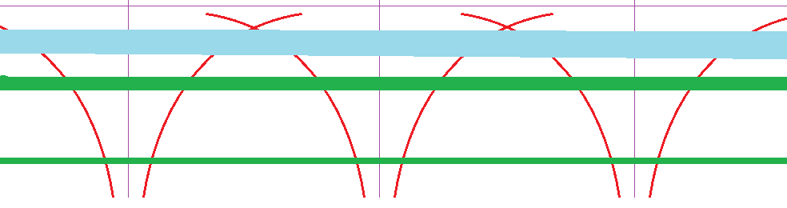
Semiconductors
When the energy difference between bands is small, thermal excitation can put a few electrons in the upper band, leaving a few “holes” in the lower band.
An electric field causes the electrons to move one way, and the holes to move the other. This is a semiconductor.

Slide 48
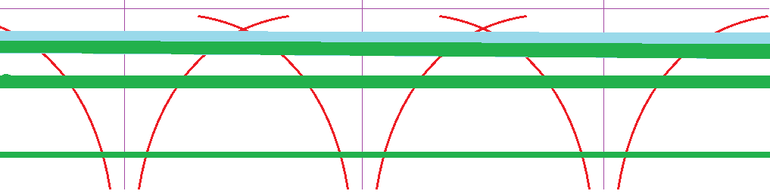
Conductors
Partially filled bands and overlapping bands give conductors.

Slide 49
Insulators
The single-particle wave functions for the low-energy states are small in size. Electrons in these states don’t move from atom to atom very often. The electron state becomes an electron “band” – a range of possible state energies.
For N atoms, there are N states. 2N electrons will fill all of them.
Widely spaced atoms with an even number of electrons are likely to form insulators.

Slide 50
Superconductivity
Superconductivity is due to a attractive interaction between electrons that causes them to form pairs.
The pairs have opposite spins, because it makes the wavefunction simpler, and because the Pauli principle isn’t going to force them apart.

Slide 51
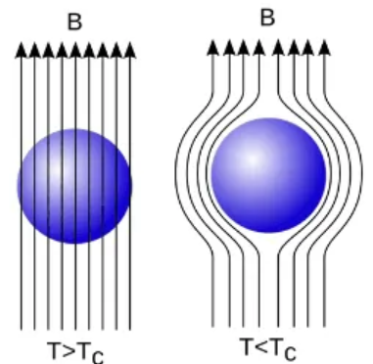
Meissner effect
A magnetic field tries to align the spins, and this would disrupt the pairing. Therefor a current appears on the surface of a superconductor to keep the magnetic field out.

Slide 52
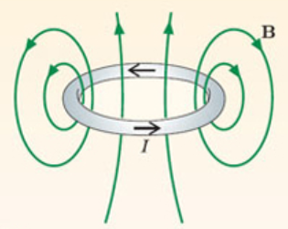
Superconductivity
A closed ring of superconductor traps magnetic flux inside it. The flux can’t escape because of the Meissner effect; the current can’t stop, because of Ampere’s law.

Slide 53
Summary
The theorists claim there are four forces
>> Electromagnetism
>> Strong force
>> Weak force
>> Gravity
But the Pauli exclusion principle is more fundamental than any of them, and plays an important role in establishing the universe we live in.

